Slide 1
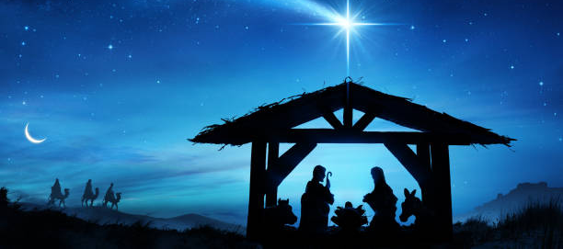
Week 14- The season of joy

Slide 2
Monday 14th December
Dear Lord
As we enter the final week of the term let us remember this season of giving. We open our hearts and pray that we can all , regardless of race or religion, see the plight of those in need. We pray you guide us in making our Christmas food appeal a positive influence in the lives of the people who will receive it. May it remind them that someone does care.
St Joseph – Pray for us

Slide 3
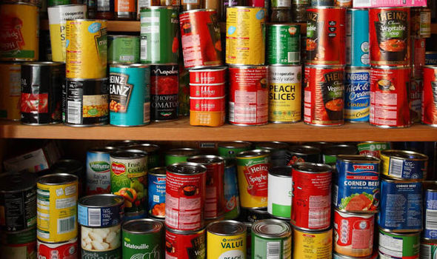
4 DAYS TO BRING IN A TIN OF FOOD FOR THE FOOD APPEAL

Slide 4
Tuesday 15th December
Dear Lord
We pray for those who will find the upcoming Christmas season a difficult time. Many this year have suffered when they never expected to. Please watch over those people and give them the strength throughout this season. We also pray for those who will find Christmas a very anxious and stressful time due to financial hardship.
St Joseph – Pray for us

Slide 5
3 DAYS TO BRING IN A TIN OF FOOD FOR THE FOOD APPEAL

Slide 6
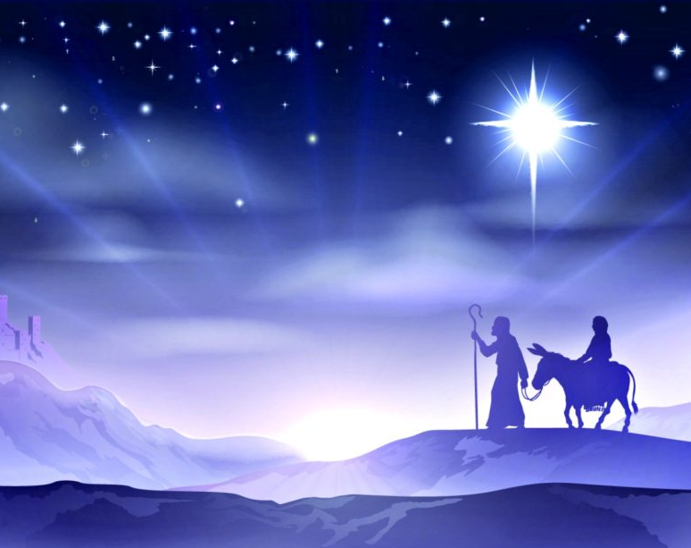
Wednesday 16th December
Christ,
Come into our world of darkness Light up our lives with your coming. Fulfil all our longings with the joy of your birth Strengthen our resolve to work for change in our world And to share the hope of your birth that each Advent brings. St Joseph – Pray for us

Slide 7
2 DAYS TO BRING IN A TIN OF FOOD FOR THE FOOD APPEAL

Slide 8
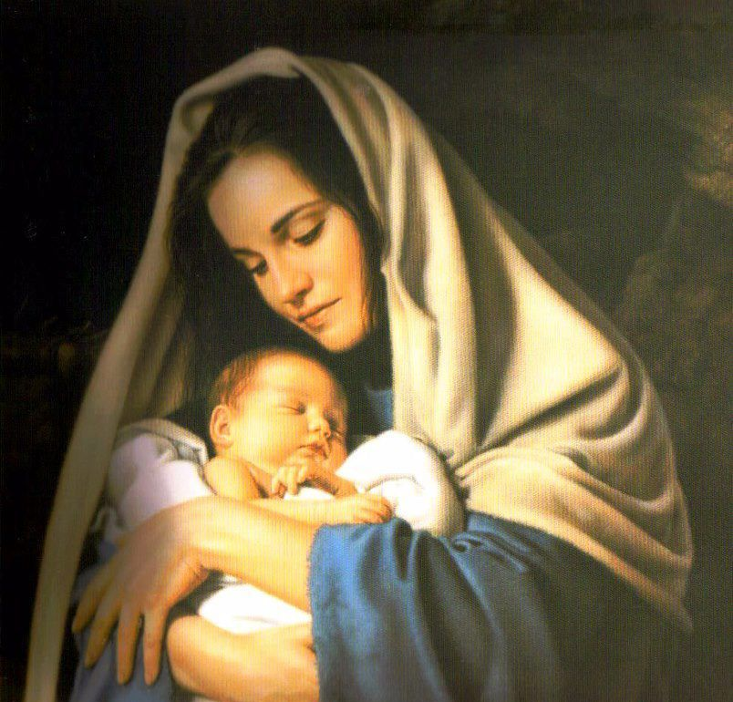
Thursday 17th December
We take all our thoughts and concerns to Mary as we ask her to petition God;
Hail Mary, Full of Grace, The Lord is with thee. Blessed art thou among women, and blessed is the fruit of thy womb, Jesus. Holy Mary, Mother of God, pray for us sinners now, and at the hour of death
Amen

Slide 9
1 DAY TO BRING IN A TIN OF FOOD FOR THE FOOD APPEAL

Slide 10
Friday 18th December
Dear Lord
We thank you for the completion of the Autumn term. We have faced many challenges this term, but we have faced them with resilience and came together as a community of learners, believer and friends.
As we leave today for the Christmas break, we pray you watch over us, give us strength and bring us back together on the 4th January energised for a new term.]
St Joseph – Pray for us

Slide 11
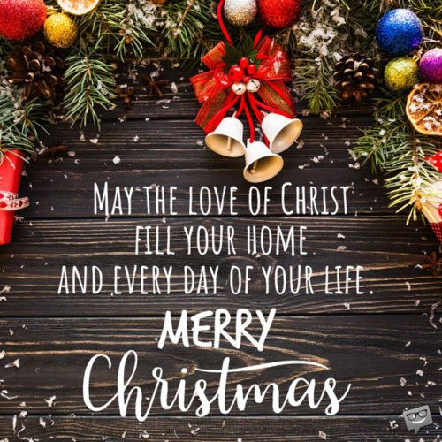
Final thought...

