Slide 1
Prayers for the week - Lent

Slide 2
Monday 22nd February
God our Father,
As we start a long an important journey toward something beautiful and amazing help us to use Lent in the right way… to make ourselves the very best that we can be.
Give us the strength this term to allow ourselves to be the best we can be.
St Joseph - Pray for us

Slide 3
Tuesday 23rd February
God our Father,
Be the strength of those who are weak, be the hope of those who have lost their way, be the companion of those who feel alone and be the courage that guides us all through life.
St Joseph – Pray for us

Slide 4
Wednesday 24th February
Christ Jesus,
You know what it is to hunger and thirst. Open our eyes to my brothers and sisters who struggle in this world. Whether it be poverty, injustice, lack of essentials, unemployment.
This Lent let us support our charity appeal to make sure that nobody goes hungry in our communities.
St Joseph – Pray for us

Slide 5
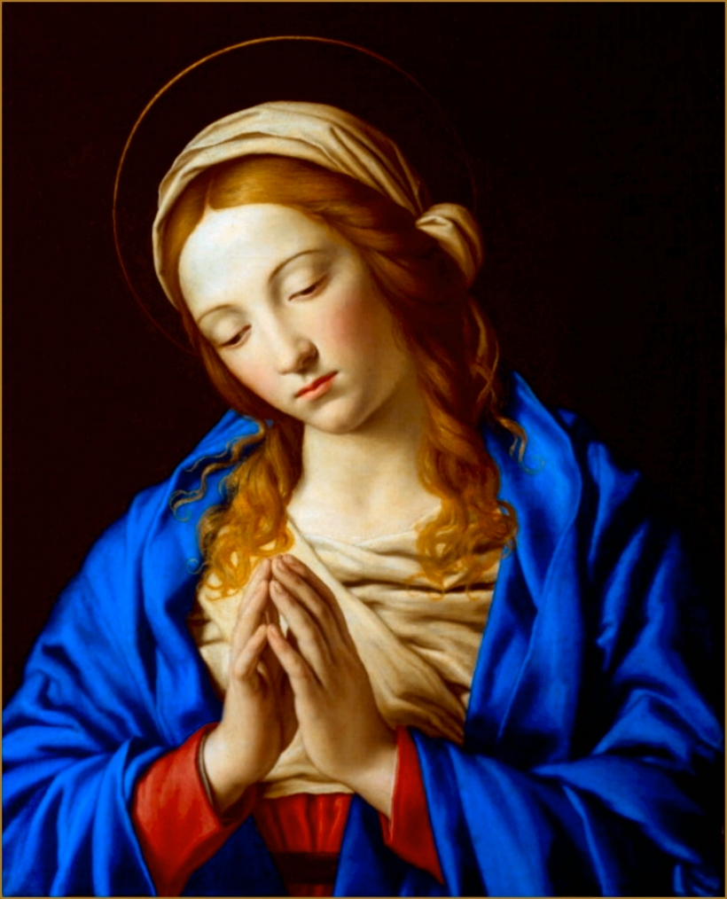
Thursday 25th February
Let us take our thoughts and needs to Mary as we ask her to intercede for us;
Hail Mary, full of grace, The Lord is with you, Blessed are you among women, and blessed is the fruit of your womb, Jesus Holy Mary, Mother of God, Pray for us sinner now, and at the hour of death, Amen

Slide 6
Friday 26th February
Loving Father,
Help us to have the courage this Lent to focus ourselves on what’s really important. There is so much in our world and so many choices for us, that things can get confusing at times. We ask you to walk beside us this Lent and to help us see what’s important.
St Joseph – Pray for us

