Slide 1
Week 10
Youth

Slide 2
Monday 16th November
Loving Father,
You are the God of the young and the old. You made us all, and you stay with us from the day we are born. We pray especially this week for those who are young. As we focus on youth, help them all to feel connected to you and at home in your Church. Give them, life, love, happiness and joy. Help them to become everything that you want them to be.
St Joseph – Pray for us

Slide 3
Tuesday 17th November
Loving Father
Help us to remember that we are never alone. You did not leave us to fend for ourselves, but you gave us your spirit, your teaching, your example and your love. Whenever we feel alone or unloved, lend us your comfort and support. Help us to transform our lives with your message.
St Joseph – Pray for us

Slide 4
Wednesday 18th November
Loving Father
We ask you this week to be with all those who are young. We ask for your special protection and care for all the young people throughout the world who are unsure of themselves, and for all of those who are in dangerous or difficult situations. Be with them all and bless them in everything that they do.
St Joseph - Pray for us

Slide 5
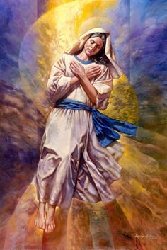
Thursday November 18th
We ask Our Lady to petition God with our prayers;
Hail Mary, Full of Grace, The Lord is with thee. Blessed art thou among women, and blessed is the fruit of thy womb, Jesus. Holy Mary, Mother of God, pray for us sinners now, and at the hour of our death.
St Joseph – Pray for us

Slide 6
Friday 18th November
Dear Lord
In this challenging time we thank you for another completed school week . Whether we are at home isolating or in school, let us always use the talents we have and make the most of the opportunities we are given. Watch over all of us and our families until we return on Monday.
St Joseph – Pray for us

Slide 7
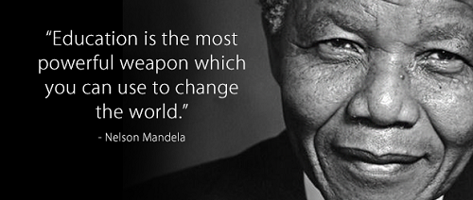
Final thought of the week.....

