Slide 1
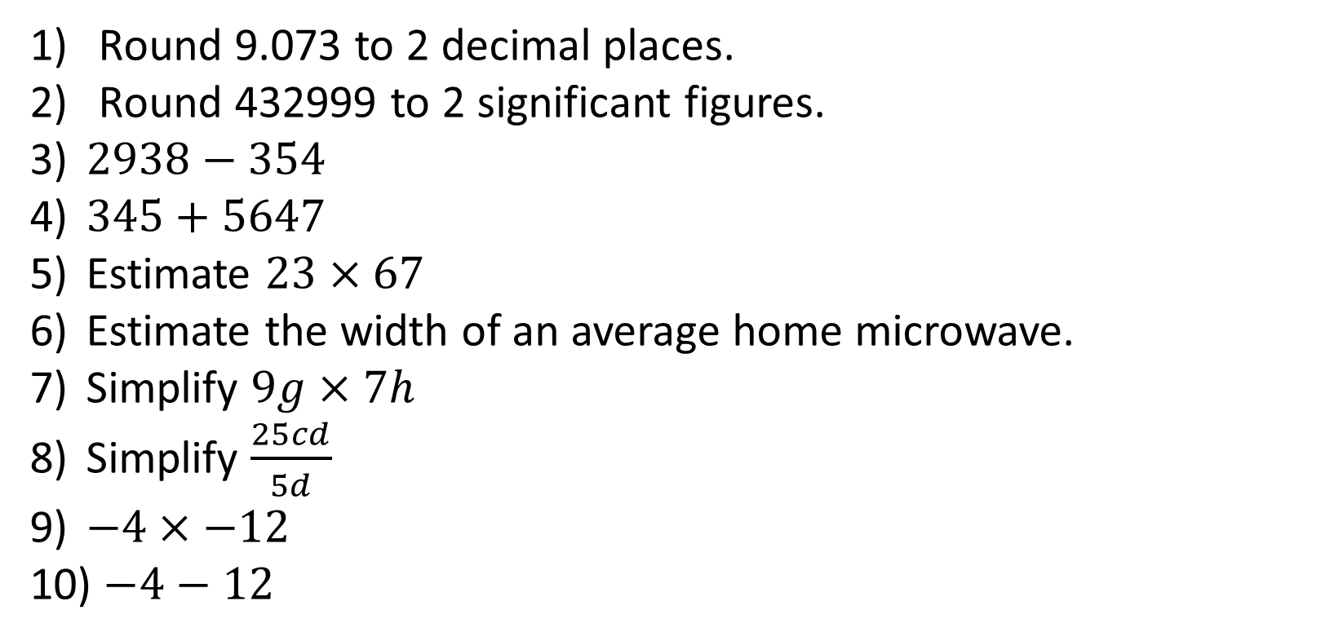
1-10 Quiz.
Round 9.073 to 2 decimal places.
Round 432999 to 2 significant figures.
$2938−354$
$345+5647$
Estimate $23×67$
Estimate the width of an average home microwave.
Simplify $9g×7h$
Simplify $\frac{25cd}{5d}$
$−4×−12$
$−4−12$
Notes:
This could also be a YouTube clip, matching exercise, Anything that will engage the learners from the start of the lesson.
TUTOR TO TAKE THE REGISTER DURING THIS TIME. THERE IS NO NEED TO CALL OUT NAMES.

Slide 2
1-10 Quiz.
Round 9.073 to 2 decimal places.
Round 432999 to 2 significant figures.
$2938−354$
$345+5647$
Estimate $23×67$
Estimate the width of an average home microwave.
Simplify $9g×7h$
Simplify $\frac{25cd}{5d}$
$−4×−12$
$−4−12$
9.07
430000
2584
5992
1400
@45cm
63gh
5c
48
-16
Notes:
This could also be a YouTube clip, matching exercise, Anything that will engage the learners from the start of the lesson.
TUTOR TO TAKE THE REGISTER DURING THIS TIME. THERE IS NO NEED TO CALL OUT NAMES.

Slide 3
Title: Compound Measures
Objectives
To be able to calculate Speed, Distance & Time.
To be able to calculate Force, Area & Pressure.
To be able to calculate Density, Mass & Volume.

Slide 4
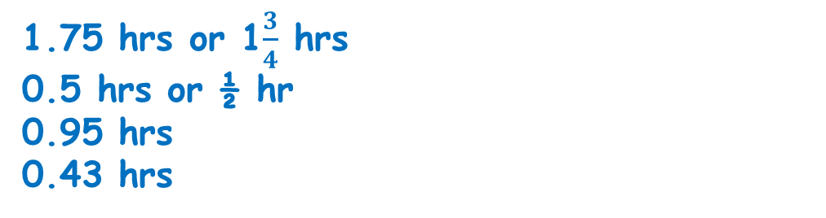
Starter
Convert the following into minutes:
1 hour and 30 minutes
1 hour 53 minutes
3 hours 6 minutes
Convert the following into hours:
105 minutes
30 minutes
57 minutes
26 minutes
90 mins
113 mins
186 mins
1.75 hrs or 1$\frac{3}{4}$ hrs
0.5 hrs or ½ hr
0.95 hrs
0.43 hrs

Slide 5
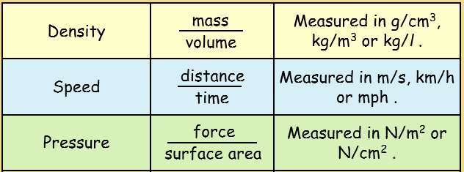
Commonly used compound measures include:

Slide 6
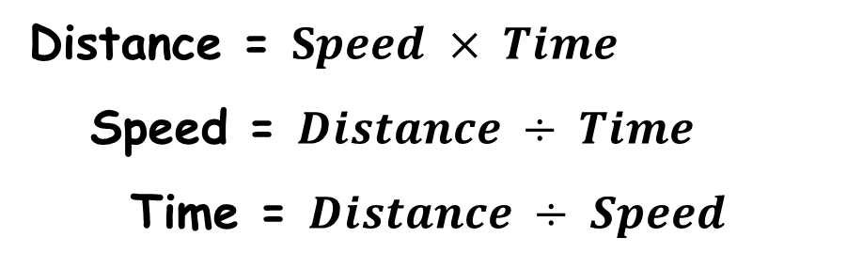
We can draw diagrams to represent these formulae, here is the one for speed.
Distance = $Speed × Time$
Speed = $Distance ÷ Time$
Time = $Distance ÷ Speed$
D
S
T

Slide 7
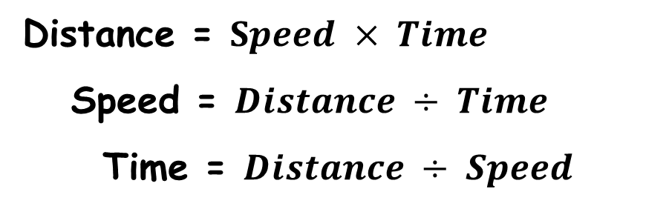
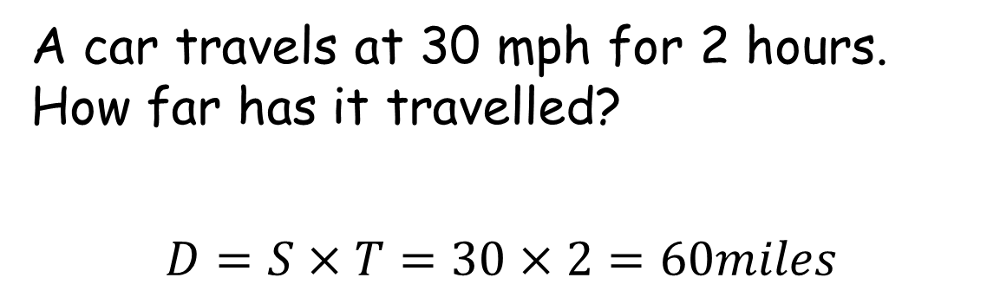
D
Distance = $Speed × Time$
Speed = $Distance ÷ Time$
Time = $Distance ÷ Speed$
S
T
A car travels at 30 mph for 2 hours. How far has it travelled?
$$D=S×T=30×2=60miles$$

Slide 8
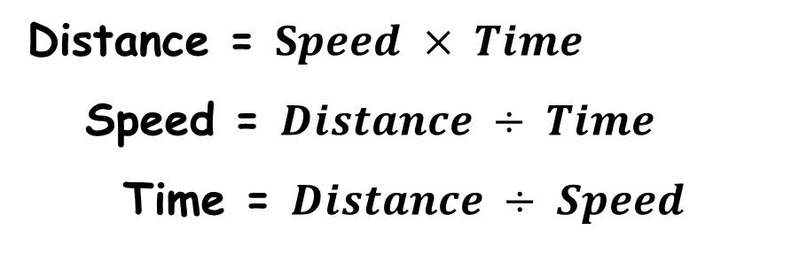
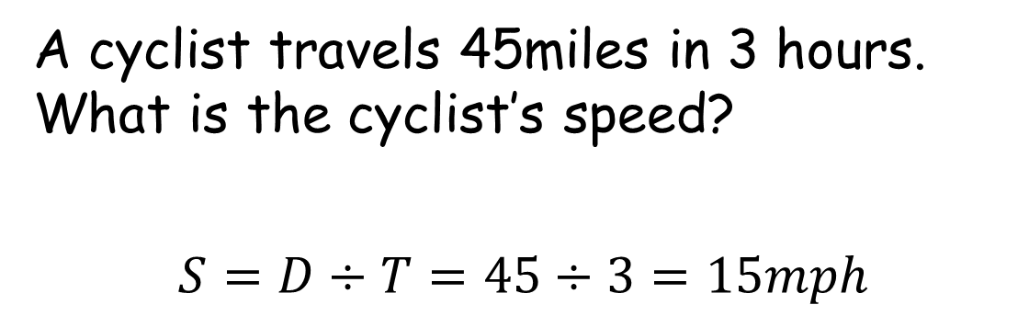
D
Distance = $Speed × Time$
Speed = $Distance ÷ Time$
Time = $Distance ÷ Speed$
S
T
A cyclist travels 45miles in 3 hours. What is the cyclist’s speed?
$$S=D÷T=45÷3=15mph$$

Slide 9
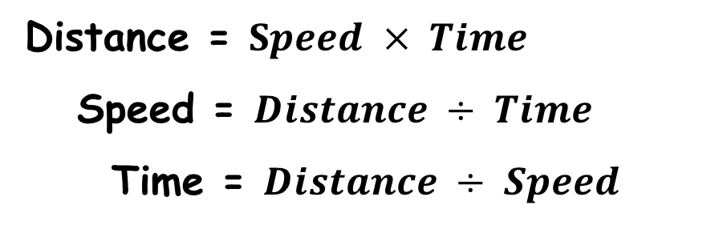
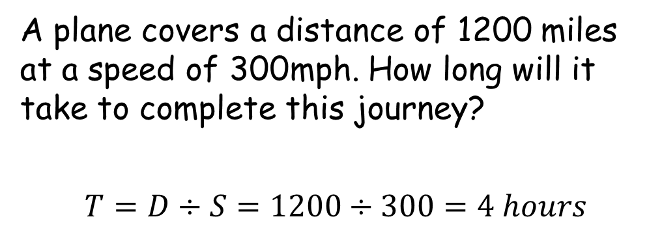
D
Distance = $Speed × Time$
Speed = $Distance ÷ Time$
Time = $Distance ÷ Speed$
S
T
A plane covers a distance of 1200 miles at a speed of 300mph. How long will it take to complete this journey?
$$T=D÷S=1200÷300=4 hours$$

Slide 10
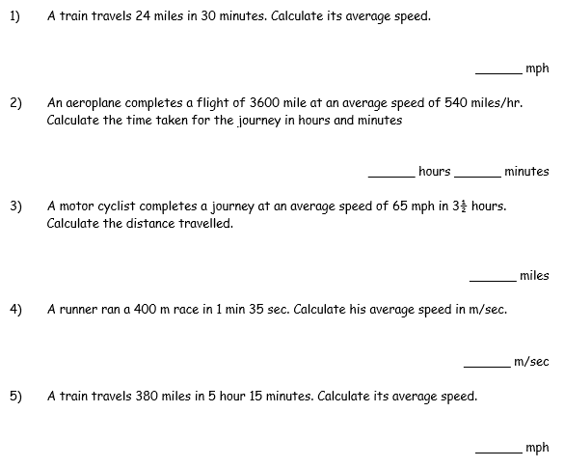
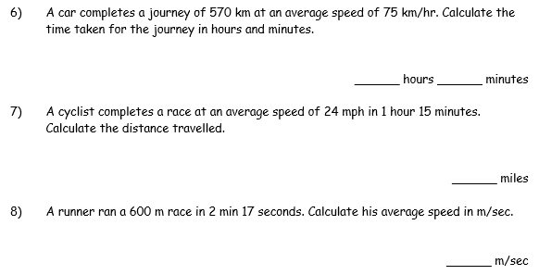

Slide 11
48mph
7 hours 36 mins
6 hours 40 mins
30 miles
227.5 miles
4.4 m/s
4.2 m/sec
72.4 mph

Slide 12

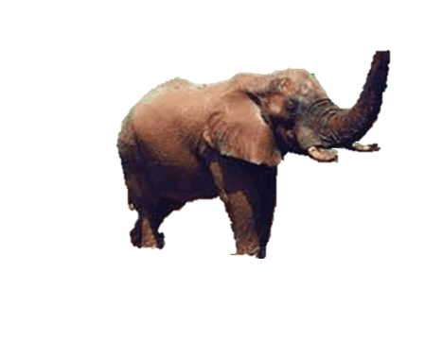
Pressure, Force and Area
Would you rather…
A woman wearing a stiletto heel trod on your foot
Or…
An elephant trod on your foot?
Pressure is a measure of how much force is applied over a unit of area.

Slide 13
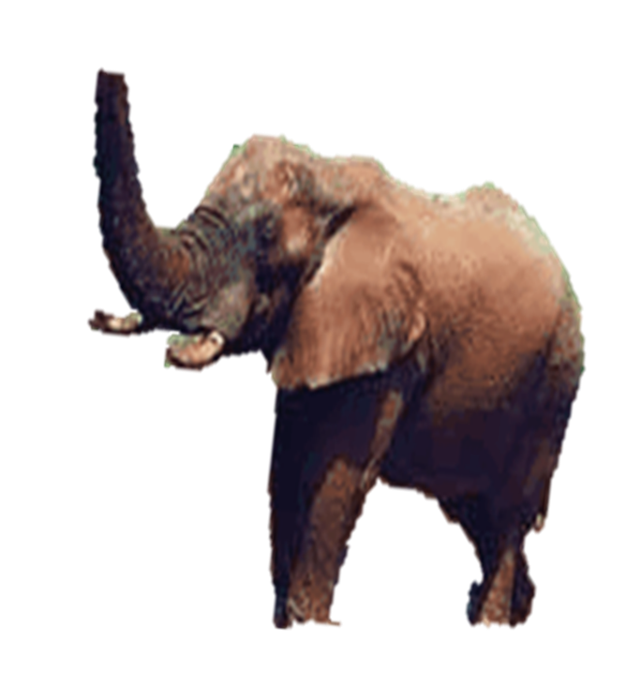
What
Do you
Notice
About
The
Numbers?
Emily weighs 500 N and is wearing stiletto heels which combined have an area of 0.0001 m².
Nelly the elephant weighs
50 000 N. Her 4 feet are on the ground and cover a total area of 0.8 m².

Slide 14
How can you find the pressure exerted?
Emily weighs 500 N and is wearing stiletto heels which combined have an area of 0.0001 m². What pressure does she exert?
Pressure = Force = 500 = 5,000,000
Area 0.0001 N/m².

Slide 15
Pressure = Force = 50,000 = 62,500
Area 0.8 N/m².
Nelly the elephant weighs
50 000 N. Her 4 feet are on the ground and cover a total area of 0.8 m². What is the pressure under her feet?
How can you find the pressure exerted?

Slide 16
So the Stiletto exerts 80 time the amount of the Elephants’ Feet.
5,000,000
N/m².
62,500
N/m².

Slide 17
Copy Triangle
Using the triangle makes finding the solution easier
F
P
A

Slide 18
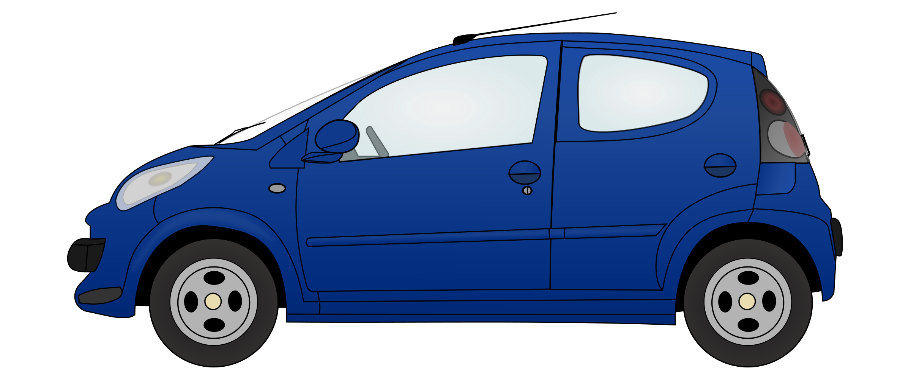
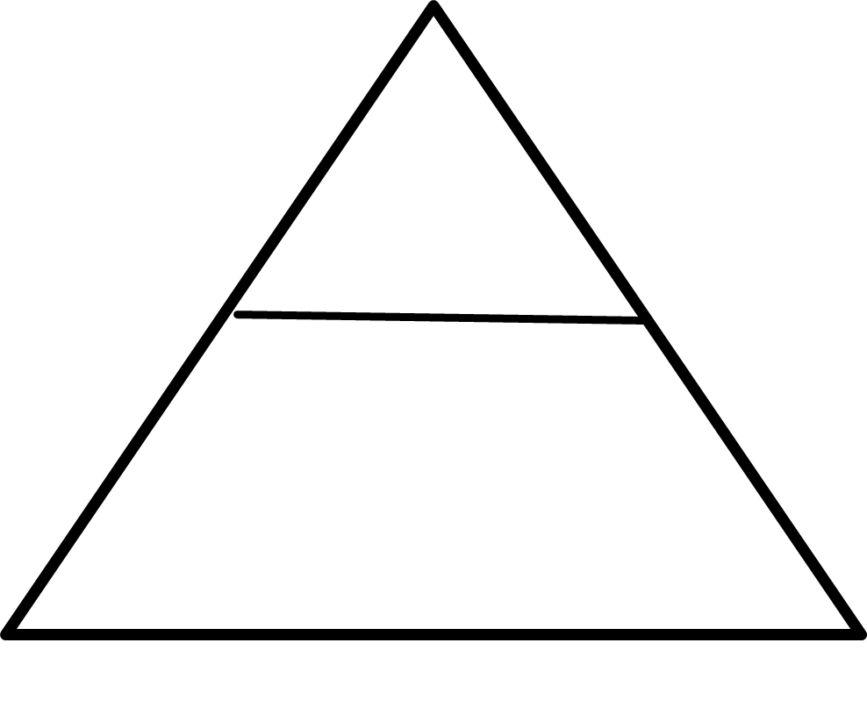
A car of weight 6,400 N has four wheels. Each wheel has an area of 80 cm² touching the road. Find the pressure the car puts on the ground.
Pressure = 6,400
4 x 80
= 6,400
320
What do you notice about the units?
= 20 N/cm²

Slide 19
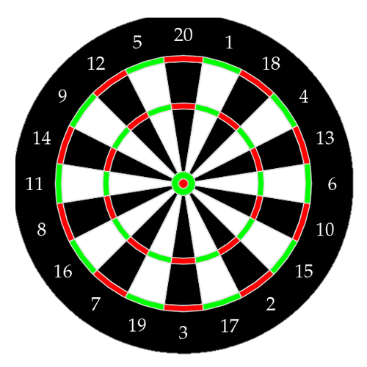
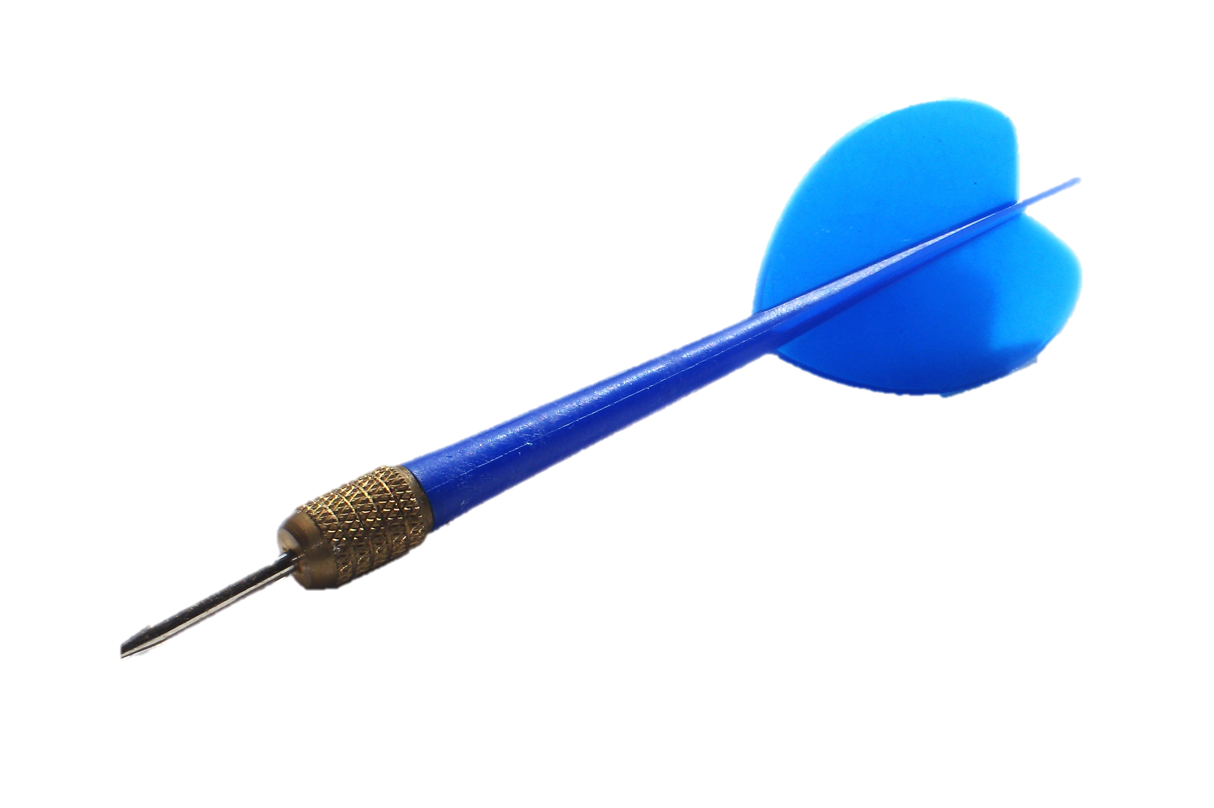
0.005cm²..
What is different about this calculation?

Slide 20
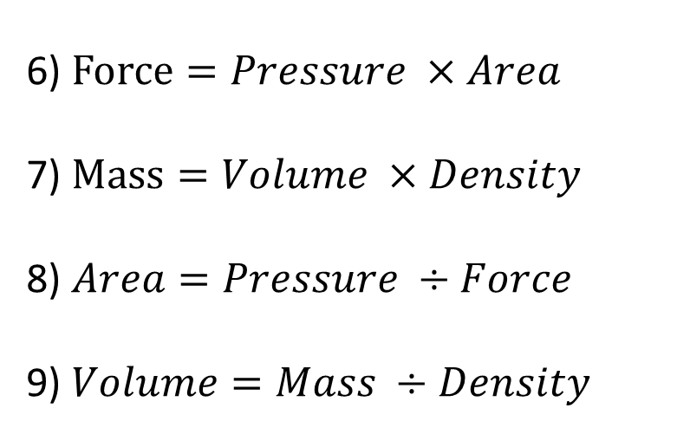
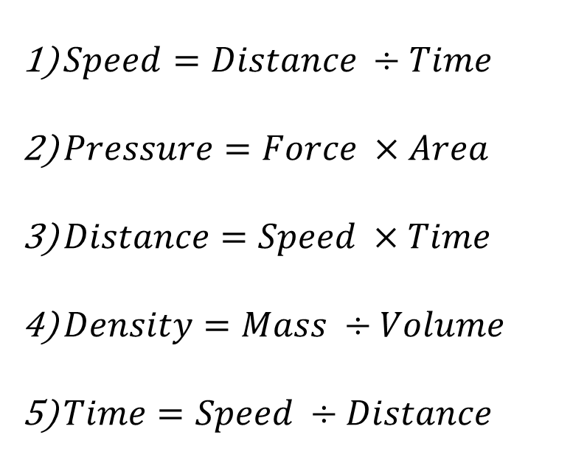
True or False
$Speed=Distance ÷Time$
$Pressure=Force ×Area$
$Distance=Speed ×Time$
$Density=Mass ÷Volume$
$Time=Speed ÷Distance$
6) $Force=Pressure ×Area$
7) $Mass=Volume ×Density$
8) $Area=Pressure ÷Force$
9) $Volume=Mass ÷Density$
True
True
False
True
True
False
True
True
False

Slide 21
What is density?
Density is the amount of mass in a volume.
It tells us how tightly matter is packed together.
Common units
g/cm³ How many grams for every cm³.
kg/m³ How many kg for every m³.

Slide 22
We can draw a diagram to represent the formulae for density
Mass = Density x Volume
Density = Mass ÷ Volume
Volume = Mass ÷ Density
M
D
V

Slide 23
Things to look out for:
Are the units consistent?
Do you need to calculate the volume before you start?
1 m
100 cm
1 m
100 cm
1 m
100 cm
1 m³ = 1 000 000 cm³

Slide 24
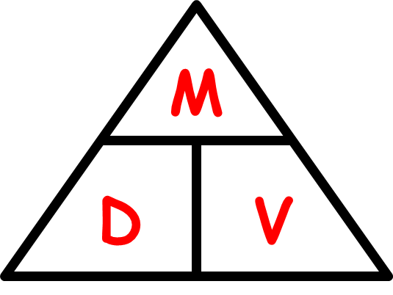
A cuboid has dimensions of
9 cm x 3 cm x 12 cm.
It has a mass of 194.4 g.
Find the density of the cuboid.
Volume = 9 x 3 x 12
= 324 cm³
Density = Mass ÷ Volume
= 194.4 ÷ 324
g/cm³
= 0.6

Slide 25
A cuboid has dimensions of
2 m x 90 cm x 140 cm.
It has a density of 0.8 kg/m³.
Find the mass of the cuboid.
Volume = 2 x 0.9 x 1.4
= 2.52 m³
Mass = Density x Volume
= 0.8 x 2.52
kg
= 2.016

Slide 26
A cylinder has a mass of 270 g.
It has a density of 0.78 g/cm³ and a height of 9cm.
Find the radius of the cylinder.
Volume = Mass ÷ Density
= 270 ÷ 0.78
= 346.1538462
cm³

Slide 27
A cylinder has a mass of 270 g.
It has a density of 0.78 g/cm³ and a height of 9cm.
Find the radius of the cylinder.
Volume = 346.1538462 cm³
346.1538462 = π x r² x h
12.24268793 = r²
3.498955263 = r
r = 3.5 cm

Slide 28
Find the density of a piece of wood weighing 6 g and having a volume of 8 cm.
6 ÷ 8 = 0.75 g/cm³

Slide 29
Calculate the volume of a liquid weighing 4 kg and having a density of 1.25 g/cm³.
4000 ÷ 1.25 = 3200 g

Slide 30
A 1 kg bag of sugar has a volume of about 625 cm³. What is the density of the sugar in grams per cubic centimeter?
1000 ÷ 625 = 1.6 g/cm³

Slide 31
Calculate the volume of a piece of wood that weighs 102 g and has a density of 0.85 g/cm³.
102 ÷ 0.85 = 120 cm³

Slide 32
Find the mass of a marble model, 56 cm³ in volume, if the density of marble is 2.8 g/cm³.
56 x 2.8 = 156.8 g

Slide 33
I bought a 50 kg bag of coal and estimated the total volume to be about 28000 cm³. What is its density in g/cm³ to 2 d.p.?
50 000 ÷ 2 800 = 1.79 g/cm³

Slide 34
Find the density of the material of a pebble weighing 34 g, which has a volume of 12.5 cm³.
34 ÷ 12.5 = 2.72 g/cm³

Slide 35
Oil has a density of 800 kg/m³.
Convert this into g/cm³
800 ÷ 1 000 000 x 1000 = 0.8 g/cm³

Slide 36
A block of lead has a volume of 540 cm³ and a mass of 6.156 kg.
Find its density in g/cm³
6156 ÷ 540 = 11.4 g/cm³

Slide 37
A statue is made of metal of density 8 g/cm³. Find the mass of the statue if its volume is 30 cm³.
8 x 30 = 240 cm³

Slide 38
It is estimated that the statue of Queen Victoria in Endcliffe Park, Sheffield has a volume of about 4 m³. The density of the material used to make the statue is 9.2 g/cm³. What is its mass?
4 x 9200 = 36 800 g

Slide 39
The volume of a solid object is 5 cm³ and its mass is 50 g. Calculate the density of the material.
50 ÷ 5 = 10 g/cm³

Slide 40
Water of density 1000 kg/m³ fills a pool. The mass of the water is 35 tonnes.
(1 tonne = 1000 kg)
Calculate the volume of the pool.
35 000 ÷ 1000 = 35 m³

Slide 41
A cuboid of dimensions 4 cm by 5 cm by 3 cm is made of metal with density 10 g/cm³. Calculate the mass of the cuboid in kg.
4 x 5 x 3 = 60 cm³
60 x 10 = 600 g = 0.6 kg

Slide 42
A certain type of plastic has a density of 3 g/cm³.
Convert the density into kg/m³
3 x 1 000 000 ÷ 1000 = 3000 kg/m³

Slide 43
A cast-iron rod 2 m long has a cross-sectional area of 14 cm². The mass of the rod is 210 kg. Calculate the density of the rod in g/cm³
14 x 200 = 2800 cm³
210 000 ÷ 2800 = 75 g/cm³

Slide 44

Todays Objectives – Have you met them?
Objectives
To be able to calculate Speed, Distance & Time.
To be able to calculate Force, Area & Pressure.
To be able to calculate Density, Mass & Volume.

Slide 45
Suggested Videos
For this lesson
Ordering Numbers: https://www.youtube.com/watch?v=gOmj58JdxL8
Ordering fractions decimals percentages – Corbettmaths
Percentages:
For next lesson
Adding & Subtracting Fractions:
https://www.youtube.com/watch?v=5juto2ze8Lg
Math Antics - Adding and Subtracting Fractions
Working with decimals:
https://www.youtube.com/watch?v=kwh4SD1ToFc
Math Antics - Decimal Arithmetic
BIDMAS:
https://www.youtube.com/watch?v=6K77Igo39vk
GCSE Maths - BIDMAS - Aslam Tutoring

