Slide 1
Using this slide and the internet write a definition of these 4 trends
● Social trends, e.g.:
o population changes, increasing life expectancy
o education, e.g. increasing achievements at GCSE
o labour market, e.g. increase in flexible working/zero hours/gig economy
● Technology trends, e.g. increasing use of information technology, telephony and web developments/internet/social media
● Environmental trends, e.g. increase in renewable energy and recycling/animal welfare/climate change
● Ethical trends – ethical concerns of potential customers, e.g. carbon footprint,
sources of timber, child labour, inadequate pay, animal welfare, identification of values of an organisation and ethical codes to address ethical concerns, contribution of business to the community
Connect

Slide 2
Title: Changing Consumer Behaviour, Laws and Trends
LO: To explain a range of changing trends in the modern economy
Success criteria:
I can define a range of trends
I can describe trends in the modern economy
I can explain the impacts of changes in the modern economy
Literacy Foci Term 1b
Reading: Sequencing
Writing: homophones and common spelling mistakes

Slide 3
Activate
You will be given information regarding changes in 4 main trends.
Listen carefully and make notes.
You will use the internet to research the trends and topics covered further.
Finally you will create a 4 page booklet about these trends
Create an information booklet about 4 trends

Slide 4
Trends affecting business
● Social trends, e.g.:
population changes
increasing life expectancy (more older people)
education, e.g. increasing achievements at GCSE/apprenticeships
labour market, e.g. increase in flexible working/zero hours/ gig economy
https://www.youtube.com/watch?v=bnTbiiFgziU
https://www.gov.uk/part-time-worker-rights

Slide 5
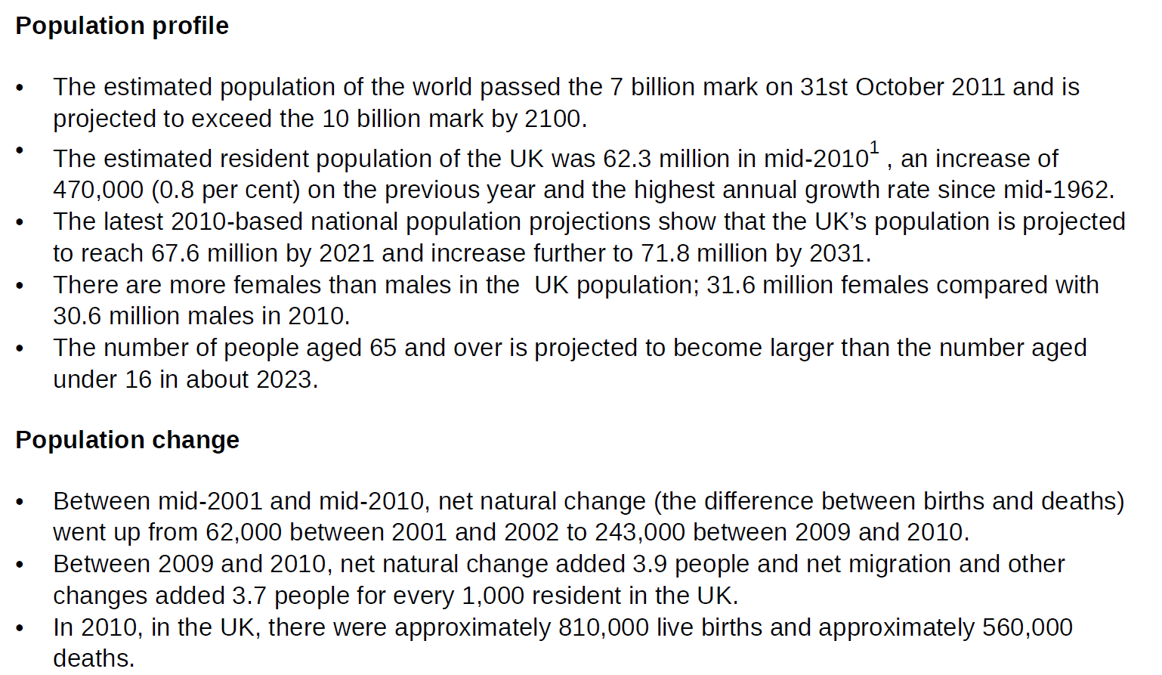

Slide 7
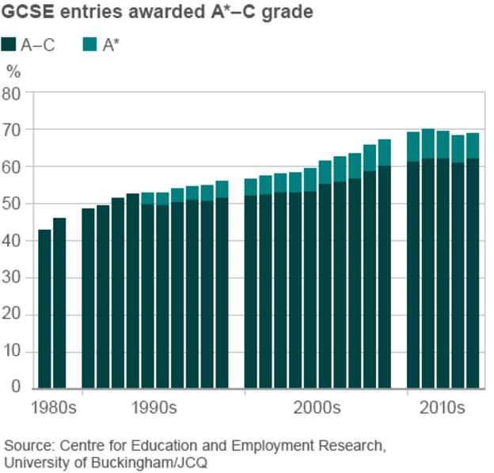

Slide 8
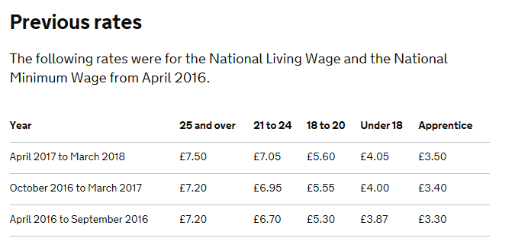
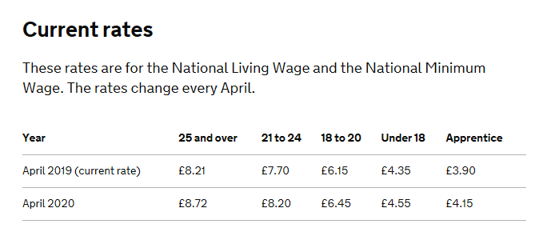
https://www.youtube.com/watch?v=NGRXQGScWf8

Slide 9
Technology trends, e.g. increasing use of information technology, telephony and web developments
Mobiles
Internet
Social Media
Webpages
Skype/Face-time
Apps
Smart Watches
Smart Textiles
Virtual Reality

Slide 12
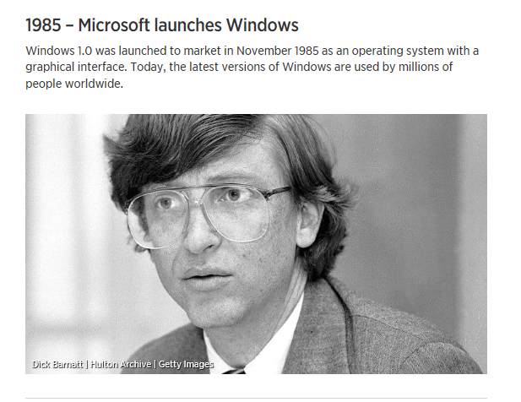

Slide 13
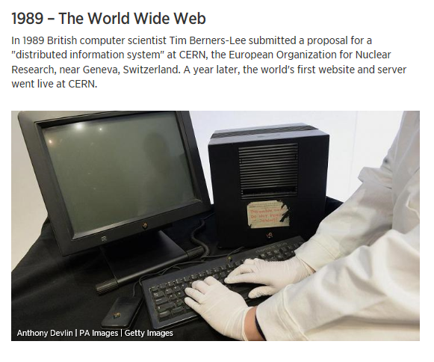

Slide 14
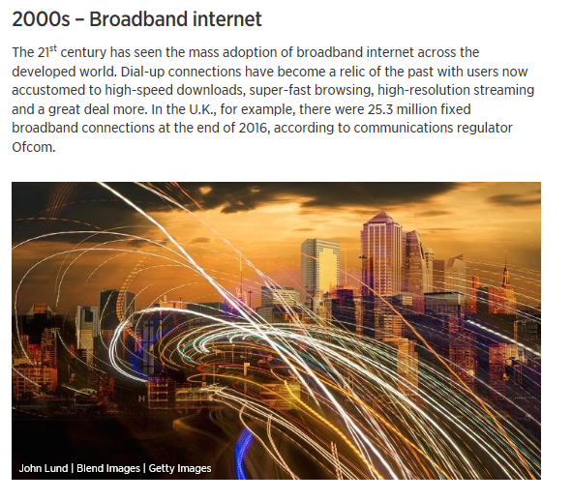

Slide 15
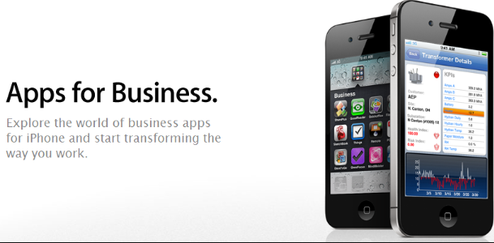
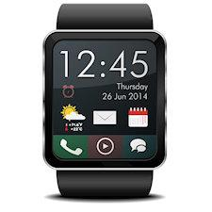

Slide 16
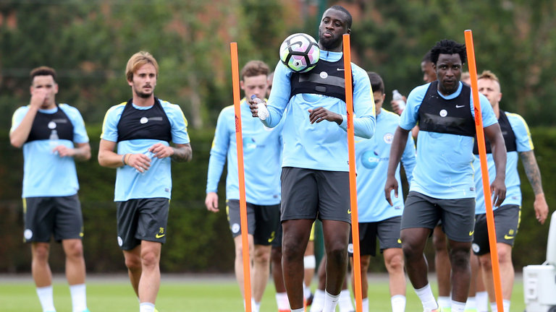

Slide 17
Trends affecting business
● Social trends, e.g.:
o population changes, increasing life expectancy
o households and families, e.g. more couples cohabiting
o education, e.g. increasing achievements at GCSE
o labour market, e.g. increase in flexible working
o increasing travel for work, e.g. longer commutes to work
● Technology trends, e.g. increasing use of information technology, telephony and web
Developments
● Environmental trends, e.g. increase in renewable energy and recycling
● Ethical trends – ethical concerns of potential customers, e.g. carbon footprint,
sources of timber, child labour, inadequate pay, animal welfare, identification of
values of an organisation and ethical codes to address ethical concerns, contribution
of business to the community

Slide 18
● Environmental trends, e.g. increase in renewable energy and recycling
Pollution….bad image…BP
Plastic
Solar
Wind
Recycle
Electric vehicles
Image
https://www.youtube.com/watch?v=KEeH4EniM3E

Slide 19
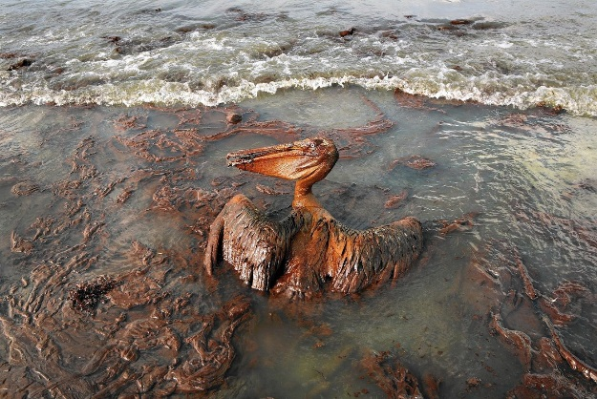
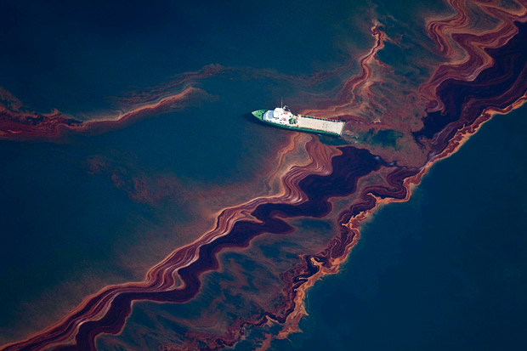
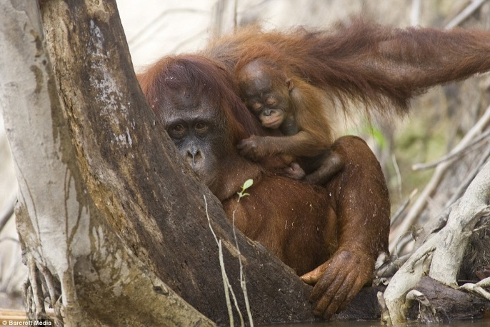
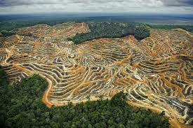
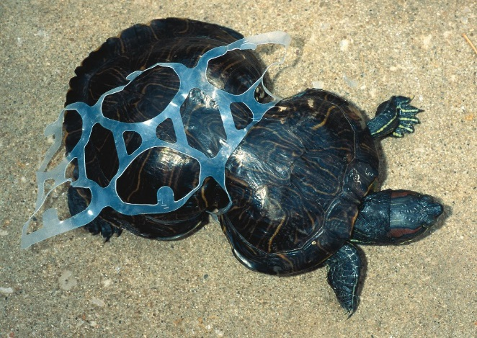

Slide 20
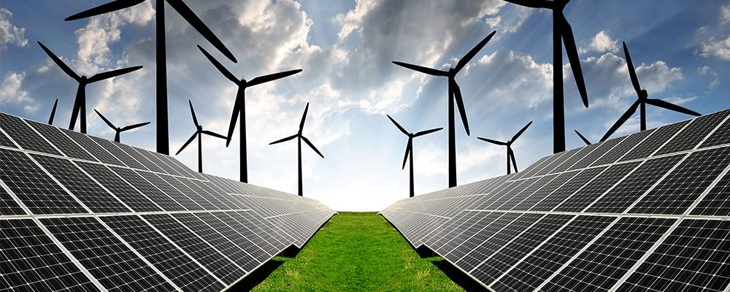
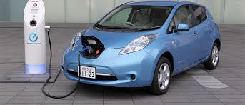

Slide 21
Ethical trends – ethical concerns of potential customers
carbon footprint
child labour
inadequate pay
animal welfare
values of an organisation
contribution to the community
https://www.youtube.com/watch?v=xoE8XlcDUI8
https://www.youtube.com/watch?v=kSvT02q4h40

Slide 22
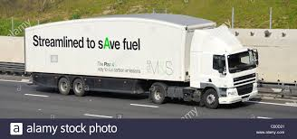
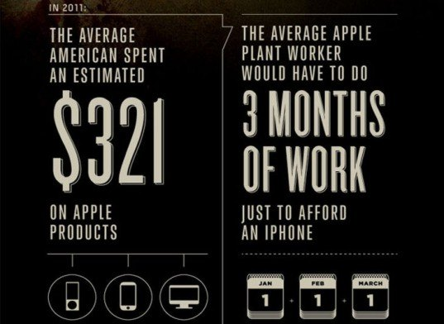

Slide 23
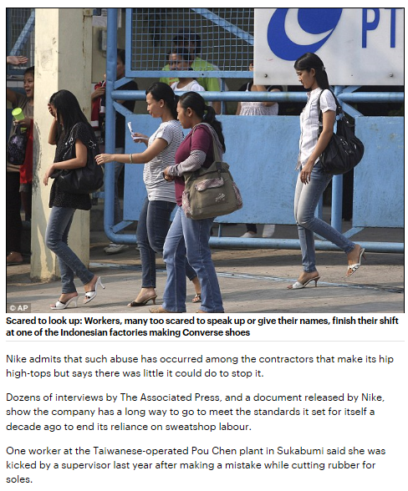
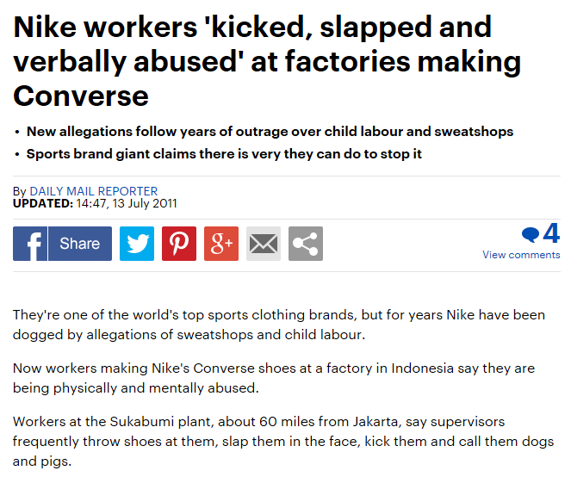

Slide 24
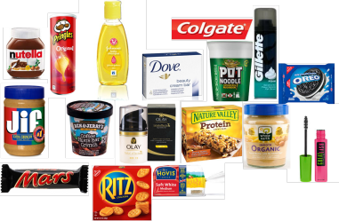

Slide 25
Demonstrate
Create an information booklet about 4 trends
Social
Environmental
Technology
Ethical

Slide 26
Consolidate
Read a buddies booklet about the Four Trends.
Write a 5 line review of their work. Outline 2 strengths and one weakness.
Grade it using 5 stars

Slide 27
Trends Affecting Businesses
Social Trends - The population changes from day to day and with increased medical care people are beginning to live longer, this means that people will have to work longer meaning that businesses like Wright the Button and my own skateboarding company will have to pay more to our workers to supply for their pensions. Wright on the Button and my own business will employ people on zero contract hours or part time to reduce the cost of paying full time workers as this is expensive. Better education means that their will be more skilled workers making fewer mistakes. This could save the company money in the long run.
Technology trends - Technology trends increase the amount of advertisement available to a business for free. This allows businesses like Wright on the Button free advertisement on social media websites. Also with the increased technology and programs businesses like my skateboarding company will be able to design the skateboards on computer, meaning that it will be a lot faster and easier for my businesses to create my own designs. Technology allows meetings to be held all across the world without having staff to be there in person. Staff can take part in the meeting via skype making meetings a lot more available for other staff abroad, this also makes meetings a lot cheaper as hotel rooms and transportation does not need to be accounted for.

Slide 28
Environmental Trends - Environmental Trends include renewable energy like solar power, hydro electric power, wind power, wave power. Environmental trends also include recycling, And Wright on the Button are donated recycled buttons meaning that they will not have to pay for buttons to be manufactured reducing the amount of pollution. Taking care of the environment will improve the image of any business who follows these environmental trends. If my business used low energy light bulbs and recycled parts my business would show that we care about the environment. My business could also harvest wood from sustainable forest where trees are replanted after everyone that is chopped down.
Ethical trends - Some issues regarding ethical trends include child labour and the businesses carbon dioxide footprint. If my business was accused of hiring children from other countries to create my skateboards my business could be sued for it. If my business had a large carbon dioxide footprint I would have to pay tax for the amount of fossil fuels I have used. This would damage my reputation as I am showing to the public that I do not care about the environment. However my business will recycle pieces and parts of skateboards and I will also make sure to plant trees in response to using wood for skateboards. Wright on the Button is ethical as they donate to two different charities Alzheimer's and the Royal Legion. This improves their reputation as Wright on the Button are showing how much they care about these charities to the public.

Slide 29
Homework task:
Due in:

Slide 30
Term 1b Reading Focus: Sequencing Time Order Words – that will help me develop my ability to write in sequence
Before | First | Next | Last | Sometimes
Earlier | Firstly | After | Afterwards | At times
Once | At the onset | As soon as | Eventually | Gradually
In the past | Before | Consequently | Finally | Occasionally
Not long ago | Embark | Not long after | In conclusion | Periodically
Preceding | Starting with | Soon after | Ultimately | Rarely
Previously | To begin | Shortly | Until | seldom
Editable

Slide 32
Top ten misused homophones Check your work – and that you have used them in the correct place | Used correctly | Corrected
Too: in addition
There: place
Their: belonging to
It’s: contraction of: it is
Our: group belonging
Know: having knowledge
You’re: contraction of: you are
Where: question of place
Through: passing
Top ten misused homophones Check your work – and that you have used them in the correct place | Used correctly | Corrected
Too: in addition
There: place
Their: belonging to
It’s: contraction of: it is
Our: group belonging
Know: having knowledge
You’re: contraction of: you are
Where: question of place
Through: passing
Top ten misused homophones Check your work – and that you have used them in the correct place | Used correctly | Corrected
Too: in addition
There: place
Their: belonging to
It’s: contraction of: it is
Our: group belonging
Know: having knowledge
You’re: contraction of: you are
Where: question of place
Through: passing

Slide 33
Top twenty one! Term 1b writing focus: Frequently misspelled words Check your work – and that you have used them in the correct place
Separate Sep a rate | Apparently Ap parent ly | Further Fur ther
Definitely Def in it ely | Across Across | Government Gov ern ment
A lot Not alot | Believe Be lie ve | Honest honest
Embarrass Em barr ass | Business Bus in ess | Knowledge Know led ge
Unnecessary Unn e ce ssary | Beginning Be ginn ing | Irresistible Irre sist ible
Disappoint Dis ap point | Calendar Cal en dar | Occasion O cca sion
Achieve Ach ie ve | Familiar Fam il iar | Receive Re ceive
Term 1b Writing focus: Common spelling mistakes.

Slide 35
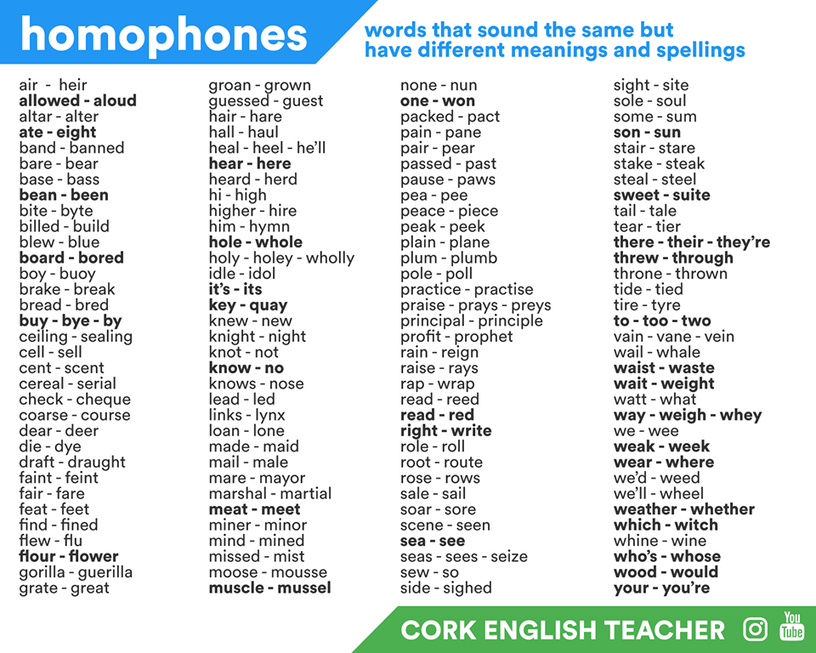
Term 1b Writing focus: Homophones

Slide 36
Lesson evaluation

