Slide 1
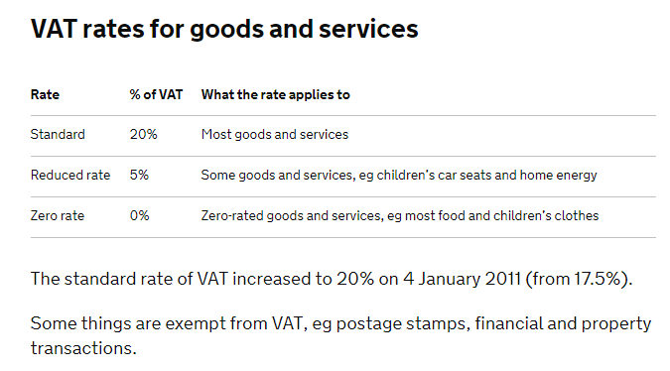
Connect
Write down anything you know about VAT (Value Added Tax).

Slide 2
Title: External Factors
LO: To investigate how changes in cost and legislation (laws) impact on an enterprise.
Success criteria:
I can explain how the costs of marketing and selling may change and impact on an enterprise
I can explain the impact of changes to wages or VAT may impact on an enterprise
I can explain how the law may change and impact on an enterprise
Literacy Foci Term 1b
Reading: Sequencing
Writing: homophones and common spelling mistakes

Slide 3
If VAT rises from 20% to 21%; how could this impact on an enterprise?
Activate
Price is £100
+20% VAT £20 to the government.
= Sells for £120
Price is £100
+21% VAT £21 to government
=Sells for £121

Slide 4
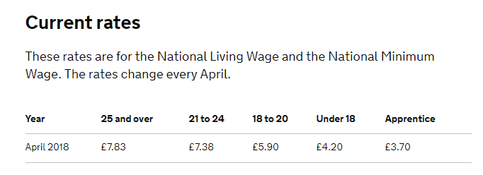
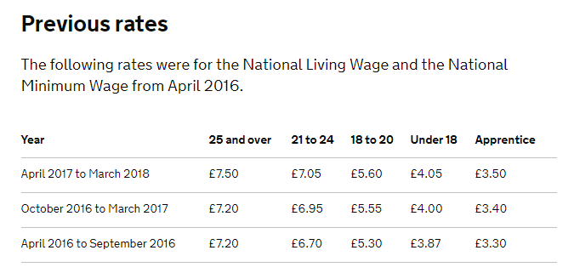
The National Minimum Wage (NMW) is the minimum pay per hour most workers under the age of 25 are entitled to by law. The government's National Living Wage (NLW) is the minimum pay per hour most workers aged 25 and over are entitled to by law.

Slide 5
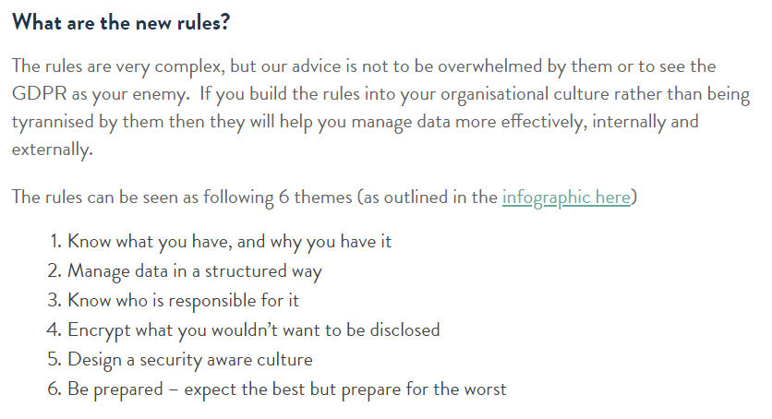
https://nilehq.com/journal/gdpr-for-dummies/

Slide 6
Demonstrate
Factor | Changes | Impact on enterprises
VAT | Increases from 20% to 21%
Costs of Leaflets | 1000 x A3 leaflets cost £83.73 in August. Down from £111.64 in July.
Wages | National Minimum Wage for 18-20 year olds increases from £5.60 to £5.90 per hour.
Laws | The General Data Protection Regulations (GDPR) were introduced in May 2018.

Slide 7
Demonstrate
Factor | Changes | Impact on enterprises
VAT | Increases from 20% to 21%
Costs of Leaflets | 1000 x A3 leaflets cost £83.73 in August. Down from £111.64 in July.
Wages | National Minimum Wage for 18-20 year olds increases from £5.60 to £5.90 per hour.
Laws | The General Data Protection Regulations (GDPR) were introduced in May 2018.

Slide 8
Consolidate
Success criteria:
I can explain how the costs of marketing and selling may change and impact on an enterprise
I can explain the impact of changes to wages or VAT may impact on an enterprise
I can explain how the law may change and impact on an enterprise

Slide 9
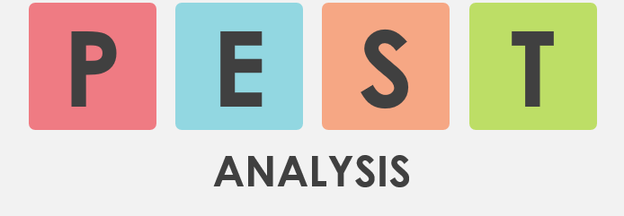
Consolidate
There are number of external factors that can impact on an enterprise.
Next lesson we will carry out a PEST Analysis of some external factors.
Use the internet to find out what this is and add an explanation to your work from today.

Slide 10
Homework task:
Due in:

Slide 11
Term 1b Reading Focus: Sequencing Time Order Words – that will help me develop my ability to write in sequence
Before | First | Next | Last | Sometimes
Earlier | Firstly | After | Afterwards | At times
Once | At the onset | As soon as | Eventually | Gradually
In the past | Before | Consequently | Finally | Occasionally
Not long ago | Embark | Not long after | In conclusion | Periodically
Preceding | Starting with | Soon after | Ultimately | Rarely
Previously | To begin | Shortly | Until | seldom
Editable

Slide 13
Top ten misused homophones Check your work – and that you have used them in the correct place | Used correctly | Corrected
Too: in addition
There: place
Their: belonging to
It’s: contraction of: it is
Our: group belonging
Know: having knowledge
You’re: contraction of: you are
Where: question of place
Through: passing
Top ten misused homophones Check your work – and that you have used them in the correct place | Used correctly | Corrected
Too: in addition
There: place
Their: belonging to
It’s: contraction of: it is
Our: group belonging
Know: having knowledge
You’re: contraction of: you are
Where: question of place
Through: passing
Top ten misused homophones Check your work – and that you have used them in the correct place | Used correctly | Corrected
Too: in addition
There: place
Their: belonging to
It’s: contraction of: it is
Our: group belonging
Know: having knowledge
You’re: contraction of: you are
Where: question of place
Through: passing

Slide 14
Top twenty one! Term 1b writing focus: Frequently misspelled words Check your work – and that you have used them in the correct place
Separate Sep a rate | Apparently Ap parent ly | Further Fur ther
Definitely Def in it ely | Across Across | Government Gov ern ment
A lot Not alot | Believe Be lie ve | Honest honest
Embarrass Em barr ass | Business Bus in ess | Knowledge Know led ge
Unnecessary Unn e ce ssary | Beginning Be ginn ing | Irresistible Irre sist ible
Disappoint Dis ap point | Calendar Cal en dar | Occasion O cca sion
Achieve Ach ie ve | Familiar Fam il iar | Receive Re ceive
Term 1b Writing focus: Common spelling mistakes.

Slide 16
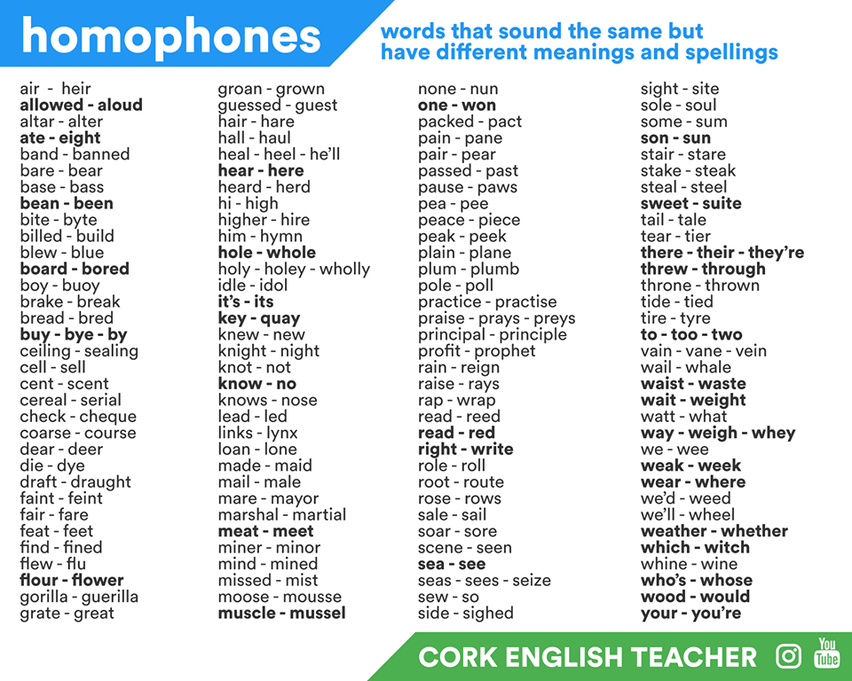
Term 1b Writing focus: Homophones

Slide 17
Lesson evaluation

