Slide 1
Week 8- Jesus

Slide 2
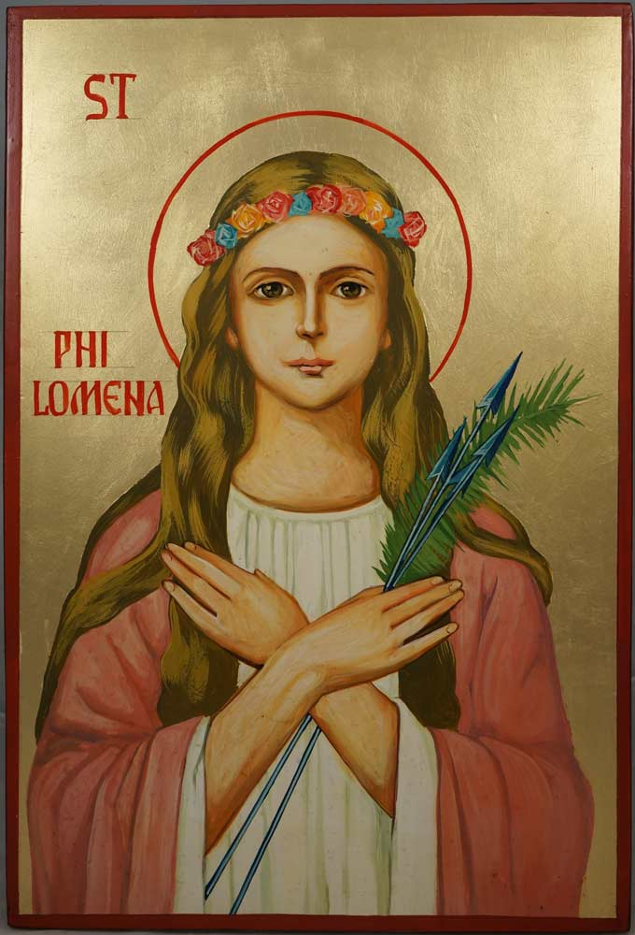
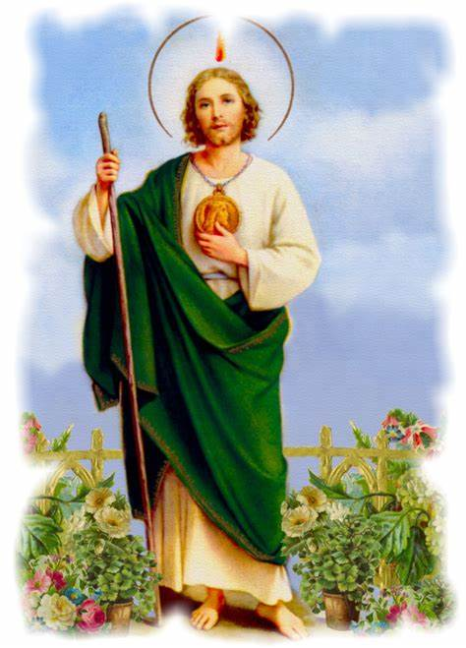
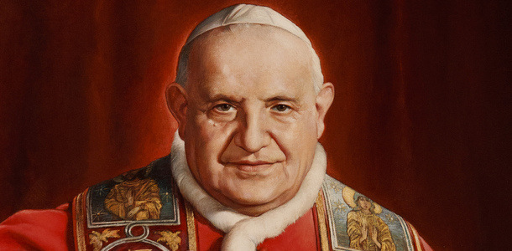
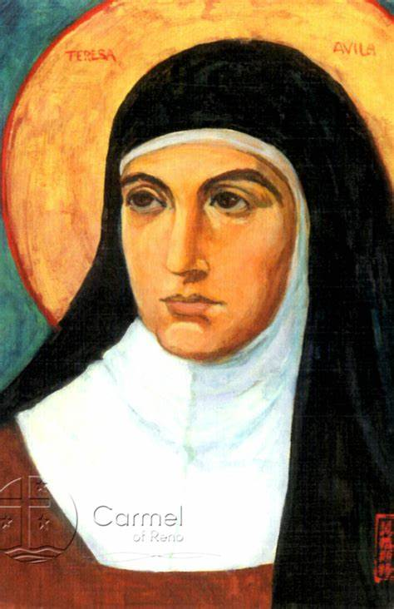
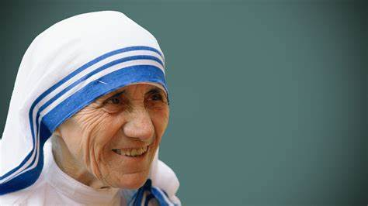
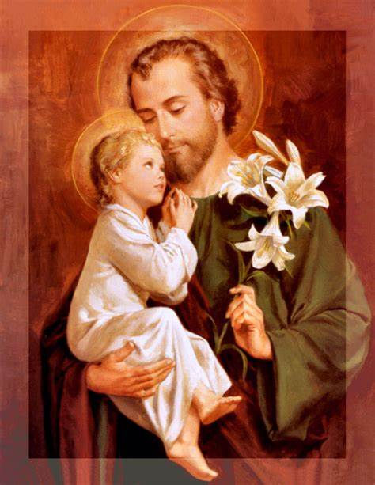
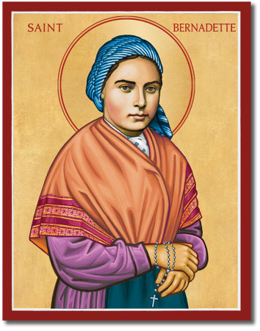
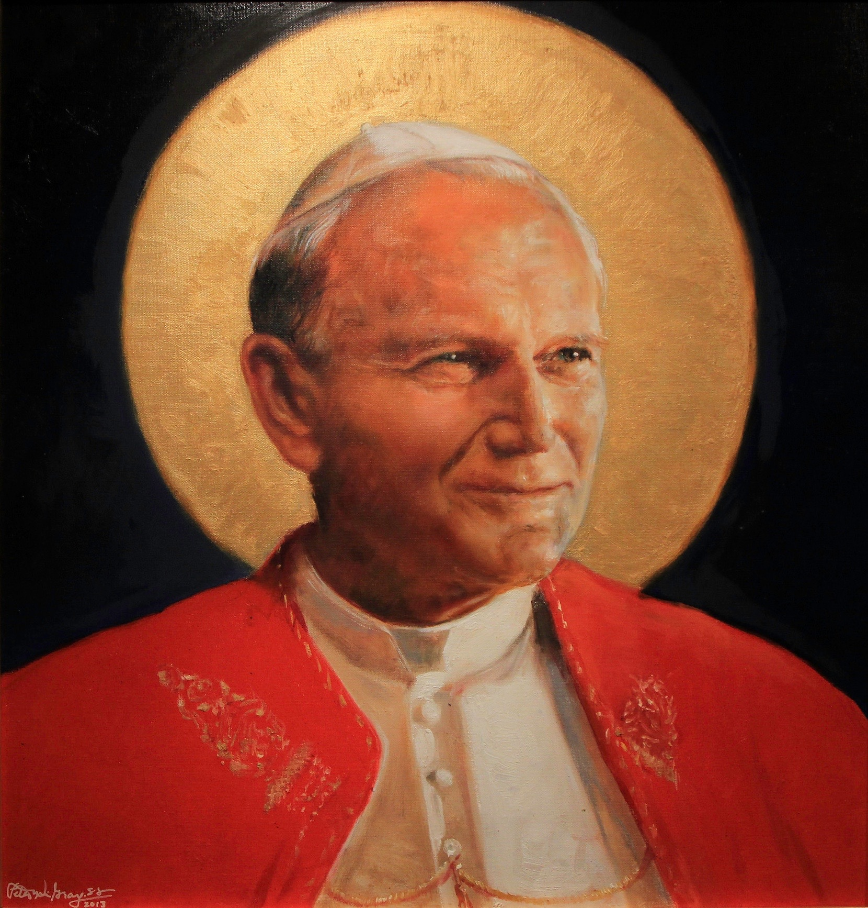
Sunday 1st November - All Saints' Day
Today we celebrate the feast of All Saints'. Let us think about what qualities these people had to become a Saint. Qualities of resilience, faith, love and compassion are just some.
Let us in this new half term try and emulate these qualities in order to help each other and create a better world in this difficult time.

Slide 3
Monday 2nd November
Dear Lord
As we face the news of a second lockdown , give us strength and faith.
Faith to know that things will get better, to understand that maybe we give up short term actions for the betterment of the long-term. .
Strength to follow the guidelines and understand that our actions may have consequences for the most vulnerable in society.
Resilience to focus and understand that our teachers are doing the upmost under difficult circumstances to deliver the gift of education.
St Joseph- Pray for us

Slide 4
Tuesday 3rd November
Dear Lord
When your Son came to earth, he changed everything. He taught people how to love and care for one another, he taught them about the God that loved them, and he gave up his life to bring them back to you, their loving God. Help us to welcome your Son and the things that he taught in our everyday lives.
St Joseph- Pray for us

Slide 5
Wednesday 4th November
Lord
You sent your Son to earth to bring us to you: to your truth, your love, your peace, and ultimately to live with you in heaven for eternity. Help us to respond to Jesus call in a generous and loving way.
St Joseph- Pray for us

Slide 6
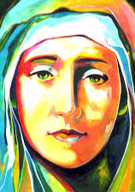
Thursday 5th November
We offer our intentions to Mary and ask her to intercede ;

Slide 7
Friday 6th November
Dear Lord
We thank you for bringing us back together as a community and for keeping us safe in this first week back. Be with us in the weeks ahead and help us to work hard so that in all things we might grow closer to the amazing people you created us to be.
St Joseph- Pray for us

Slide 8
Final thought of the week
Next theme; remembrance

