Slide 1
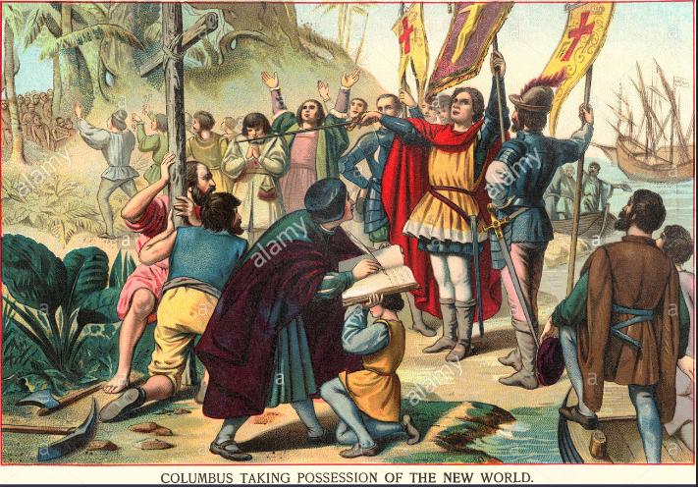
Paper 2
Spain and the New World
Exam practice pack

Slide 2
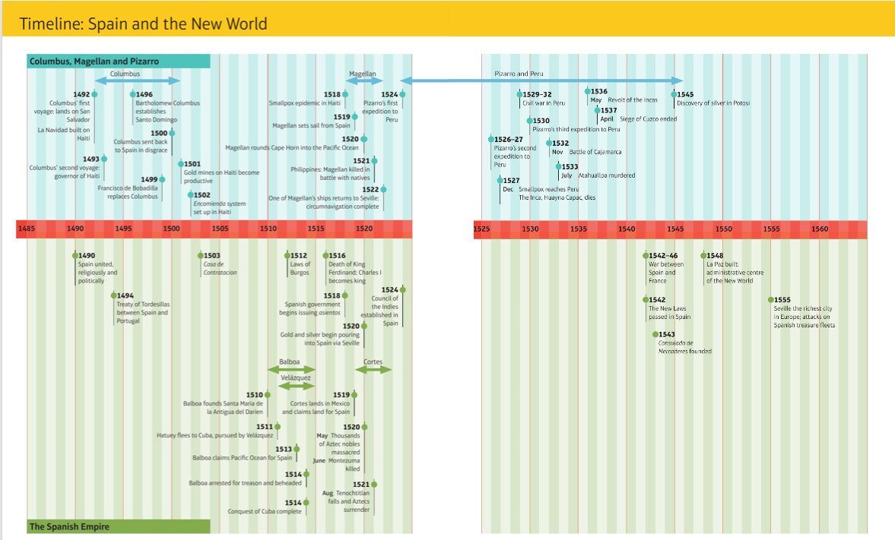

Slide 3
Know what I want!
DOs | DON’TS
Read all pages in the Spain and the New World revision book. | Try and learn all the information in one go.
Read the questions carefully and plan using the TCKRS sheet. | Write outside of the time period
Link directly to the question. | Use the revision when writing the questions

Slide 4
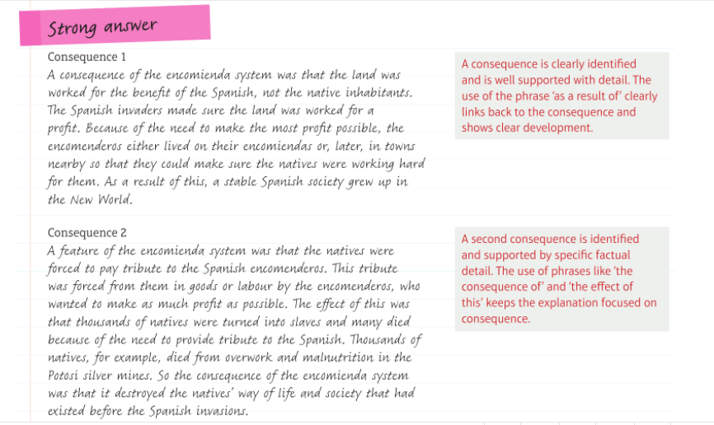
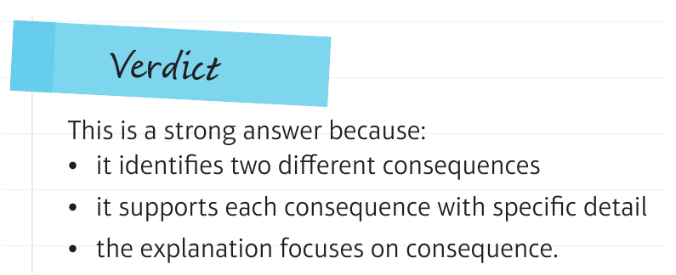

Slide 5
Demonstrate
A consequence of ……..is ……..
Own knowledge to support
Another consequence of ……..is ……..
Own knowledge to support
Carry out a quick TKCRS check
T | Theme
K | Knowledge
C | Command words
R | Restrictions
S | Structure

Slide 6
Demonstrate
Q1. Explain two consequences of Christopher Columbus’ return to Spain in March 1943
---------------------------------------------------------------------------------------------------------------------------------------------------------------------------------------------------------------------------------------------------------------------------------------------------------------------------------------------------------------------------------------------------------------------------------------------------------------------------------------------------------------------------------------------------------------------------------------------------------------------------------------------------------------------------------------------------------------------------------------------------------------------------------------------------------------------------------------------------------------------------------------------------------------------------------------------------------------------------------------------------------------------------------------------------------------------------------------------------------------------------------------------------------------------------------------------------------------------------------------------------------------------------------------------------------------------------------------------------------------------------------------------------------------------------------------------------------------------------------------------------------------------------------------------------------------------------------------------------------------------------------------------------------------------------------------------------------------------------------------------------------------------------------------------------------------------------------------------------------------------------------------------------------------------------------------------------------------------------------------------------------------------------------------------------------------------------------------------------------------------------------------------------------------------------------------------------------------------------------------------------------------------------------------------------------------------------------------------------------------------------------------------------------------------------------------------------------------------------------------------------------------------------------------------------------------------------------------------------------------------------------------------

Slide 7
-------------------------------------------------------------------------------------------------------------------------------------------------------------------------------------------------------------------------------------------------------------------------------------------------------------------------------------------------------------------------------------------------------------------------------------------------------------------------------------------------------------------------------------------------------------------------------------------------------------------------------------------------------------------------------------------------------------------------------------------------------------------------------------------------------------------------------------------------------------------------------------------------------------------------------------------------------------------------------------------------------------------------------------------------------------------------------------------------------------------------------------------------------------------------------------------------------------------------------------------------------------------------------------------------------------------------------------------------------------------------------------------------------------------------------------------------------------------------------------------------------------------------------------------------------------------------------------------------------------------------------------------------------------------------------------------------------------------------------------------------------------------------------------------------------------------------------------------------------------------------------------------------------------------------------------------------------------------------------------------------------------------------------------------------------------------------------------------------------------------------------------------------------------------------------------------------------------------------------------------------------------------------------------------------------------------------------------------------------------------------------------------------------------------------------------------------------------------------------------------------------------------------------------------------------------------------------------------------------------------------------------------------------------------------------------------------------------------------------------------------------------------------------------------------------------------------------------------------------------------------------------------------------------------------------------------------------------------------------------------
---------------------------------------------------------------------------------------------------------------------------------------------------------------------------------------------------------------------------------------------------------

Slide 8
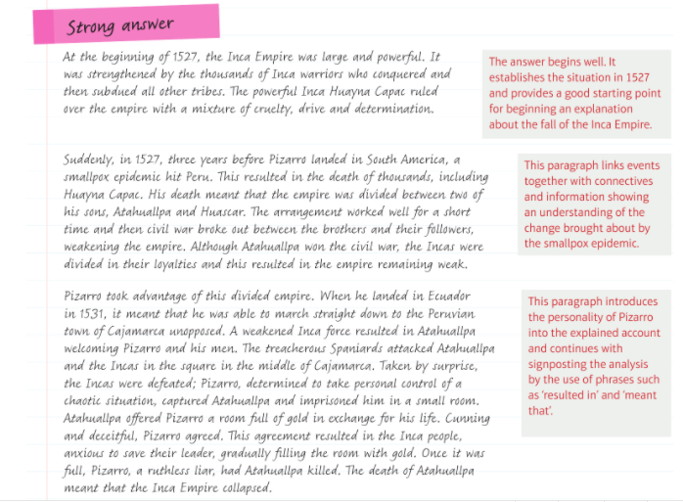

Slide 9
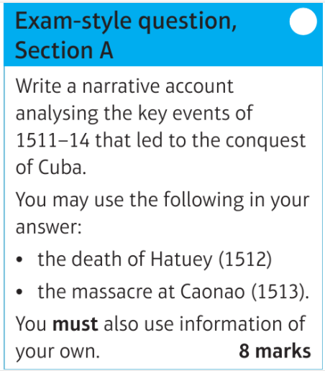
Demonstrate
Describe the death of Hatuey – link to the question This then led to ……
Describe the massacre at Caonao – link to the question This then led to ……
Describe the (Your choice) – link to the question This then led to ……
Carry out a quick TKCRS check
T | Theme
K | Knowledge
C | Command words
R | Restrictions
S | Structure

Slide 10
Demonstrate
Q2. Write a narrative account analysing the key events of 1511-14 that led to the conquest of Cuba .
------------------------------------------------------------------------------------------------------------------------------------------------------------------------------------------------------------------------------------------------------------------------------------------------------------------------------------------------------------------------------------------------------------------------------------------------------------------------------------------------------------------------------------------------------------------------------------------------------------------------------------------------------------------------------------------------------------------------------------------------------------------------------------------------------------------------------------------------------------------------------------------------------------------------------------------------------------------------------------------------------------------------------------------------------------------------------------------------------------------------------------------------------------------------------------------------------------------------------------------------------------------------------------------------------------------------------------------------------------------------------------------------------------------------------------------------------------------------------------------------------------------------------------------------------------------------------------------------------------------------------------------------------------------------------------------------------------------------------------------------------------------------------------------------------------------------------------------------------------------------------------------------------------------------------------------------------------------------------------------------------------------------------------------------------------------------------------------------------------------------------------------------------------------------------------------------------------------------------------------------------------------
---------------------------------------------------------------------------------------------------------------------------------------------------------------------------------------------------------------------------------------------------------------------------------------------------------------------------------------------------------------------------

Slide 11
-------------------------------------------------------------------------------------------------------------------------------------------------------------------------------------------------------------------------------------------------------------------------------------------------------------------------------------------------------------------------------------------------------------------------------------------------------------------------------------------------------------------------------------------------------------------------------------------------------------------------------------------------------------------------------------------------------------------------------------------------------------------------------------------------------------------------------------------------------------------------------------------------------------------------------------------------------------------------------------------------------------------------------------------------------------------------------------------------------------------------------------------------------------------------------------------------------------------------------------------------------------------------------------------------------------------------------------------------------------------------------------------------------------------------------------------------------------------------------------------------------------------------------------------------------------------------------------------------------------------------------------------------------------------------------------------------------------------------------------------------------------------------------------------------------------------------------------------------------------------------------------------------------------------------------------------------------------------------------------------------------------------------------------------------------------------------------------------------------------------------------------------------------------------------------------------------------------------------------------------------------------------------------------------------------------------------------------------------------------------------------------------------------------------------------------------------------------------------------------------------------------------------------------------------------------------------------------------------------------------------------------------------------------------------------------------------------------------------------------------------------------------------------------------------------------------------------------------------------------------------------------------------------------------------------------------------------------------------------------------
---------------------------------------------------------------------------------------------------------------------------------------------------------------------------------------------------------------------------------------------------------

Slide 12
-------------------------------------------------------------------------------------------------------------------------------------------------------------------------------------------------------------------------------------------------------------------------------------------------------------------------------------------------------------------------------------------------------------------------------------------------------------------------------------------------------------------------------------------------------------------------------------------------------------------------------------------------------------------------------------------------------------------------------------------------------------------------------------------------------------------------------------------------------------------------------------------------------------------------------------------------------------------------------------------------------------------------------------------------------------------------------------------------------------------------------------------------------------------------------------------------------------------------------------------------------------------------------------------------------------------------------------------------------------------------------------------------------------------------------------------------------------------------------------------------------------------------------------------------------------------------------------------------------------------------------------------------------------------------------------------------------------------------------------------------------------------------------------------------------------------------------------------------------------------------------------------------------------------------------------------------------------------------------------------------------------------------------------------------------------------------------------------------------------------------------------------------------------------------------------------------------------------------------------------------------------------------------------------------------------------------------------------------------------------------------------------------------------------------------------------------------------------------------------------------------------------------------------------------------------------------------------------------------------------------------------------------------------------------------------------------------------------------------------------------------------------------------------------------------------------------------------------------------------------------------------------------------------------------------------------------------------------------------------------
---------------------------------------------------------------------------------------------------------------------------------------------------------------------------------------------------------------------------------------------------------

Slide 14
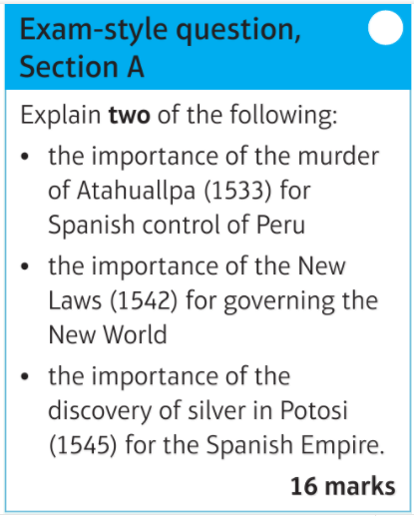
Demonstrate
Describe and explain the importance
Describe and explain the importance
Describe and explain the importance
Carry out a quick TKCRS check
T | Theme
K | Knowledge
C | Command words
R | Restrictions
S | Structure
X2

Slide 15
Demonstrate
Q3. Explain the following: The importance of the murder of Atahuallapa (1533) for Spanish control of Peru.
-----------------------------------------------------------------------------------------------------------------------------------------------------------------------------------------------------------------------------------------------------------------------------------------------------------------------------------------------------------------------------------------------------------------------------------------------------------------------------------------------------------------------------------------------------------------------------------------------------------------------------------------------------------------------------------------------------------------------------------------------------------------------------------------------------------------------------------------------------------------------------------------------------------------------------------------------------------------------------------------------------------------------------------------------------------------------------------------------------------------------------------------------------------------------------------------------------------------------------------------------------------------------------------------------------------------------------------------------------------------------------------------------------------------------------------------------------------------------------------------------------------------------------------------------------------------------------------------------------------------------------------------------------------------------------------------------------------------------------------------------------------------------------------------------------------------------------------------------------------------------------------------------------------------------------------------------------------------------------------------------------------------------------------------------------------------------------------------------------------------------------------------------------------------------------------------------------------------------------------------------------------------
--------------------------------------------------------------------------------------------------------------------------------------------------------------------------------------------------------------------------------------------------

Slide 16
-------------------------------------------------------------------------------------------------------------------------------------------------------------------------------------------------------------------------------------------------------------------------------------------------------------------------------------------------------------------------------------------------------------------------------------------------------------------------------------------------------------------------------------------------------------------------------------------------------------------------------------------------------------------------------------------------------------------------------------------------------------------------------------------------------------------------------------------------------------------------------------------------------------------------------------------------------------------------------------------------------------------------------------------------------------------------------------------------------------------------------------------------------------------------------------------------------------------------------------------------------------------------------------------------------------------------------------------------------------------------------------------------------------------------------------------------------------------------------------------------------------------------------------------------------------------------------------------------------------------------------------------------------------------------------------------------------------------------------------------------------------------------------------------------------------------------------------------------------------------------------------------------------------------------------------------------------------------------------------------------------------------------------------------------------------------------------------------------------------------------------------------------------------------------------------------------------------------------------------------------------------------------------------------------------------------------------------------------------------------------------------------------------------------------------------------------------------------------------------------------------------------------------------------------------------------------------------------------------------------------------------------------------------------------------------------------------------------------------------------------------------------------------------------------------------------------------------------------------------------------------------------------------------------------------------------------------------------------------------------
---------------------------------------------------------------------------------------------------------------------------------------------------------------------------------------------------------------------------------------------------------

Slide 17
-------------------------------------------------------------------------------------------------------------------------------------------------------------------------------------------------------------------------------------------------------------------------------------------------------------------------------------------------------------------------------------------------------------------------------------------------------------------------------------------------------------------------------------------------------------------------------------------------------------------------------------------------------------------------------------------------------------------------------------------------------------------------------------------------------------------------------------------------------------------------------------------------------------------------------------------------------------------------------------------------------------------------------------------------------------------------------------------------------------------------------------------------------------------------------------------------------------------------------------------------------------------------------------------------------------------------------------------------------------------------------------------------------------------------------------------------------------------------------------------------------------------------------------------------------------------------------------------------------------------------------------------------------------------------------------------------------------------------------------------------------------------------------------------------------------------------------------------------------------------------------------------------------------------------------------------------------------------------------------------------------------------------------------------------------------------------------------------------------------------------------------------------------------------------------------------------------------------------------------------------------------------------------------------------------------------------------------------------------------------------------------------------------------------------------------------------------------------------------------------------------------------------------------------------------------------------------------------------------------------------------------------------------------------------------------------------------------------------------------------------------------------------------------------------------------------------------------------------------------------------------------------------------------------------------------------------------------------------------------------
---------------------------------------------------------------------------------------------------------------------------------------------------------------------------------------------------------------------------------------------------------

Slide 18
-------------------------------------------------------------------------------------------------------------------------------------------------------------------------------------------------------------------------------------------------------------------------------------------------------------------------------------------------------------------------------------------------------------------------------------------------------------------------------------------------------------------------------------------------------------------------------------------------------------------------------------------------------------------------------------------------------------------------------------------------------------------------------------------------------------------------------------------------------------------------------------------------------------------------------------------------------------------------------------------------------------------------------------------------------------------------------------------------------------------------------------------------------------------------------------------------------------------------------------------------------------------------------------------------------------------------------------------------------------------------------------------------------------------------------------------------------------------------------------------------------------------------------------------------------------------------------------------------------------------------------------------------------------------------------------------------------------------------------------------------------------------------------------------------------------------------------------------------------------------------------------------------------------------------------------------------------------------------------------------------------------------------------------------------------------------------------------------------------------------------------------------------------------------------------------------------------------------------------------------------------------------------------------------------------------------------------------------------------------------------------------------------------------------------------------------------------------------------------------------------------------------------------------------------------------------------------------------------------------------------------------------------------------------------------------------------------------------------------------------------------------------------------------------------------------------------------------------------------------------------------------------------------------------------------------------------------------------------------------------
---------------------------------------------------------------------------------------------------------------------------------------------------------------------------------------------------------------------------------------------------------

