Slide 1
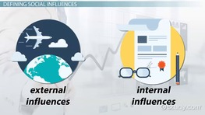
Connect
What is the difference between an internal and an external influence on a business?

Slide 2
Title: External Factors 1
LO: To identify the external impacts
on an enterprise
Success criteria:
I can identify external influences
I can outline the 3 main government parties
I can explain political impacts
Literacy Foci Term 1b
Reading: Sequencing
Writing: homophones and common spelling mistakes

Slide 3
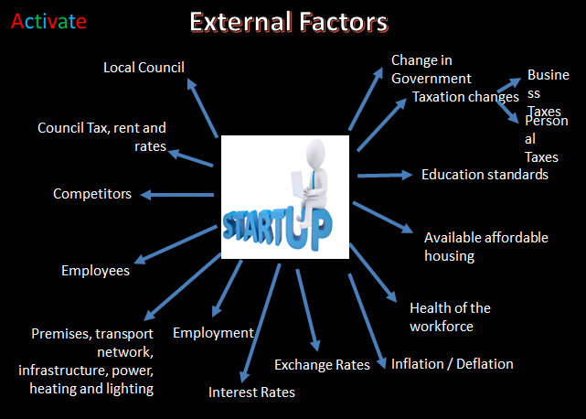
Activate
Copy the diagram of external factors that could impact on an enterprise.

Slide 4
External Factors
Local Council
Laws
Change in Government
Business Taxes
Taxation changes
Council Tax, rent and rates
Personal
Taxes
Education standards
Competitors
Available affordable housing
Employees
Health of the workforce
Premises, transport network, infrastructure, power, heating and lighting
Employment
Exchange Rates
Inflation / Deflation
Interest Rates

Slide 5
External Factors
Local Council
Change in Government
Business Taxes
Taxation changes
Council Tax, rent and rates
Personal
Taxes
Education standards
Competitors
How could an increase in tax be bad for a business?
Available affordable housing
How could a decrease in tax be good for a business?
Employees
Health of the workforce
Premises, transport network, infrastructure, power, heating and lighting
Employment
Exchange Rates
Inflation / Deflation
Interest Rates

Slide 6
Government:
Currently the leading party in Government.
Leader of the Conservatives is Boris Johnson (Prime Minister)
Main Political Policies:
Scrap free school lunches for infants in England, but offer free breakfasts across the primary years
Pump an extra £4bn into schools by 2022
Net migration cut to below 100,000
Increase the amount levied on firms employing non-EU migrant workers
Liberal Democrats
Leader of the Liberal Democrats is Ed Davey
Main Political Policies
1p in the pound on income tax to raise £6bn for NHS and social care services
End the 1% public sector pay cap
Invest nearly £7bn extra in education
Ban the sale of diesel cars and small vans in the UK by 2025
Labour Party
Leader of the Labour Party is Jeremy Corbyn
Main Political Policies
Scrap student tuition fees
Re-introduce the 50p rate of tax on the highest earners (above £123,000)
More free childcare, expanding free provisions for two, three and four year olds
End to zero hours contracts
Hire 10,000 new police officers, 3,000 new fire fighters

Slide 7
Government:
Currently the leading party in Government.
Leader of the Conservatives is Boris Johnson (Prime Minister)
Main Political Policies:
Scrap free school lunches for infants in England, but offer free breakfasts across the primary years
Pump an extra £4bn into schools by 2022
Net migration cut to below 100,000
Increase the amount levied on firms employing non-EU migrant workers
Liberal Democrats
Leader of the Liberal Democrats is Ed Davey
Main Political Policies
1p in the pound on income tax to raise £6bn for NHS and social care services
End the 1% public sector pay cap
Invest nearly £7bn extra in education
Ban the sale of diesel cars and small vans in the UK by 2025
Labour Party
Leader of the Labour Party is Jeremy Corbyn
Main Political Policies
Scrap student tuition fees
Re-introduce the 50p rate of tax on the highest earners (above £123,000)
More free childcare, expanding free provisions for two, three and four year olds
End to zero hours contracts
Hire 10,000 new police officers, 3,000 new fire fighters
If the government changed to the ____________ Party this could be good for a business because………..
It could also be bad because…………..

Slide 8
Reduction in Interest Rates 0.75% to 0.25% | £600 billion for infrastructure over 5 years -roads -railways -broadband -electricity | Resources for coronavirus -Sick Pay -Loans -Temporary suspension of business rates (under 51,000)
Create a table and comment on how these measures announced in the budget would have advantages or disadvantages for businesses

Slide 9
Consolidate
Success criteria:
I can identify external influences
I can outline the 3 main government parties
I can explain political impacts

Slide 10
Homework task:
Due in:

Slide 11
Term 1b Reading Focus: Sequencing Time Order Words – that will help me develop my ability to write in sequence
Before | First | Next | Last | Sometimes
Earlier | Firstly | After | Afterwards | At times
Once | At the onset | As soon as | Eventually | Gradually
In the past | Before | Consequently | Finally | Occasionally
Not long ago | Embark | Not long after | In conclusion | Periodically
Preceding | Starting with | Soon after | Ultimately | Rarely
Previously | To begin | Shortly | Until | seldom
Editable

Slide 13
Top ten misused homophones Check your work – and that you have used them in the correct place | Used correctly | Corrected
Too: in addition
There: place
Their: belonging to
It’s: contraction of: it is
Our: group belonging
Know: having knowledge
You’re: contraction of: you are
Where: question of place
Through: passing
Top ten misused homophones Check your work – and that you have used them in the correct place | Used correctly | Corrected
Too: in addition
There: place
Their: belonging to
It’s: contraction of: it is
Our: group belonging
Know: having knowledge
You’re: contraction of: you are
Where: question of place
Through: passing
Top ten misused homophones Check your work – and that you have used them in the correct place | Used correctly | Corrected
Too: in addition
There: place
Their: belonging to
It’s: contraction of: it is
Our: group belonging
Know: having knowledge
You’re: contraction of: you are
Where: question of place
Through: passing

Slide 14
Top twenty one! Term 1b writing focus: Frequently misspelled words Check your work – and that you have used them in the correct place
Separate Sep a rate | Apparently Ap parent ly | Further Fur ther
Definitely Def in it ely | Across Across | Government Gov ern ment
A lot Not alot | Believe Be lie ve | Honest honest
Embarrass Em barr ass | Business Bus in ess | Knowledge Know led ge
Unnecessary Unn e ce ssary | Beginning Be ginn ing | Irresistible Irre sist ible
Disappoint Dis ap point | Calendar Cal en dar | Occasion O cca sion
Achieve Ach ie ve | Familiar Fam il iar | Receive Re ceive
Term 1b Writing focus: Common spelling mistakes.

Slide 16
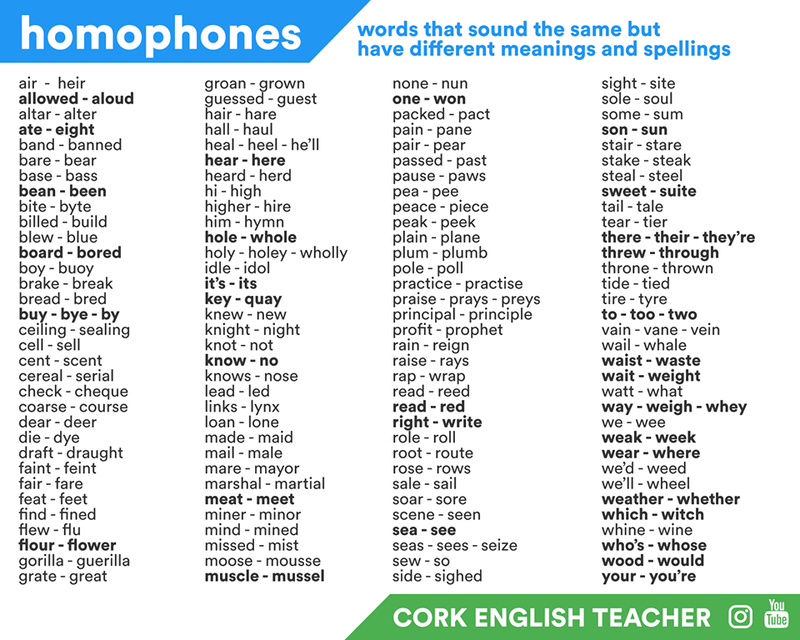
Term 1b Writing focus: Homophones

Slide 17
Lesson evaluation

