Slide 1
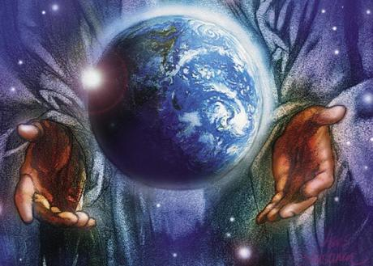
Form prayers week 3
Theme: Stewardship

Slide 2
24th Sunday in Ordinary time
Matthew 18: 21-35
In today's Gospel Peter asks Christ " Lord how often should I forgive ?".
Jesus replied " not seven but seventy times seven"
Jesus is saying we must always forgive. Although it is hard let us this week take this teaching on board, and always seek to forgive in order to create a harmonious community.

Slide 3
Monday 14th September
Loving Father
You created people out of nothing. You created us in a beautiful world with lots of amazing possibilities. Help us to be good stewards of the things you give us to look after and help us to make the right decisions in everything we must do in order to show respect to our environment. In all things, Lead us closer and closer to you.
Amen
St Joseph
Pray for us

Slide 4
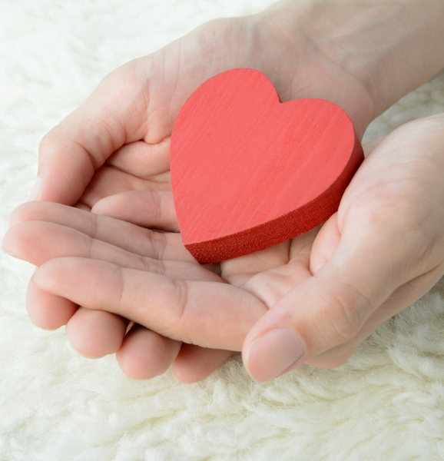
Tuesday 15th September
Dear Lord
Help us to appreciate all those who contribute something to our lives, whether something huge or something small. Help us always to remember that as well as creating us, you created a world of people around us, and help us always to be grateful and kind to them. Give us the guidance to be responsible in all our thoughts and words.
St Joseph
Pray for us

Slide 5
Wednesday 16th September
Dear Lord
Thank you for another day in our school community. Although we all have ups and downs, give us the resilience to enjoy each other's company and support each other in the environment we share.
St Joseph
Pray for us

Slide 6
Thursday 17th September
We bring all our personal thoughts and needs as we ask Mary to petition on our behalf;
Hail Mary, full of grace. The Lord is with thee. Blessed art thou among women, and blessed is the fruit of thy womb, Jesus. Holy Mary, Mother of God, pray for us sinners, now and at the hour of our death. Amen.

Slide 7
Friday 18th September
Dear Lord
We thank you for the week which ends today
We thank you for all the blessings and challenges
We look forward Lord for your guidance and protection over the weekend
During the weekend keep us close to you.
Guide us and protect us
St Joseph
Pray for us

Slide 8
Final thought of the week
Next week's theme: Charity

