Slide 1
Prayers for the week - Joy

Slide 2
Monday 1st February
Lord
We give thanks for the joy of a new week. Whatever canvas we painted for ourselves last week, we give thanks that we have the opportunity to create a whole new one this week. Where we have succeeded, enhance us further. Where we have needed help, support us in our weakness. Let us make every word we speak and action we take a joyous reminder of your message.
St Joseph – Pray for us

Slide 3
Tuesday 2nd February
Lord
You love us, you created us, and you fill us with light and life. Help us to always be joyful and help our faith to be something that lights us up rather than weighs us down.
St Joseph – Pray for us

Slide 4
Wednesday 3rd February
Loving Lord
Help us to look at our lives with gratitude for the things you have given us and with honesty to change the things that aren’t quite so good. By doing this, may we come closer to you and closer to one another.
St Joseph – Pray for us

Slide 5
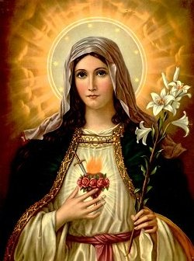
Thursday 4th February
Let us take our concerns to Mary and ask that she intercedes for us;
Hail Mary full of Grace, the Lord is with thee. Blessed are thou amongst women and blessed is the fruit of thy womb Jesus. Holy Mary Mother of God, pray for us sinners now and at the hour of our death Amen.

Slide 6
Friday 5th February
Loving Father
Help us to feel happy because of our relationship with you. Help us too, to pass that joy onto others by our words, our actions and our hope.
Watch over us this weekend and bring us back safely on Monday, in whatever way that may be, for another week of learning.
St Jospeh - Pray for us

Slide 7
Final thought of the week.....

