Slide 1
Week 11 - Mary

Slide 2
Monday 23rd November
Lord
You call each of us to be saints and you give us all the power to make it happen. Help us to believe that, like Mary, we too can find opportunities to do amazing things. Give us the wisdom to see those opportunities and the courage to take them. As we enter a new school week inspire us in our words and actions.
St Joseph – Pray for us

Slide 3
Tuesday 24th November
Loving Father
Help us to remember that whenever we go wrong, you are there to call us back. You look at us with the love of a caring Father and you want us to be the best that we can.
St Joseph – Pray for us

Slide 4
Wednesday 25th November
Dear Lord, Bless our community. Be so kind as to give us the unity, peace, and mutual love that You found in Your own family in the little town of Nazareth.
Mary, Pray for our community. Pray that as we approach the season of Advent, we can open our hearts and help those in need.
St Joseph – Pray for us

Slide 5
Thursday 26th November
Let us pray for all those we have thought about during light fever week who are no longer with us. May we always hold them in our heart;
Eternal rest grant unto them, O Lord, and let perpetual light shine upon them. May they rest in peace.
Amen

Slide 6
Friday 27th November
Loving Father
Help us to follow the example of Joseph in the upcoming season of Advent, and to stick by those who we love. Help us to be faithful, caring and kind. Help us not to desert our friends when they need us most, but to be their strength and their help. Watch over us this weekend and bring us back safely for another week of learning on Monday.
St Joseph – Pray for us

Slide 7
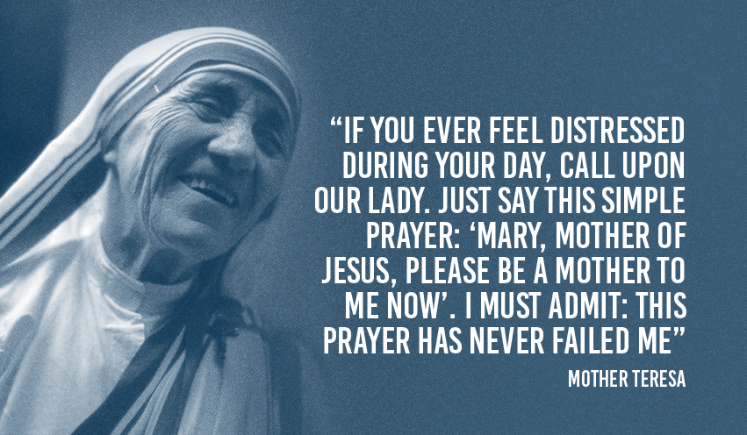
Final thought of the week
Next week's theme;
Advent

