Slide 1
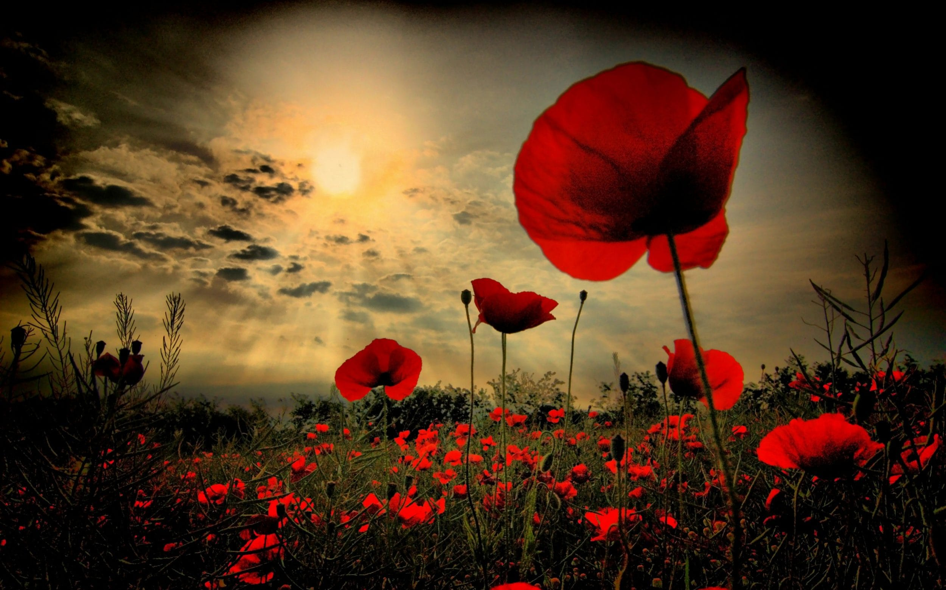
Week 9- Remembrance

Slide 2
Monday 9th November
Loving Father, In this week where we remember conflicts and give thanks to those who fought on our behalf, we pray for the gift of peace. Bring healing and peace to the troubled parts of the world and bring that same healing and peace to the hearts of us all.
St Joseph- Pray for us

Slide 3
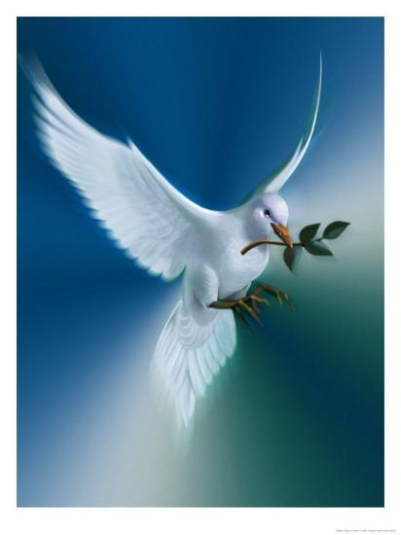
Tuesday 10th November
Loving Father,
You alone can give us the love and the hope to bring healing and peace. We ask you today to be with all those affected by war. Those who have lost loved ones, those who have been injured, and those whose lives have been torn apart.
St Joseph- Pray for us

Slide 4
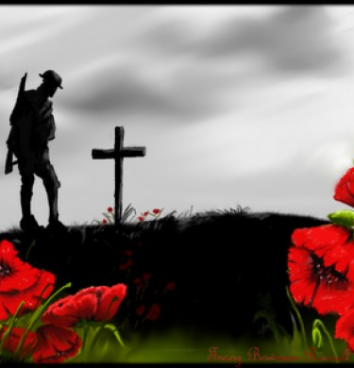
Wednesday 11th November
Lord God
On this day we hold before you those men and women who have died in active service: in World War One and Two, Iraq, Afghanistan and elsewhere. As we honour their courage and cherish their memory, may we put our faith in your future; for you are the source of life and hope, now and forever.
St Joseph- Pray for us

Slide 5
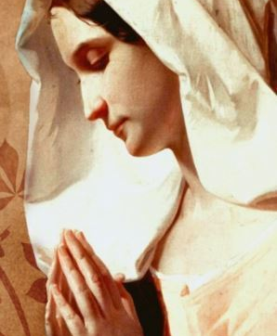
Thursday 12th November
Let us petition Mary and asks that she takes our prayers to God;
Hail Mary. Hail Mary, full of grace. The Lord is with thee. Blessed art thou amongst women, and blessed is the fruit of thy womb, Jesus. Holy Mary, Mother of God, pray for us sinners, now and at the hour of our death.
St Joseph- Pray for us

Slide 6
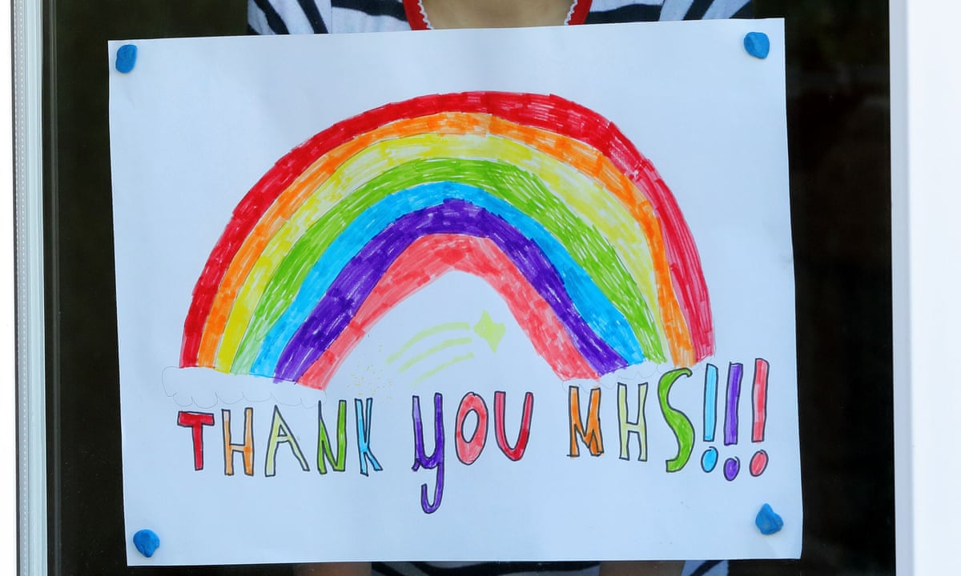
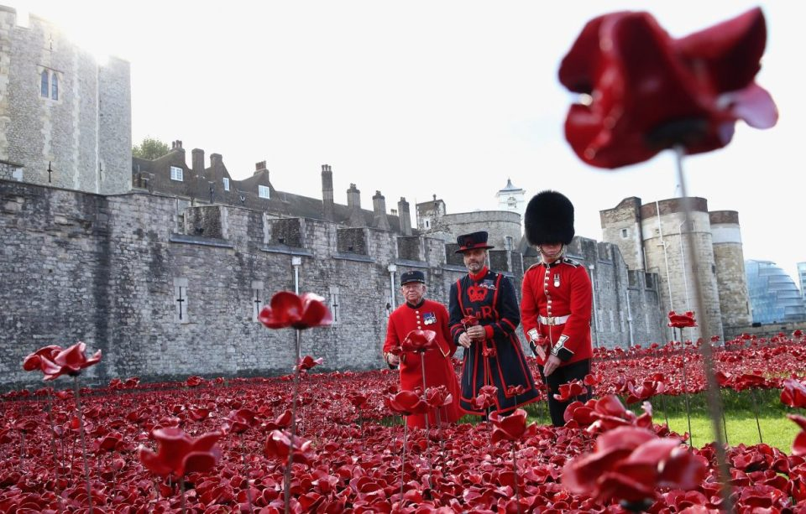
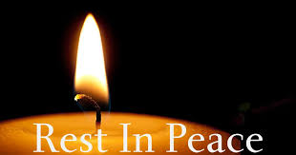
Friday 13th November
Lord,
As we come to the end of this week of remembrance, we ask you remember all those who have given their lives in the service of our county. Not only the service personnel in wars but also those key workers who have given their lives in this pandemic in the duty of helping others. May they all rest in eternal peace.
St Joseph- Pray for us

Slide 7
Final thought of the week.... Next week's theme: Youth

