Slide 1
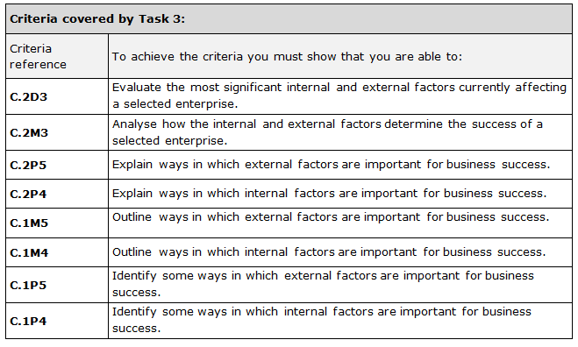
Title: Assignment 1: Task 3: Section 1
Internal & External Factors
LO: To investigate how internal and
External factors affect success or factors

Slide 2
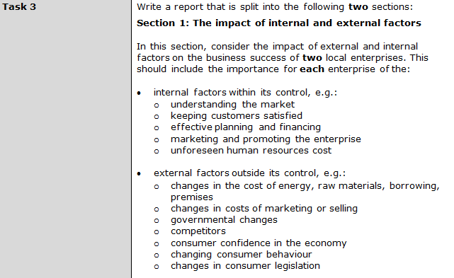

Slide 3
The success of Original Hair Studio is affected by internal factors like….
Understanding the market
Keeping customers satisfied
Effective planning and financing
Marketing and promotion
Unforeseen human resources costs
Use the table below to explain the internal factors effecting OHS. Try to analyse if they are successful at each one (it is OK to say they need to improve them too). Then try to add a short conclusion to evaluate which factors effect the business the most (and least).

Slide 4
Factor | Evidence from the webpage | Positive/negative/both
Understanding the market | The website seems mainly to focus on women as the target market. There are prices for Gents and Children but these are very small sections compared to services for women. Local competitors would be town centre salons like The Hair Lounge. Google maps shows 12 competitors in the area. The salon needs to have fair prices, but not be so cheap that customers think it lacks quality. A cut and finish starts at £39 at The Salon at Vida Loca this is £32. | They seem to be focused on the target market of women which means they can be experts in women’s styles which is good, but the bad thing is they will lose male customers if they don’t appeal to them. Prices seem a bit more expensive than competitors so this is positive as they make more per customer and they are trying to promote luxury. However, this could be negative because they might put people off who will go to a cheaper competitor.
Keeping customers satisfied | Use the Testimonials | Are customers satisfied in your opinion?
Effective planning and financing | The owner of the salon is Sandra Kotecha. She employs the staff and runs the business supervising a team of 14 in total. She also raised the finance to invest in the business. | Large team of expert staff. Sandra may struggle for finance. May need a bank loan or investors.
Marketing and promoting | The salon does not really do a lot of promotion. They have a loyalty scheme. If a customer makes 10 visits to the salon and collects 10 stamps they get 15% of any service on their next visit. | Is the Loyalty scheme good? Spend £390 15% = £5.85 11th cut costs £33.15
Human resources (staff) | The salon has a wide range of staff members from the salon director, style directors, senior stylists, assistants, a beauty therapist, trichologist and the receptionist. Style directors are self employed so the owner does not have to pay them or provide paid holidays etc. However other staff are employed and are entitled to a range of pay and benefits. | Specialists. Senior staff are self employed. High wage bill.

Slide 5
Carr’s Pasties success is affected by internal factors like….
Understanding the market
Keeping customers satisfied
Effective planning and financing
Marketing and promotion
Unforeseen human resources costs
Use the table below to explain the internal factors effecting Carrs. Try to analyse if they are successful at each one (it is OK to say they need to improve them too). Then try to add a short conclusion to evaluate which factors effect the business the most (and least).

Slide 6
Factor | Evidence from the webpage | Positive/negative/both
Understanding the market | Bolton NW of England Traditional | Popular pasties/Proud Only local, not national Limited product range
Keeping customers satisfied | Good Quality Taste Tests Reviews | +/- reviews? Do customers like them?
Effective planning and financing | Joe Carr – manages the factory 3 shops Market shop closed December 2018 | Use profit to expand to open shops across the North West He is good at managing money
Marketing and promoting | Webpage Bolton News Social media U-BOL Stadium | Good local promotion Could increase to cover NW
Human resources (staff) | 90 staff Well trained | Specialised staff- bakers/ shop assistants High wage bill (fixed costs) because they have lots of staff

