Slide 1
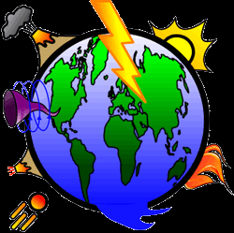
Geography
Learning at home
Year 8
Natural Hazard
Revision information booklet
A community of learners, believers and friends

Slide 2
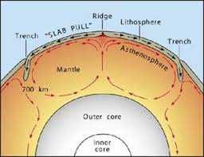
Inside the Earth
The Earth is made up of several layers – the inner and outer core, the mantle, and the crust. They each have different compositions and unique physical properties
The Lithosphere and Asthenosphere:
These two parts make up the upper mantle and are involved in tectonic activity.
Lithosphere:
This includes the crust and the top layer of the mantle, it is about 80-100km thick (thinner under the oceans). This part is broken up into tectonic plates which float on the asthenosphere below
Asthenosphere:
This is a denser, more mobile layer in the upper part of the mantle (100-300km deep). The temperature is much higher here so the rock is partially melted allowing plate movement
Continental Crust
Oceanic crust
Continental lithosphere
Oceanic lithosphere
Upper mantle
asthenosphere
The Crust:
Thinnest layer
Two types of crust:
Oceanic (ocean) – thin 5-8km and is denser (heavier) and made of basaltic rock
Continental (land) – 30 – 40km, however thickness varies, lighter as it’s made of granite rock
The Mantle:
Thickest layer – nearly 2,900km
Temperature ranges from 1000°C (near the crust) to 3,700°C (near the core)
It can be divided into two layers:
Upper mantle is mostly solid. It is slow moving
Lower mantle – solid, it gets hotter and denser with depth.
The Core:
Centre of the Earth
Very hot and dense
Two types:
Outer Core: Hot (4,500-5,000°C), made of iron and nickel
Inner core: Hot (6000°C), solid ball of iron and nickel
What drives movement in the mantle?
Convection currents are the driving force behind tectonic plate movement. These currents move in a circular motion.
Rock is heated in the lower mantle and rises
When it reaches the asthenosphere it cools and is forced sideways by the lithosphere above
It continues to cool and sinks back towards the core
This process continues as it’s reheated by the core

Slide 3
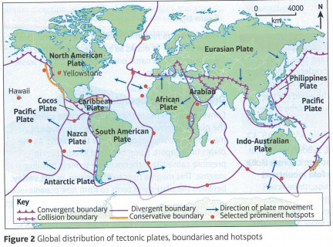
Tectonic plates
Distribution – earthquakes and volcanoes happen at plate boundaries, in linear line patterns and the majority are around the Pacific plate or Pacific ring of fire.
Tectonic plates are large areas of rock that make up the Earth’s crust. These are important because they float on the mantle below and are moved by the convection currents acting in the mantle.
The way these plates move are driven by the convection currents. This is turn gives us different types of plate boundaries which can lead to earthquakes, volcanoes etc.

Slide 4
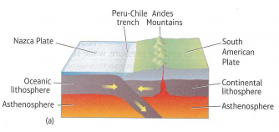
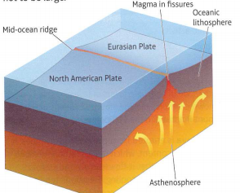
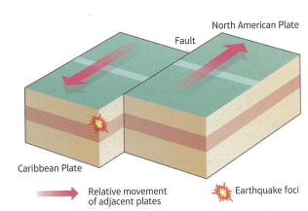
Types of Plate Boundaries
The different types of plate boundaries are all controlled by the convection currents in the mantle. Different boundaries give different features. Volcanoes and earthquakes tend to be found along plate boundaries.
Below are the 4 different types of plate boundaries
Boundary | Description | Features | Examples
Convergent or destrustritve | Convection currents in the mantle cause the plates to move towards each other. The ocean plate subducts beneath the continental plate as it is denser into the asthenosphere. As it subducts the increase in temperature due to friction and pressure force the curst to melt. This creates magma which can lead to a volcanic eruptions | Ocean trench Trench Composite volcano | Peru and Chile Trench Andes Mountains
Divergent or constructive | Convection currents cause the plates to move away from each other. This mainly occurs under the oceans. As the plates break apart the rising heat and reduction in pressure cause the asthenosphere to melt forming magma. The magma rises to fill the rift between the two plates creating new crust. Where the magma breaks through a shield volcano is formed. Earthquakes are also found here | Shield volcano Rift valley | Iceland-Eurasion plate Mid-Atlantic ridge
Conservative | Convection currents cause these plates to slide past each other. The plates can move in opposite directions or in the same direction but at different speeds. In both examples, the plates tend to get stuck, increasing the tension and pressure. The pressure builds until one plate jerks and causes an earthquake. | Fault lines | San-Andreas fault (USA)

Slide 5
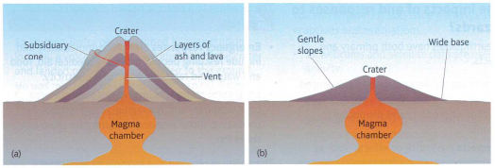
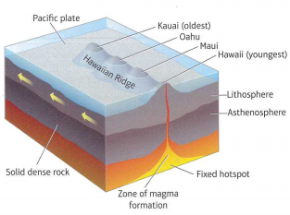
Volcano types
Volcanoes are formed when molten rock from a magma chamber inside the earth erupts through a vent in the lithosphere. Molten rock is called magma below the surface and lava when it erupts. As well as lava, volcanoes erupt steam, gas and ash from the crater. There are two main types of volcanoes:
Composite Volcano
Shield Volcano
These are formed along convergent plate boundaries
They are tall, steep sided, conical and have a narrow base.
They are made of alternating layers of ash and lava
Andesitic lava is erupted – it has a high silica content making it more viscous (so it runs like sticky toffee), it is unable to travel very far
Eruptions are infrequent but violent
Primary hazards include lava bombs and pyroclastic flows
Secondary hazards include lahars (mudflow)
These are formed along divergent plate boundaries and hotspots
They are gently sloping domes with a wide base.
They are made of lava only
Basaltic lava is erupted – low in silica so it is less viscous (so it runs like runny honey), it is able to travel long distances before cooling
Eruptions tend to be frequent and gentle
Whilst lava flows often destroy farm land and property they rarely kill people
Hotspots
These are volcanoes that are formed away from plate boundaries.
They are formed by a plume of superheated rock (not magma) rising slowing through the mantle.
Once it reaches the upper mantle it causes the asthenosphere and base of the lithosphere to melt. The magma produced then rises through weaknesses in the crust and erupts at the surface.
An example – Hawaii hotspot volcanoes

Slide 6
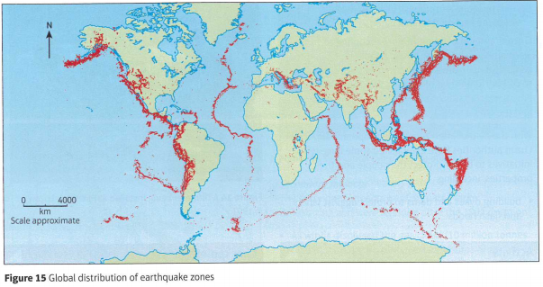
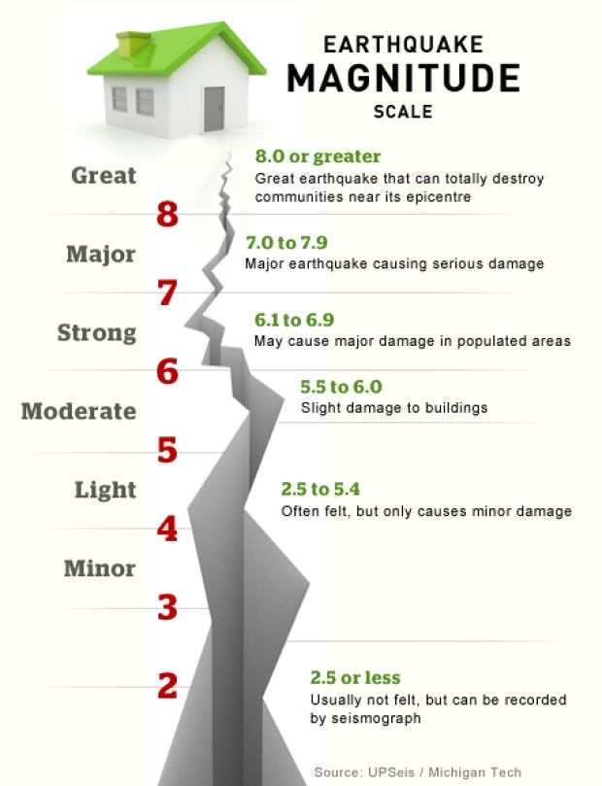
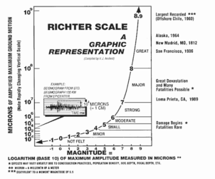
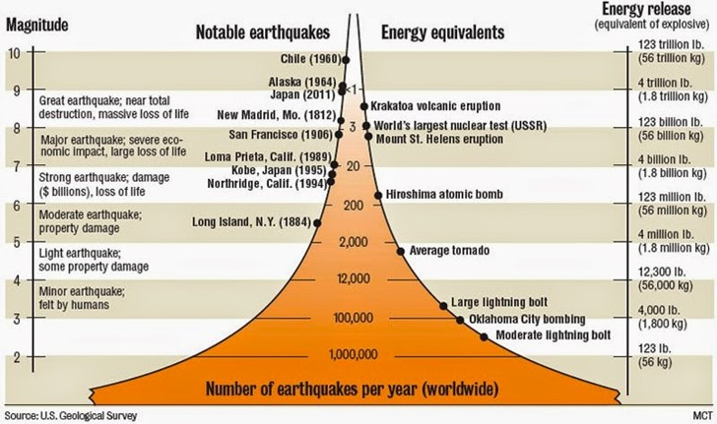
Earthquakes
Earthquakes are intense vibrations within the Earth’s crust that make the ground shake. They are sudden events.
90% of earthquakes occur where plates are colliding at convergent plate boundaries.
Energy builds up until the rock fractures along a fault, and the energy is released in an earthquake. The point of rupture is called the focus. Shockwaves or seismic waves radiate out from this point on the ground surface (epicentre). These make the ground shake.
Earthquakes can also occur along conservative and divergent plate boundaries. They are caused as the plate moves and gets stuck.
The scale of the event in terms of energy, the area affected and how long it lasts
The density of human settlements in an area
The time of day/week – there are more casualties if people are inside buildings
The amount of damage caused by earthquakes depends on
The level of development
The degree to which the country and people are prepared
The depth of the focus – shallow earthquakes can be more deadly than deep ones
How are earthquakes measured?
The size of an earthquake is recorded using a seismometer. The magnitude (size) is given according to the Richter scale which gives a value between 1 – 10.
The scale is logarithmic – meaning an earthquake measured at a 7 is 10x more powerful than an earthquake measured at 6 and 100x more powerful than 5.
Another scale is the Moment Magnitude Scale (Mw) is frequently used.
Similar to the Richter scale
But works over a wider range of earthquakes and is more accurate

Slide 7
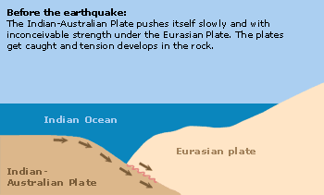
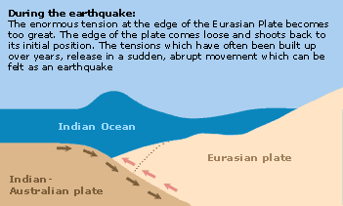
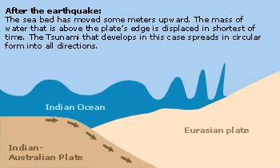
Earthquakes and Tsunamis
Tsunamis are usually triggered by earthquakes and can therefore be defined as a secondary hazard.
Tsunamis are a series of giant ocean waves that can be up to 30m in height
Formation of Tsunamis
Tsunamis are caused by earthquakes at sea
A Tsunami forms when energy from an earthquake vertically jolts the seabed by several meters, displacing the ocean above
Large waves begin moving through the ocean, away from the earthquakes epicentre
In deep water, the tsunami moves at great speeds. When it reaches shallow water near coastal areas the tsunami slows but increases in height
Before a tsunami hits land, the sea looks like it is retreating exposing hundreds of metres of beach and seabed
Tsunami waves hit shorelines in intervals causing widespread destructions

Slide 8
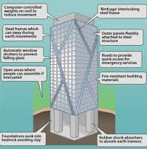
Preparing for Tectonic Hazards
Impacts – Primary impacts are the immediate damage caused by an earthquake, such as injury or loss of life. Secondary impacts are the ‘knock on’ effects from primary impacts such as shortage of clean water, diseases spreading
Response – Emergency responses take place immediately after the event such as rescue teams. Long term responses include restoring the area back to normal and managing the area by predicting, protecting and preparing for future hazards. The ability to respond relies on the countries wealth (economic development)
Prediction | Method | Description | For?
 | Seismometer | This measures sensitive movements from the earth. It picks up foreshocks before a major earthquake and earthquakes occurring before a volcanic eruption. | Earthquakes Volcanoes
 | Hazard Map | This can be made to show local people areas that are the most vulnerable. However, this can be difficult if earthquakes and volcanic eruptions happen quickly | Earthquakes Volcanoes
 | Satellite monitoring | Satellites can measure changes in gas emissions, melting of snow on volcano mountains, bulging of magma chambers | Volcanoes
 | Tiltmeters | These can be installed on volcanoes to measure ground or rock deformation | Volcanoes
Preparation | Hazard proofing homes | Earthquake proof buildings can be built as most deaths are caused by falling buildings. | Earthquakes
 | Education | Government agencies, schools and councils can educate locals about the hazards so that they can be prepared for the hazard and its effects, this can include: earthquake drills, evacuation drills. Leaflets ensuring people know what to do | Earthquake Volcanoes
 | Emergency Services | These groups can prepare to respond to a hazard with food, water, shelter and medical aid. Organise search and rescue teams and communicate so that areas that need help the most get it. | Earthquake Volcano
Protecting infrastructure from tectonic hazards
Infrastructure can be built to protect people from buildings collapsing through design.
The image to the left shows an earthquake proof building
Hazard proofing homes:
Remove heavy items from the walls
Secure chimneys with metal brackets
Fasten bookshelves and cabinets with L-shaped brackets
Bold the house to its concrete foundation to prevent it from slipping off
Strap heaters and boilers to the walls to prevent them falling
Learn how to turn the gas, water and electrics off
Use metal connectors to strengthen joints in the house
Use plywood to strengthen walls and ceilings

Slide 9
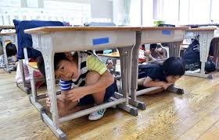
Case Study: Tohoku Earthquake, Japan (2011)
At 2.47pm on 11th March 2011 and earthquake (magnitude of 9) stuck Japan and triggered a tsunami. It occurred on a convergent plate boundary
667-1,479 deaths
The Tsunami destroyed 127,000 buildings, damaged 2,000 roads, 56 bridges and 26 rail lines along the east coast
Damaged in excess of US$300 billion was caused
Deaths caused by buildings collapsing
Damage to roads and railways
Impacts
The Tsunami caused over 17,000 deaths and 5,000 injuries
Electric power, water and sewage systems were disrupted
Fukishima dam burst, cutting power to the nuclear power plant
Tokyo suffered from liquefaction (ground turned to liquid), impacting 1000 buildings
Warnings | Short-term Relief | Long-term Relief
Advanced warning of the earthquake and Tsunami allowed people to get outside or reach higher ground The Pacific Tsunami warning centre warned coastal areas in Japan and other areas around the pacific Further 140,000 people evacuated from a 20km radius around the Fukushima power plant | Rescue workers and the Japanese army were dispatched to help deal with the crisis Government requested International Aid Australia, China, NZ, India, South Korea and USA all sent search teams Red Cross, Red Crescent and NGOs all provided support such as shelters | Ten’s of thousands of Prefabricated housing was set up in Sendai Honshu’s transportation & communication services were partially restored In 2012 – the government set up an Agency to rebuild the Tohoku area, reported to take 10 years By 2015 it was reported that the debris from the disaster had been removed
Reducing the impact
Earthquakes cannot be predicted. Therefore, emergency services are being trained to be more effective, schools, businesses and organisations practise drills: 1st September each year is a National Disaster Prevention Day. New buildings are built according to strict building codes to ensure they are able to stay up during an earthquake and older buildings are being retrofitted to be stronger

Slide 10
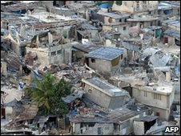
Case Study: Haiti Earthquake (2010)
At 4.53pm on 12th January 2010 an earthquake (magnitude of 7) stuck Haiti. It occurred along a conservative plate boundary
Estimated at 316,000 deaths and 300,000 injured
Airport control tower collapsed so no flights could go
Looting and crime increased as the government and police collapsed
3 million were impacted by the earthquake, 1.5m were made homeless
Electric, water, sanitation and communications were badly disrupted or destroyed
8 hospitals collapsed or were damaged
Impacts
One prison collapsed, 4,000 inmates escaped
Factories closed and no tourists economic losses increased
Cholera spread through the camps
8 hospitals collapses or were damaged
19 million m³ of rubble and debris were created
5,000 schools were damaged or destroyed including 3 universities collapsed
Short-term Relief | Long-term Relief
Many countries sent search and rescue teams to help search for survivors Food, water, medical supplies were sent from the US and Dominican Republic US engineers and divers cleared the port so aid could be unloaded UN and US troops provided security when distributing the aid The UK raised £100 million, this provided emergency shelters, medication, bottled water and purification tablets and sanitation | The Government moved 235,000 people from Port-au-prince to less damaged cities Three quarters of the damaged buildings were inspected and repaired 200,000 people were paid or received food for public work such as clearing away the rubble Money was given by individuals and governments around the world (included €300 million Euros from the EU, $100 million from the USA, £20 million from the UK: The World Bank also cancelled Haiti’s debt repayments for 5 years
Reducing the impact
On rebuilding Haiti, the government want to rebuild buildings with more technical designs to withstand future earthquakes. A new building code will be priority as well as getting people out of high density slum housing into more stable housing off hillsides.

Slide 11
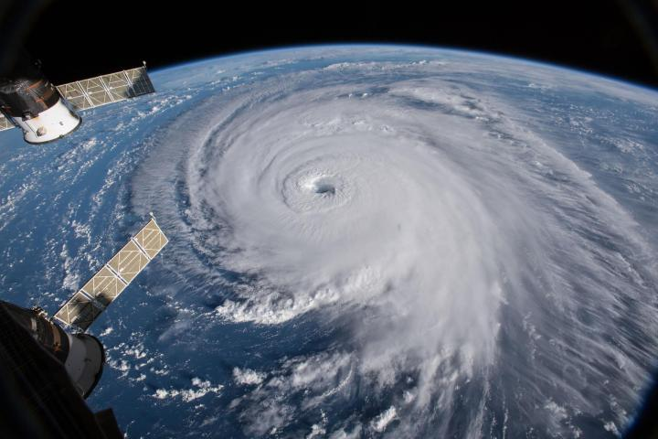
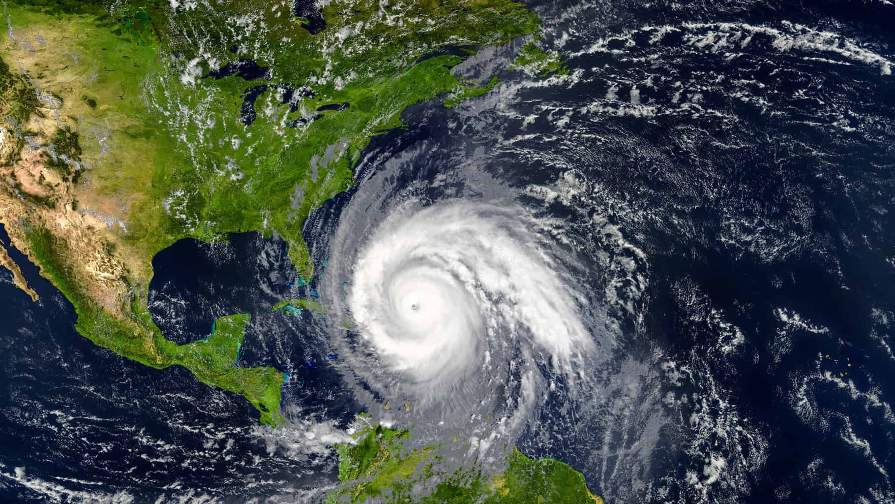
What is a tropical storm? A huge storm that develops in the tropics. USA and Caribbean are hurricanes. South-east Asia are cyclones and Japan and the Philippines are Typhoon. Where do tropical storms form? Form near the equator. A narrow band between 5-15 degrees north and south of the equator. High temperatures mean oceans are at least 27 degrees. How do tropical storms form? Hurricanes form over the warm ocean water of the tropics. At least 27 degrees. Rapid evaporation of the ocean water occurs creating warm moist air. The warm moist air rises and more cool air is the drawn in. The rising warm air cools and condenses forming huge storm clouds. These storm clouds will begin to rotate with the spin of the Earth (The Coriolis effect) forming a spinning storm. If there is enough warm water, the cycle will continue and the storm clouds and wind speeds will grow causing a hurricane to form.
Tropical storms where do they happen and how do they form?

Slide 12
Tropical storm case study
Place | Typhoon Haiyan 2013
Area | Philippines – SE Asia - LIC – low income country
Primary effects | 6300 people killed 600,000 displaced 90% of the main city destroyed 30,000 fishing boats destroyed
Secondary effects | 14 million people homeless and affected 4 million people lost their jobs and money Flooding and landslides cut off power, polluted waters and blocked roads for weeks and months.
Immediate responses | International aid from the UK and the USA came quickly such as food, water and tents. USA aircrafts aided in searching and rescuing people French and Belgium field hospitals set up
Long term responses | UN and other countries donated money to help rebuild Cash for work programmes – paid people to help clean up Oxfam helped replace fishing boats and create jobs.

Slide 13
How can we reduce the effects of tropical storms?
Monitoring and Prediction | Protection | Planning
Satellite images monitor ocean conditions and try to predict when and where a hurricane will form. Hurricane watch – warns hurricane conditions are likely. Hurricane warnings – issued so people can evacuate | Windows and doors strengthen and reinforced Storm drains to remove flood waters Houses built on stilts to reduce flood risk Sea walls built to reduce storm surges along the coast | Raising community awareness so people know the dangers and how to help save themselves Planned evacuation routes and strategies. Emergency service plans Stocks and supplies ready such as food, water and medicine.

