Slide 1
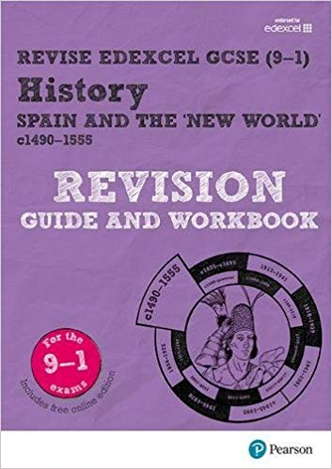
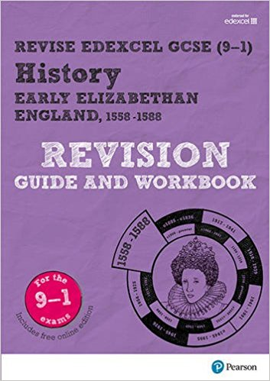
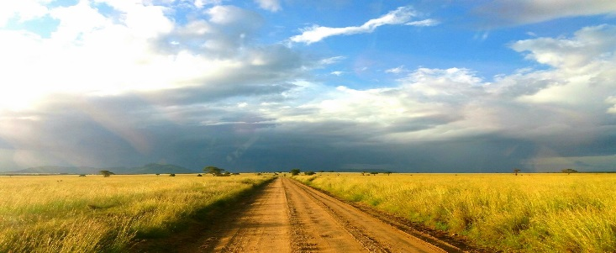
Don’t forget to use your revision book…it will help you!
Also, refer to your key work sheet – and build up those connections!
Paper 2: Spain & the ‘New World’ combined with Early Elizabethan England Exam date: Tuesday 19th March 2019 – afternoon paper: 1 hour 45 min 32 marks for Spain & 32 marks for Elizabeth – you are advised to spend 50 min on each section
Q1 Spain | Explain 2 consequences of … This means that you must give an explanation of why something happened as a result of something else – use conjunctions like: as a result of…, this meant that …, this allowed…, this led to …, (8 marks – 4 for each consequence)
Q2 Spain | Analytical narrative This question will ask you to ‘write a narrative account analysing…’ a narrative account means you will have to explain how events led to an outcome. (8 marks)
Q3 Spain | Explain the importance of… This question provides three statements about the importance of events and developments, and asks you to pick two of them and explain why they were important. (16 marks – 8 for each importance)
Q5a Liz | Describe two features of … You will need to ‘Describe two features of …’. A feature is something distinctive or a characteristic. (4 marks -2 marks for each feature you describe).
Q5b Liz | Explaining why … Explain why mean to explain CAUSATION: explain why something happened.
Q5c choice (ci/cii) Liz | How far do you agree (statement) – you have the choice of 2 questions For this question you will need to show you can analyse a statement. The statement will always give a judgement on something. You decide whether you agree or not (try to go for a balanced essay) using precise, contextual knowledge to back up you judgements. SPaG In the essay question you can gain up to 4 marks for your spelling, punctuation and grammar and your use of specialist terms, remember to use as much specialist terminology as you can.
Make it count…you’ve work hard for this!

Slide 3
Challenge yourself
Well done?
Here are more Q5as you could practice and develop yourself.
Describe two features of the religious settlement. | Describe two features of the impact of religious settlement. | Describe two features of the Dutch Revolt. | Describe two features of Mary, Queen of Scots’ claim to the throne.
Describe two features of the revolt of the Northern Earls. | Describe two features of the Throckmorton Plot. | Describe two features of the plot against Elizabeth in the years 1571 -86 | Describe two features of the execution of Mary, Queen of Scots’.
Describe two features of Elizabeth’s foreign policy aims. | Describe two features of the voyages by Sir Francis Drake. | Describe two features of Elizabeth’s support for the Dutch Protestants. | Describe two features of Anglo-Spanish relations after 1584.
Describe two features of Elizabeth’s involvement in the Netherland 1585 - 88 | Describe two features of the Spanish Armada. | Describe two features of Elizabethan education. | Describe two features of Elizabethan leisure.
Describe two features of poverty in Elizabethan England. | Describe two features of the changes made in the countryside in Elizabethan England. | Describe two features of the system of poor relief that were new. | Describe two features of Raleigh’s attempts to colonize Virginia.

Slide 4
Challenge yourself
Here are more Q5bs you could practice and develop yourself.
Explain why Philip II challenged Elizabeth’s support for Protestant rebels in 1563 Trade embargoes The Dutch Revolt | Explain why Mary, Queen of Scots challenged Elizabeth’s right to throne Treaty of Edinburgh 1560 Mary’s arrival in England 1568 | Explain why there was rivalry between Elizabeth I and Mary, Queen of Scots Refusal to name her the heir Murder of Darnley | Explain why the Catholic threat against Elizabeth I increased after 1566 Revolt of the Northern Earls Catholic influence from abroad
Explain why the Northern Earls revolted against Elizabeth I Religious differences Political challenges | Explain the significance of the Papal Bull after 1570 Ridolfi Plot Throckmorton Plot | Explain the significance of the execution of Mary, Queen of Scots Sir Francis Walsingham Phillip fo Spain | Explain the aims of Elizabeth I’s foreign policy Sir Francis Drake The New World

Slide 5
Challenge yourself
Here are more Q5/6s you could practice and develop yourself.
Q6: Population growth was the main reason that vagabondage increased in Elizabethan England. How far do you agree? Explain your answer You may use the following in your answer. Sheep farming Rising prices You must also include information of your own | Q6: ‘Religion was Elizabeth’s main problem in the years 1558-69’. How far do you agree? Explain your answer You may use the following in your answer. The settlement of religion Mary, Queen of Scots’ arrival in England in 1568 You must also include information of your own | Q6: ‘The decline in Anglo- Spanish relations in the years 1569-85 was caused by Elizabeth I’. How far do you agree? Explain your answer You may use the following in your answer. Drakes voyages to the New World The Netherlands You must also include information of your own | Q6: ‘The main reason that voyages of exploration were undertaken during Elizabeth I’s reign was to increase England’s wealth’. How far do you agree? Explain your answer You may use the following in your answer. Anglo-Spanish relations Developing trade You must also include information of your own

Slide 6
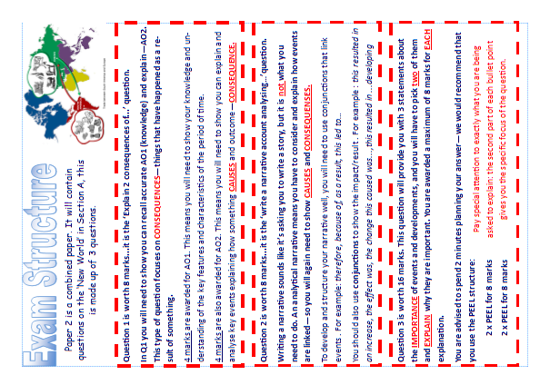

Slide 7
Challenge yourself
Here are more Q1 you could practice and develop yourself.
Explain two consequences of the establishment of the Spanish encomienda system in New Spain after the fall of the Aztec Empire. | Explain two consequences of Christopher Columbus’ return to Spain in 1493. | Explain two consequences of Balboa’s exploration of the Isthmus of Panama. | Explain two consequences of the Spanish conquest of Mexico.
Explain two consequences of the voyage of Magellan (1519-22). | Explain two consequences of Cortes’ decision to sink his ships in July 1519. | Explain two consequences of the encomienda system. | Explain two consequences of the conquest of Cuba.

Slide 8
Challenge yourself
Here are more Q2 you could practice and develop yourself.
Write a narrative account analysing the key events of 1511-14 that led to the conquest of Cuba. You may use the following in your answer: the death of Hatuey (1512) The massacre at Canano (1513) You must also use information of your own. | Write a narrative account analysing the key events of 1491-92 that led to Columbus sighting land in the New World in October 1492. You may use the following in your answer: Queen Isabella and King Ferdinand’s sponsorship Preventing mutiny on the voyage. You must also use information of your own. | Write a narrative account analysing the key events of 1484-92 that led to Columbus’s first voyage to the New World. You may use the following in your answer: You may use the following in your answer: Ferdinand and Isabella’s funding of Columbus’s expedition (1491) The conquest of Granada (1492) You must also use information of your own. | Write a narrative account analysing the key events that led to the Treaty of Tordesillas. You may use the following in your answer: You may use the following in your answer: Columbus discovery of the New World (1492) Portuguese claims to the New World (1493) You must also use information of your own.

Slide 9
Challenge yourself
Here are more Q3 you could practice and develop yourself.
Explain two of the following: The importance of the murder of Atahualpa (1533) for Spanish control of Peru The importance of the New Laws (1542) for governing the New World The importance of the discovery of silver in Potosi (1545) for the Spanish Empire. | Explain two of the following: The importance of Santa Domingo for Spanish control of the New World. The importance of monopoly of trade for Spanish control of the New World. The significance of Roman Catholic missionaries for the development of the New World in the years to 1512. | Explain two of the following: The importance of silver in Bolivia and Mexico for the Spanish government. The importance of Cortes’s reign as governor and captain-general of New Spain for the Aztecs. . The importance of Pizarro’s expedition of 1526-27 for the growth of the Spanish Empire. | Explain two of the following: The importance of the New Laws for the government of the Spanish Empire. The importance of the voyage of Magellan for the growth of the Spanish Empire. The importance of the capture of Tenochtitlan for the defeat of the Aztecs.

