Slide 1
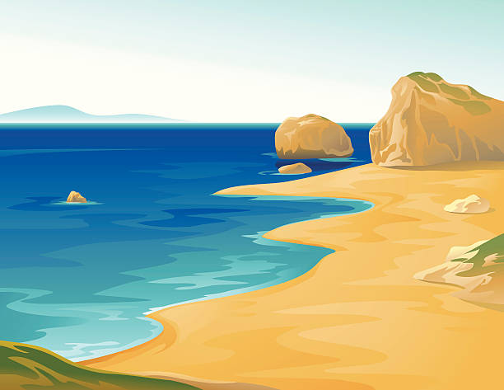
Geography
Learning at home
Year 7
Coasts
Revision information booklet
A community of learners, believers and friends

Slide 2
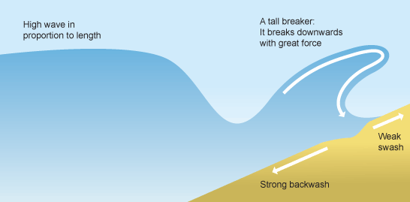
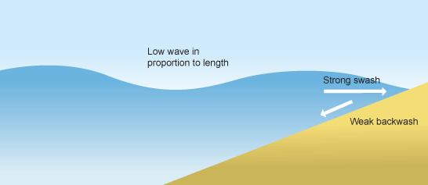
Types of waves
The size and energy of a wave is influenced by:
how long the wind has been blowing
the strength of the wind
how far the wave has travelled (the fetch)
Destructive
Destroys (takes beach away)
Strong backwash
Weak swash
Constructive
Creates (put sand on the beach)
Strong swash
Weak backwash

Slide 3
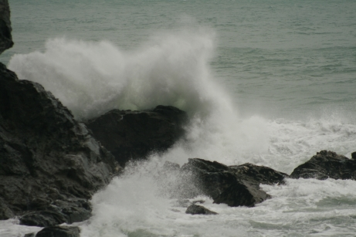
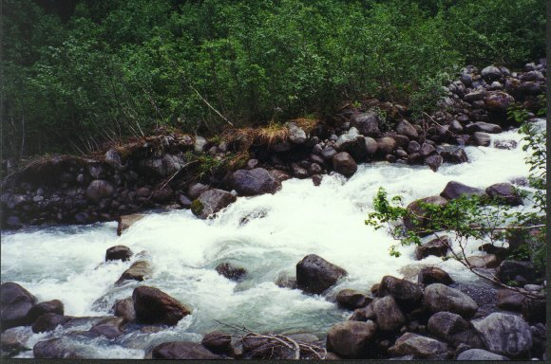
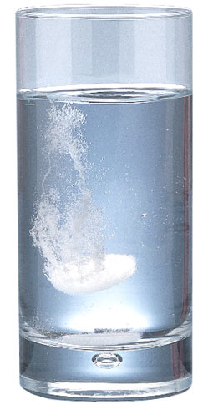
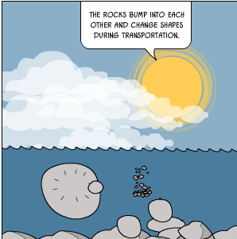
Coastal erosional processes
These processes erode material at the coast and in a river.
Corrasion/Abrasion
Eroded rocks rub against the channel/thrown against the cliff wearing it away.
Hydraulic action
The force of the water breaks rock particles away from the river channel/cliff.
Corrosion/Solution
River/sea dissolves some types of rock such as chalk and limestone.
Attrition
Eroded rocks picked up by the river/waves smash into each other.
Coastal erosion is affected by:
The point at which the wave breaks
Steepness of the wave.
Rock type and structure - (hard rock such as granite is far more resistant to erosion than soft rocks, such as clay).

Slide 4
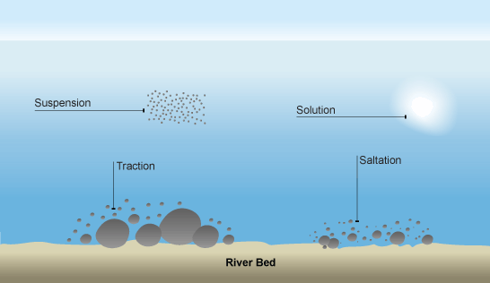
Coastal transportation processes
These processes move material at the coast and in a river.
Suspension
Small particles are carried along by the water.
Solution
Soluble materials dissolve in water and are carried along.
Traction
Large particles like boulders are pushed along the bottom of the river bed/sea by the force of the water.
Saltation
Pebble sized particles are bounced along the river bed/sea by the force of the water.

Slide 5
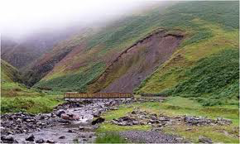
Cliff collapse
Marine processes- the sea erodes by erosional processes
Chemical weathering- includes solution where water reacts with calcium carbonate in rocks.
Why?
Sub-aerial processes such as weathering
Mechanical weathering- includes freeze thaw when water gets into cracks and expands and contracts.
Mass movement
Sliding- this is when large chunks of rock slide down the slope quickly without any warning. This can make is dangerous to walk along the beach.
Slumping- this is when the cliffs are made of clay. The clay becomes saturated during heavy rainfall and oozes down towards the sea.

Slide 6
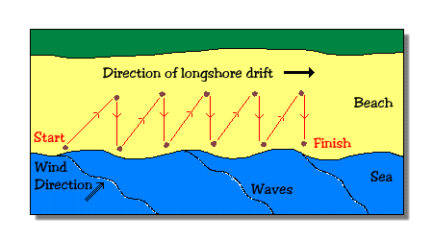
Coastal transportation processes- longshore drift
Erosion
Deposition
Swash
Backwash
1
Prevailing wind
Waves approach the beach at a slight angle influenced by the prevailing wind.
2
As the waves break the swash carried the material up the beach at the same angle.
3
As the swash dies away the backwash and any material carried by it falls straight back down the beach.
4
The means that material is moved along the beach in a zig-zag route.

Slide 7
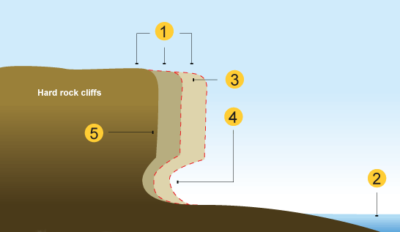
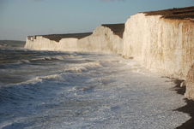
Coastal erosional landforms Wave cut notch and platform
Wave cut platform
Weather weakens the top of the cliff.
1
The sea attacks the base of the cliff forming a wave cut notch.
2
The notch increases in size causing the cliff to collapse.
3
The backwash carries the rubble back to the sea forming a wave cut platform.
4
The process repeats itself and the cliff continues to retreat.
5

Slide 8
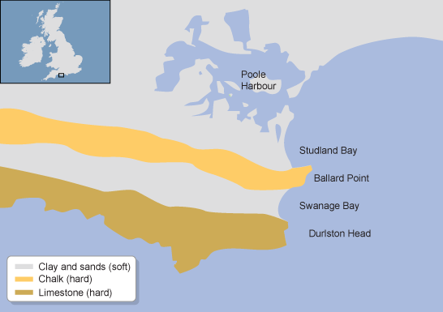
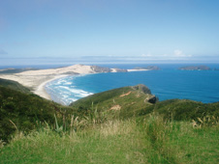
Coastal erosional landforms
Headland and bays
The sea attacks a discordant coasta line – an area of coast with alternating bands of hard and soft rock.
1
The soft rock (sand or clay) are eroding more quickly.
2
Headlands and bays
This creates a bay.
3
The hard rock is more resistant and takes longer to erode.
4
This leaves a headland jutting out to sea.
5

Slide 9
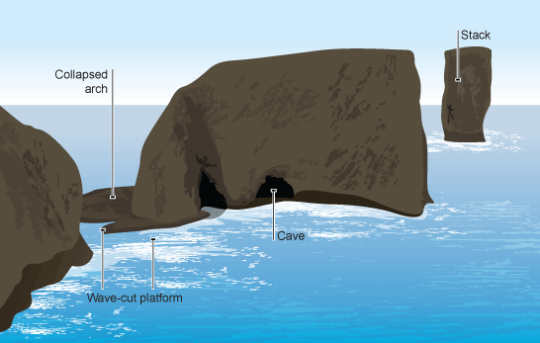
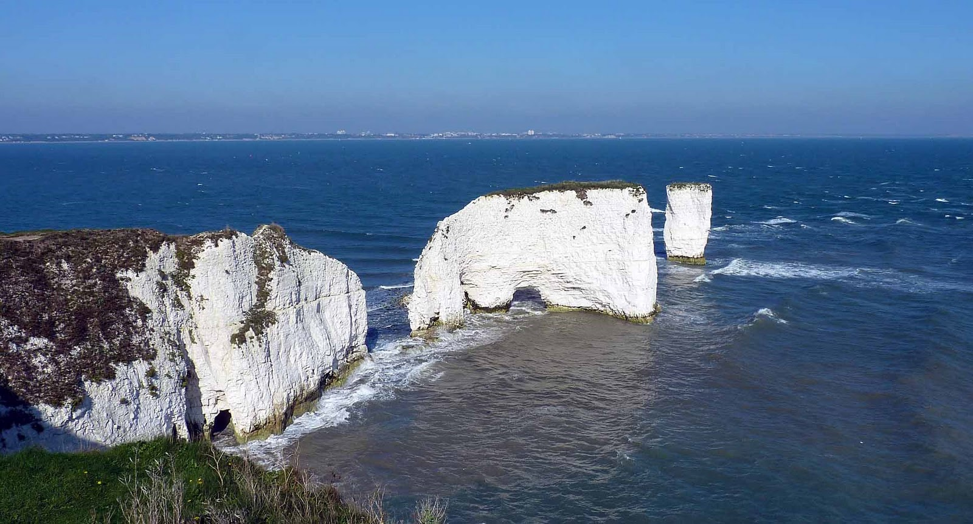
Coastal erosional landforms – coastal stack
Hydraulic action creates cracks in the headland.
1
Overtime the hydraulic action causes the crack to become deeper.
2
Headland erosion
This creates a cave. This may eventually break through.
3
This creates an arch. The arch will eventually become bigger and collapse.
4
This leaves a stack. Forces of erosion turn the stack into a stump.
5

Slide 10
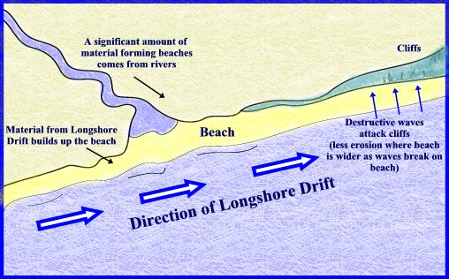
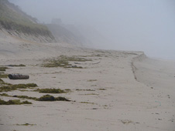
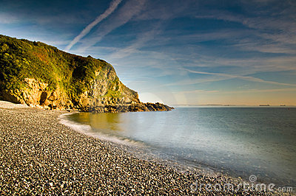
Coastal depositional landforms
Deposition occurs when the sea deposits material on the beach. This occurs because of a change in direction of the coastline, the waves lose energy, erosion is happening rapidly along the coast or the waves are constructive.
Beaches
Constructive waves help to build up beaches.
1
The soft rock (sand or clay) are eroding more quickly.
2
This creates a bay.
3
The hard rock is more resistant and takes longer to erode.
4

Slide 11
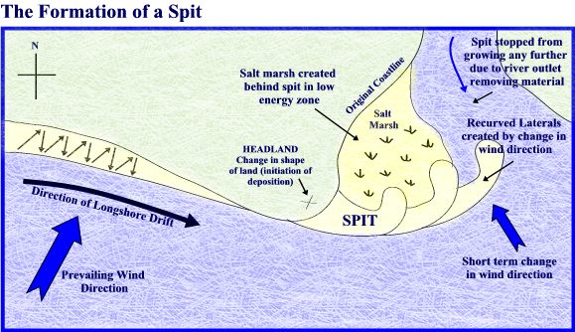
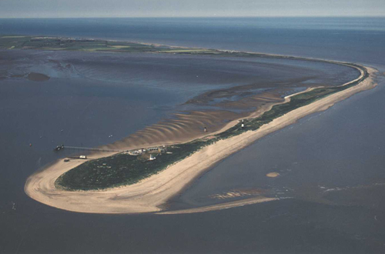
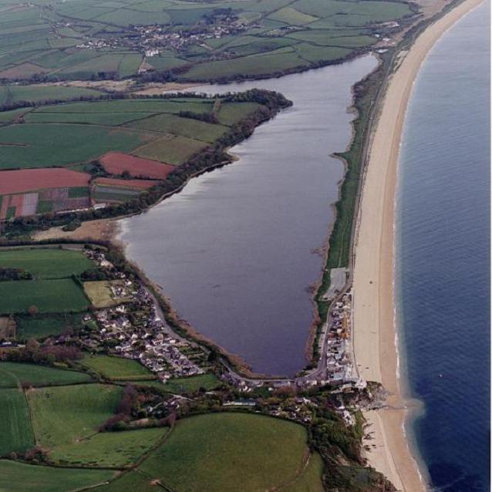
Coastal depositional landforms
Spits
Longshore drift moves material along the coastline.
1
A spit forms when the material is deposited.
2
Over time, the spit grows and develops a hook if wind direction changes further out.
3
Waves cannot get past a spit, which creates a sheltered area where silt is deposited and mud flats or salt marshes form.
Bars
4
A bar forms when a spit joins to two headlands.
5

Slide 12
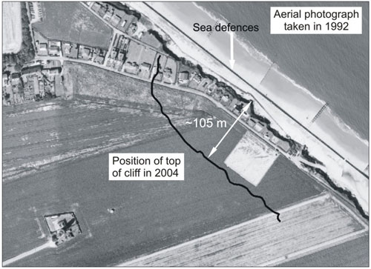
Coastal erosion case study
Happisburgh, Norfolk
Social impacts
People loose their homes if they fall into the sea.
Homes close to the cliff go down in value.
It is difficult and expensive to insure houses close to the cliff.
It is dangerous for people to walk along the coast as the cliff could collapse on them.
Conflict arises when the local government are not doing anything.
Case study facts
Homes on the cliff have been valued at £1.
Residents such as Di Wrightson have lost their businesses (she owns a guest house)
The main road has been lost.
24 homes have fallen into the sea.
By a rock for Happisburgh has been set up to raise money for sea defenses.
Agriculture and tourism contribute to the economy significantly.
The local government is pursuing a policy of managed retreat and so locals are having to fight for compensation-most are loosing everything.
The village has a strong community with a light house, church and shops which will all be lost
Economic impacts
Road and railways near the coast are under threat.
Tourists may not visit because of danger. This affects local businesses such as hotels and cafes.
The local economic value of the area decreases.
Environmental impacts
Cliff collapse makes the area look unattractive.
Cliff collapse causes wildlife habitats to be lost.
Green land and farm land is lost.

Slide 13
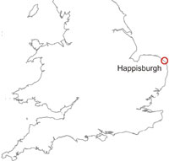
Coastal management case study
Happisburgh, Norfolk
Eroding 12metres
each year
By 2055, loss of 20 more properties
Loss of caravan park and farmland
-A small village with a pub , tea shop, lighthouse, church and homes
-850 population
-Mainly farmland
-No main roads
-Historic records indicate that over 250 m of land were lost between 1600 and 1850.
-The cliffs are soft clay, so erode very quickly. Weathering increases the erosion rate. The location of Happisburgh causes increasing problems with powerful waves from the North sea, which creates landslides from eroding the base of the cliff.
Management case study
Conflict from managed retreat
-To repair revetment cost £5 million, not cost effective
-Farmers lose land and livelihood
-Insurance companies won’t pay out
-Increasing protest from locals to central government but g’ment has said no.
-Defences would cost more than the land and homes are worth.
-Locals want compensation for the lack of management and for their homes collapsing into the sea.
-The historical lighthouse has had to be moved further back from the edge of the cliff.
-local campaign ‘buy a rock for Happisburgh’ to raise money for private defences.
Old Management (all 40 years old)
-Revetments – now damaged (from a storm) and not effective
-Groynes were placed to stop the rate of erosion, however they are not helping enough.
-Rock Armour – now little effectiveness
Increasing climate change and sea level rise are impacting and increasing erosion
Managed Retreat- monitor but no management

Slide 14
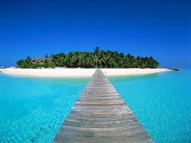
Case study: Rising sea levels in the Maldives
Social impacts
People will be forced to leave their homes and possibly become environmental refugees in neighboring countries. The total population is 400, 000.
The traditional way of life will be lost.
In Kandholhudhoo, a densely-populated island in the north of the Maldives, 60% of residents have volunteered to evacuate over the next 15 years.
Tidal surges flood the peoples homes every fortnight, and recently hammered a 3m (9.8ft) hole in their concrete flood defences.
The Maldives is a small country made up of a group of 1000 islands in the Indian Ocean. It is the lowest country in the world.
Tourism is very important providing 30% of the country’s GDP.
Global warming is blamed for the countries rising sea levels.
Political impacts
The whole country could disappear under water.
The government is looking to other countries for help- Japan paid 99% of the $63m bill for a 3 m high wall to built around the capital Male.
Politically it puts the government under a lot of pressure to sort it out. This in Feb 2012 the president was removed in what some have called a coup.
Environmental impacts
Coral reefs will die as they are bleached and the water gets deeper.
The ecosystem associated with the reefs will be lost.
Fish numbers are lowering as the ecosystem is being destroyed.
As the sea levels rise the islands become more vulnerable to events such as tsunamis and coastal flooding.
Economic impacts
Rising sea levels could put an end to the tourism industry.
As the coral reefs are affected by warming temperature so will diving tourism.
The fishing industry will slowly disappear- the majority of Maldivians rely on this for their income and farming is not possible.
Notes:
http://www.bbc.co.uk/education/clips/zj23cdm
http://news.bbc.co.uk/1/hi/world/south_asia/3930765.stm

Slide 15
Why protect the coast?
Loss of housing
Deaths
Social
Water supplies affected
Businesses on the edge
Loss of jobs
Damage to infrastructure
Economic
SSIs are threatened by erosion
Loss of tourism
Environmental
House prices fall
Floods damage farm land
Ecosystems are affected as sea water has high salt content

Slide 16
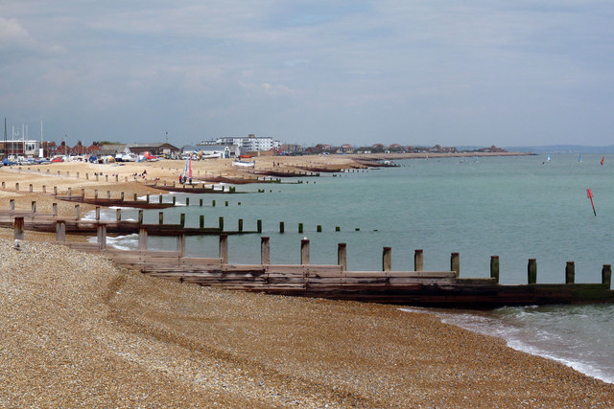
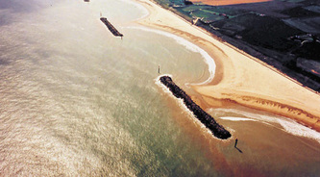
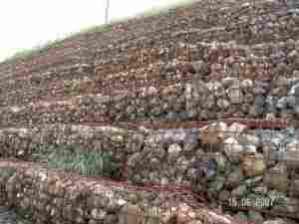
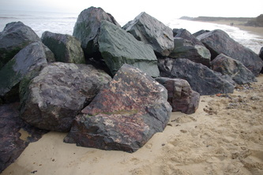
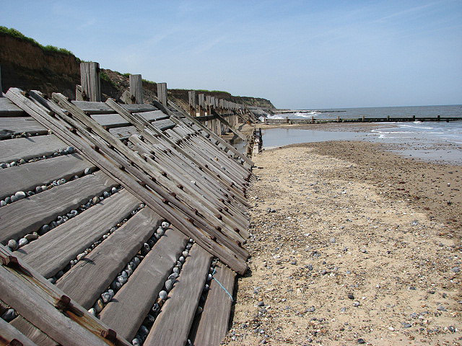
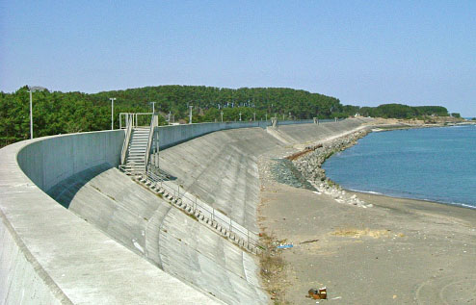
Coastal management
Groynes
Hard engineering
Build up the beach
Cheap
Easily destroyed
South beaches a deprived of sediment
Breakwater
Long-term
Beaches remain natural
Expensive
Unattractive
Gabions
Cheap
Efficient
Cages rust
Short lifespan
Rip-rap
The boulders are good at absorbing wave energy
Can easily be moved
They need to be replaced
Revetment
Sea wall
Expensive Creates a strong backwash which erodes under the barrier.
Prevents erosion.
Acts as a flood barrier
Expensive
Need maintaining
Creates a strong backwash
They absorb the wave energy

Slide 17
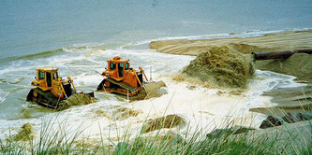
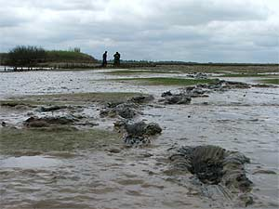
Coastal management
The purpose of soft engineering is to work with the natural processes of the coast.
Soft engineering
Beach replenishment
Creates wider beaches.
Protects from erosion and flooding
Looks natural
Beach replenishment
Adding sand and sediment to the beach from the sea floor.
Taking material can kill organisms
It is very expensive
It has to be repeated
Could affect tourism
Managed retreat
Managed retreat
Allowing a section of land to flood in order for plants to grow and therefore become a natural wave and flood barrier.
Creates new marshland habitats
Fairly cheap
Flooding is reduced
May cause conflict due to lost land.
Could affect peoples lives.

Slide 18
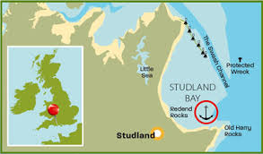
Case study: Coastal habitats Studland Bay Nature Reserve
Environmental characteristics
The nature reserve includes sand dunes and heath.
In this type of environment there is a unique ecosystem.
The area is internationally important and is a conservation area managed by the National Trust.
Species that inhabit the area
A special grass called marram grass grows on the sand and holds the dunes together. This allows more vegetation to develop creating a natural heath.
The low shrubs and small trees allow butterflies, insects, small animals and sea bird to survive.
It is the richest 1000 hectares for wildflowers in the country.
The area supports many rare bird such as the nightjar.
The sand lizard is one of the native species.
Where?
Studland Bay is located in Dorset and is very popular with tourists.
Up to 1.5 million people visit every year.
Most tourists arrive by car.
Strategies to ensure environmental conservation but sustainable use.
Vulnerable areas have been fenced off to limit access and damage.
Bird-watching hides and guided walks help visitors to enjoy the wildlife properly.
No driving on the beach and limited car parking spaces.
Specific paths have been created to keep visitors off the dunes.
Jet ski’s are not allowed to be launched from the beach and a 5mph speed limit to reduce the noise.
Dogs are not allowed on the beach in the Summer.
Tourists are focused into one area with the facilities such as a shop and toilets.
Information boards to educate visitors about the wildlife
Issues
The nature reserve and sand dune are a vulnerable environment. The vegetation takes many years to establish.
If the habitat is destroyed the eco-system will break down.
It is home to rare species of plants and birds and all 6 British reptiles.
The area attracts many tourists and gets very busy in the summer.
Visitors need somewhere to park and other facilities such as paths and toilets
Visitors bring problems such as litter.

