Slide 1
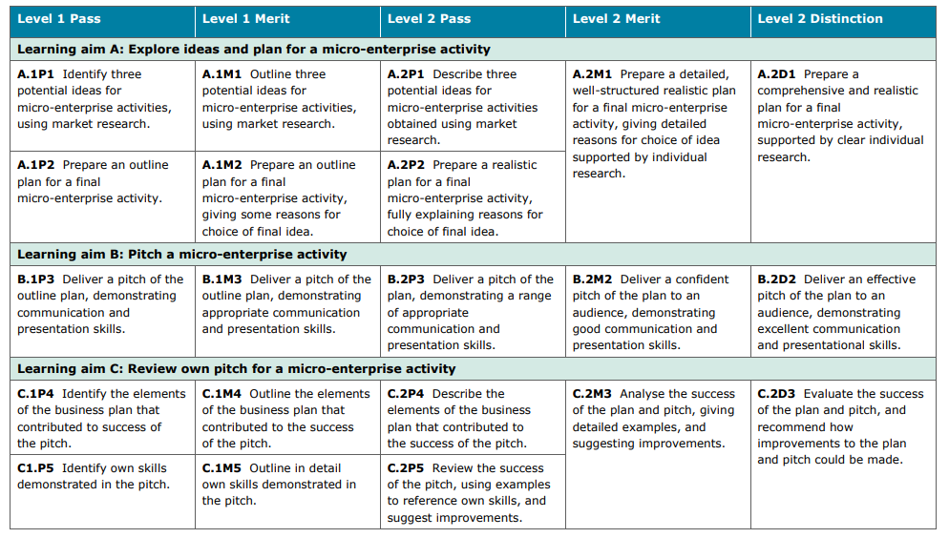

Slide 3
Business Plan: Name:
Section one
Introduction to Business Ideas
Idea 1
Research
Pros
Cons

Slide 4
Idea 2
Research
Pros
Cons

Slide 5
Idea 3
Research
Pros
Cons

Slide 6
Section Two
The Business
2.1 Your Business Name:
2.2 Strapline: ‘I’m Lovin’ it’
2.3 Business Overview:
Write a paragraph in detail to describe your business.
Include reasons why you chose this
Explain why you rejected your other ideas

Slide 7
Section Two
The Business
2.1 Your Business Name:
2.2 Strapline: ‘I’m Lovin’ it’
2.3 Business Overview:
2.4 Location/Premises
2.5 Products/Services
Features/Costs/USP
2.6 Business Aims
Financial Aims
Non-Financial Aims
Google……
Commercial property Bolton

Slide 8
2.4 Location/Premises
2.5 Products/Services
Features/Costs/USP
2.6 Business Aims
Financial Aims
Non-Financial Aims
Google……
Commercial property Bolton

Slide 9
Location &Property
I will locate my business in ………………….
The reasons I have chosen this location are……
The advantages of my location are……
(Does it have parking/loading bay?)
Available properties in this area are……….
This would cost………per month/year

Slide 10
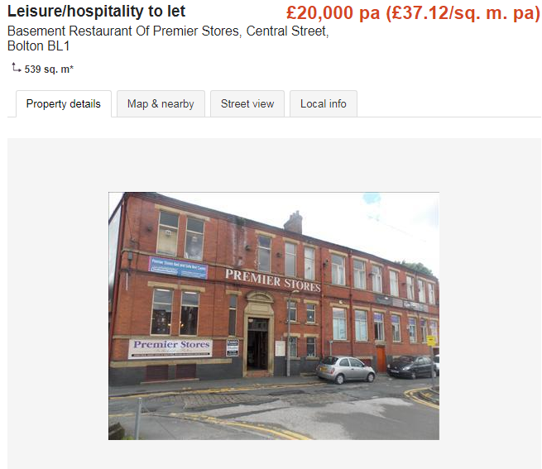
Location and Premises
Originally I wanted to set up my business in Lostock, however there is a lack of interesting commercial properties in Lostock.
I have found this premises located in the central Bolton which may be even better than Lostock as there will be more people passing the restaurant. That means I can get more potential customers, which can help me to increase my sales. It is also really close to the Victoria square meaning people will be able to find it easily.
It costs £20,000 per annum, which equals to £1,666 per month. This is not a lot, meaning I will have more money to invest in the renovation of the interior of the premises.
Before I found this location, I found the premises in the vaults. Unfortunately the vaults are really expensive (£95,000 pa) and there are already established competitors which will not be beneficial for a new business like mine. Therefore I decided to choose this location instead.
https://www.primelocation.com/to-rent/commercial/details/45182041?search_identifier=4ed88e41b9a6331fccd97cb124a16003#ZVZqSamK4Dk8ej9a.97

Slide 11
2.4 Location/Premises
2.5 Products/Services
Features/Costs/USP
2.6 Business Aims
Financial Aims
Non-Financial Aims

Slide 13
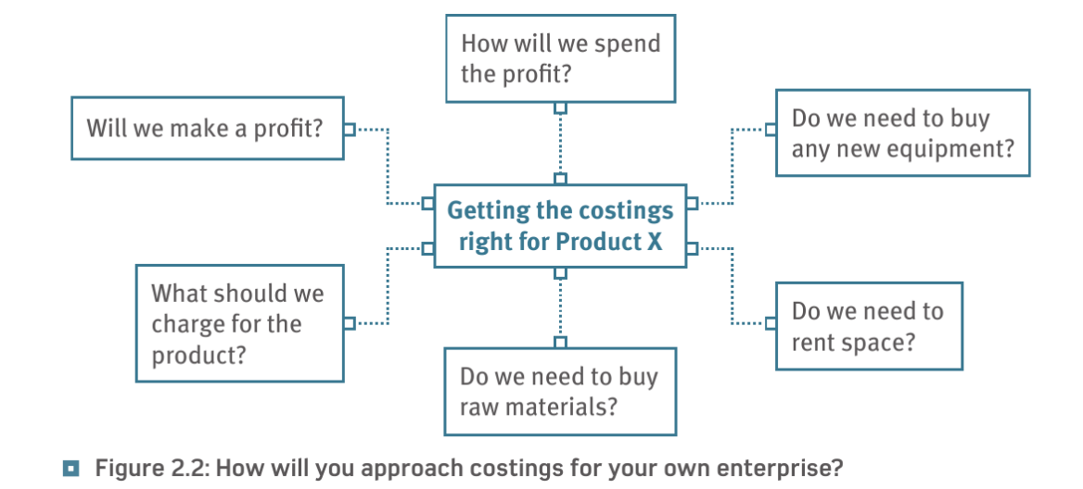
Consider:
START UP COSTS
RUNNING COSTS
FIXED COSTS
VARIABLE COSTS

Slide 14
Consider:
START UP COSTS
RUNNING COSTS
FIXED COSTS
VARIABLE COSTS
SELLING PRICE (s)
Justify your choice of:
Pricing Model
Cost-Plus Pricing - cost plus a percentage is added.
Competition based pricing – look at what competitors charge and set a similar price
Price Skimming – charge a high price and then drop it later.
Penetration pricing – charge a low price to start with and then increase it
(You can say why you rejected ideas too)

Slide 15
2.4 Location/Premises
2.5 Products/Services
Features/Costs/USP
2.6 Business Aims
Financial Aims
Non-Financial Aims

Slide 16
Aims & Objectives
Aims: the long-term visions or goals of a business.
Objectives: steps to help achieve the overall aims of a business.

Slide 17
Aim to survive.
Non-financial
aims
Financial
aims
Choose 3 aims
At least one must be from each group
Explain the aims of your enterprise
Aim to offer customer satisfaction.
Aim to keep within a budget.
Aim to maximise sales and revenue
Aim to be environmentally friendly
Aim to make a profit.
Aim to be socially aware.

Slide 18
Questionnaires

Slide 19
Section Three
The Market & Market Research
3.1 Who are your customers:
3.2 How will you sell your product?
3.3 Key findings from field research – customer questionnaires:
3.4 Target Market/Segments
How will you appeal to these customers?
How will you establish sales and maintain loyalty?

Slide 20
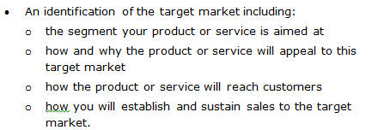
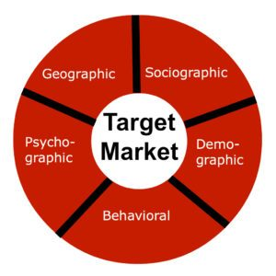
Activate

Slide 21
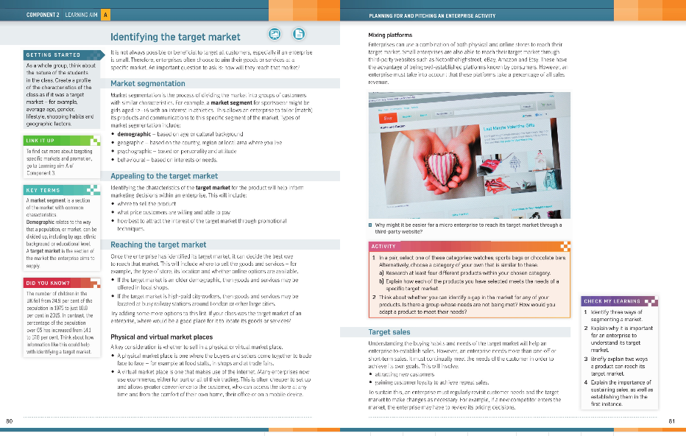
Demonstrate
P80-81 will help you with this task

Slide 22
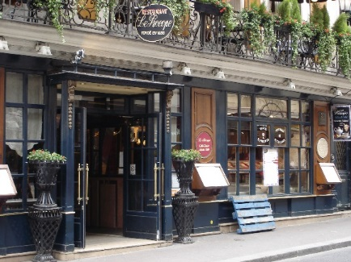
Target Market
My target market would be customers in Horwich as it is a fun café that anyone can come, however during school time children wouldn’t be able to come and adults would be at work, so my target market then would be elderly people as I could make deals for them like afternoon teas where they can relax an take there time. However I can also make it children friendly by making deals and making it fun for them which will make the adults come as well. Mainly my target market can be anyone from young people to old people. The area that my business is located in is Horwich with is a good place and people there have got money to spend in my business. I will most likely aim the local area of Horwich as I won’t be selling online however I will be delivering across Horwich. Customers won’t be able to see or chose the products they want so they would have to come and see what products my business does and would be able to place an order and we would delivery to them. As we know from the map we could see that Horwich was a wealthy place which means people will have to be in group B-C as my business isn’t too expensive and isn’t to cheap, however also my target would be C-D classes just for the people who would want to have a snack in the café as it is fairly cheap. Also customers would want good products as they would want to spend their money something that is worth it. My customers will have a special interest in cakes and food from around the world as it is a international cake and café shop.

Slide 23
Activate
Segment
Demographic-age/culture
Geographic-area
Psychographic-personality/attitude
Behavioural-interests/needs
Why will they like it?
How is it suited to them?
Physical market (shop)
Virtual market (on-line)
Mixed market (both)
How will you attract new customers?
How will you gain loyalty to maintain customers/get repeat sales?

Slide 24
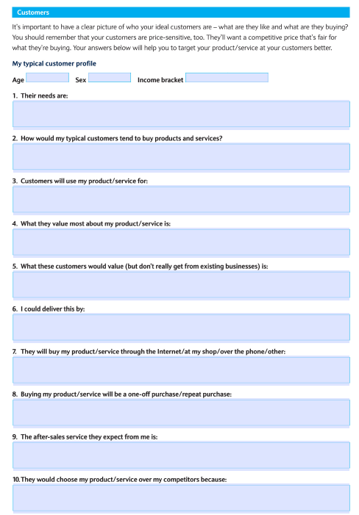

Slide 25
Section Four
Marketing strategy
Marketing Method | Reasons for Choice/How effective will it be? | Cost
Social Media
Flyers
Bolton News
Ambient Promotion
Direct Marketing (e.mail/post)
Web page
Radio
 |  | Total Cost =
Create an example of a Promotional Material if you have time

Slide 26
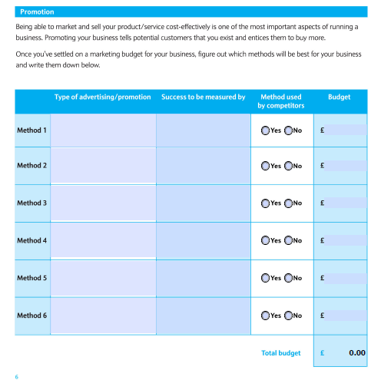

Slide 27
Activate

Slide 28
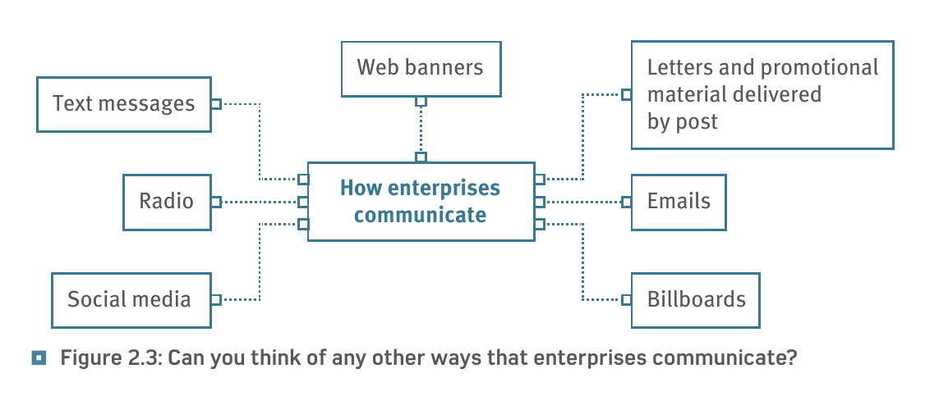
Methods of Communication
Which methods will you use?
Why do they suit your target market?
Are they cost effective?

Slide 29
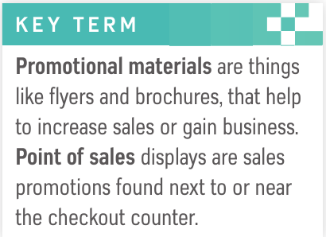
Promotional Methods
Explain those you will you use:
Print: Leaflets, flyers, brochures, magazines, newspapers, vouchers
Ambient: Posters, billboards, vehicles
Digital: Social Media, website, text, e.mail
Moving images/video: TV, cinema, You Tube e.t.c
Audio: radio, Spotify e.t.c
Challenge
If you can explain if your choice of promotions are cost effective.
Give reasons why you neglected some methods.

Slide 30
Section Five
Competitors
Name, location and business size | Product/service | Prices | Strengths | Weaknesses

Slide 31
Explain the current competition:
Who are your main local competitors?
How are they similar/different?
What do you need to be aware of?
Are they a threat? Can you compete?

Slide 32
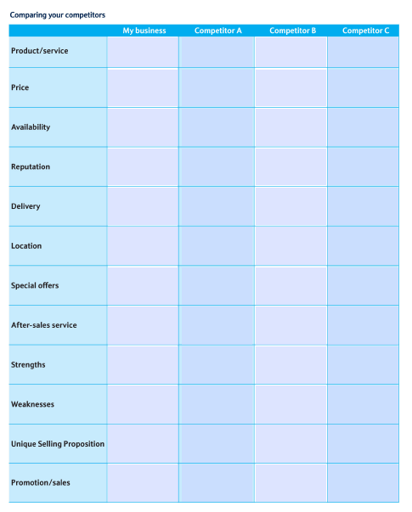
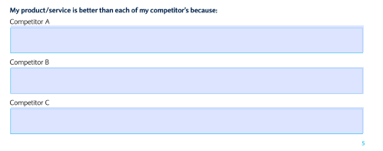

Slide 33
Section Six
Operations and logistics
6.1 Production:
6.2 Timeline
6.3 Payment methods and terms:
6.4 Equipment
Item Required | New | Second hand | Purchased from | Cost

Slide 34
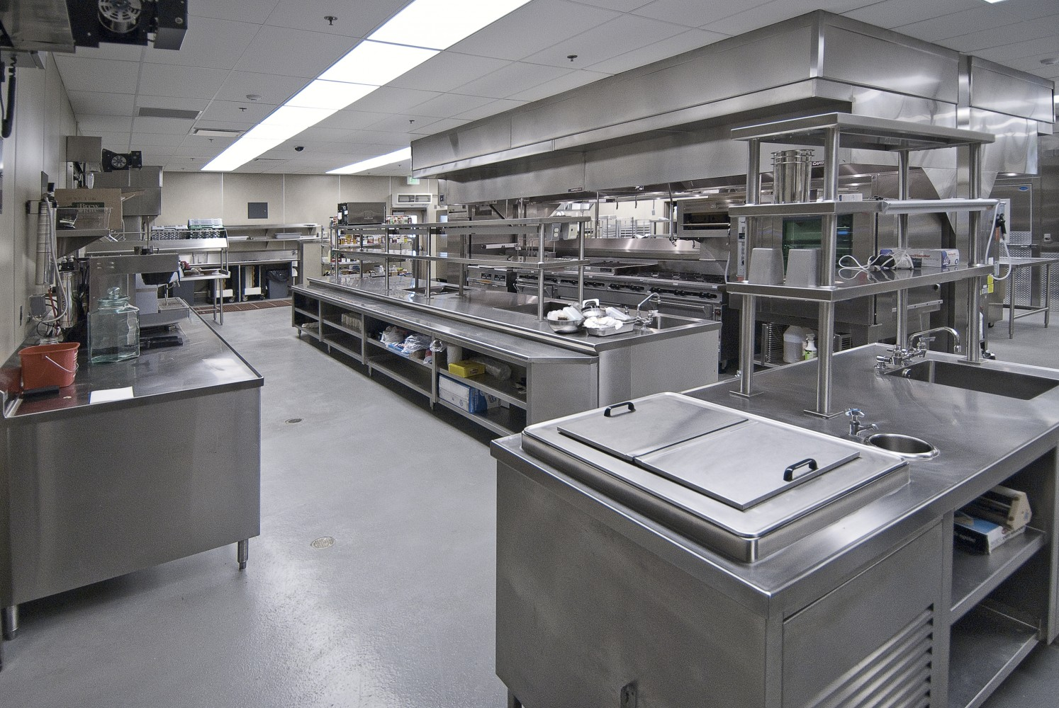
List of resources
Make a shopping list of all the resources you would need for your enterprise idea
Pans
Dishes
Tables
Chairs
Silverware
Glassware
Napkins
Flooring
Paints
Oven
Fridge
Freezer
Shelves
Alcohol shelves
Radio
Fire extinguisher
Blender
Bar
Bar stools
Counter tops

Slide 35
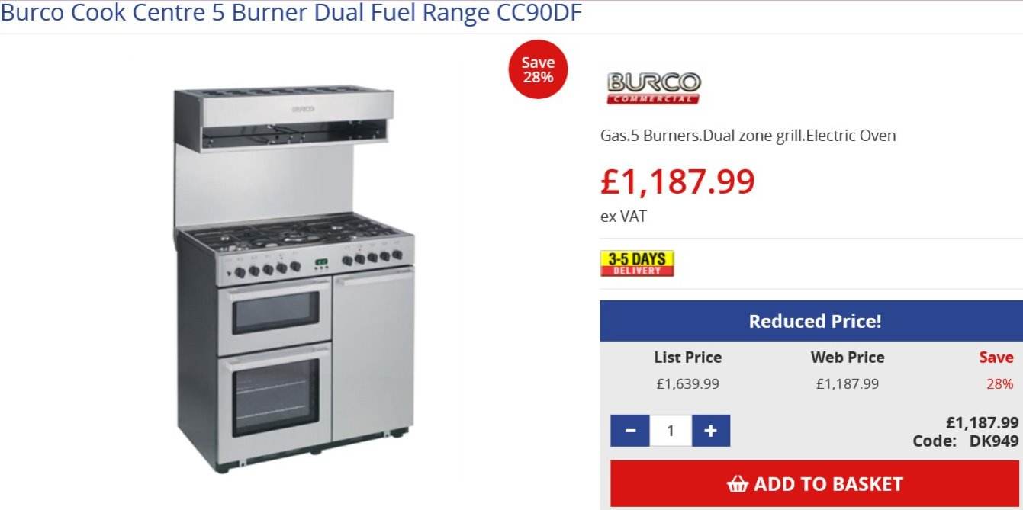
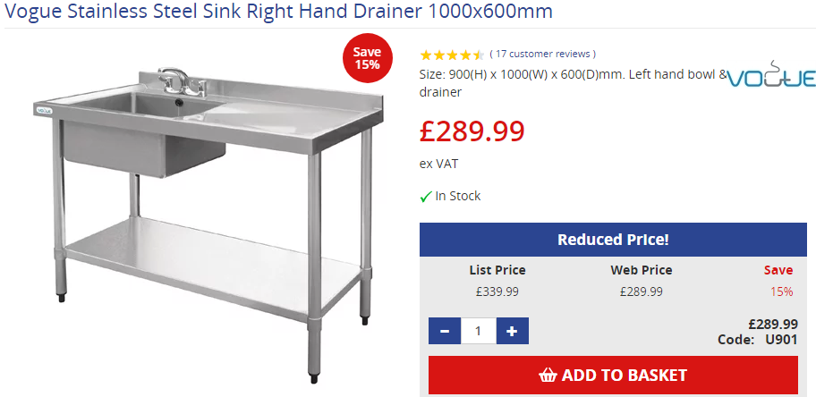
Kitchen
https://www.nisbets.co.uk/burco-cook-centre-5-burner-dual-fuel-range/dk949
https://www.nisbets.co.uk/vogue-stainless-steel-sink-left-hand-bowl-1000x600mm/u901

Slide 36
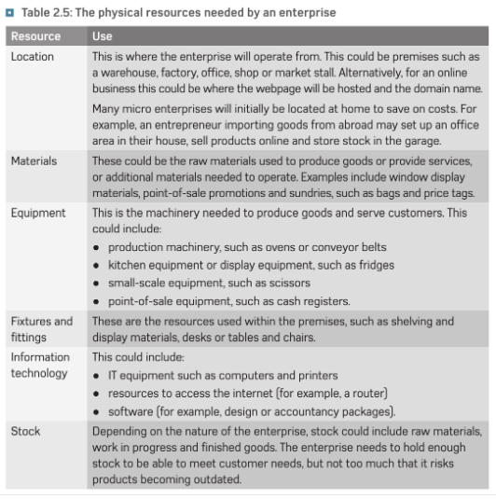
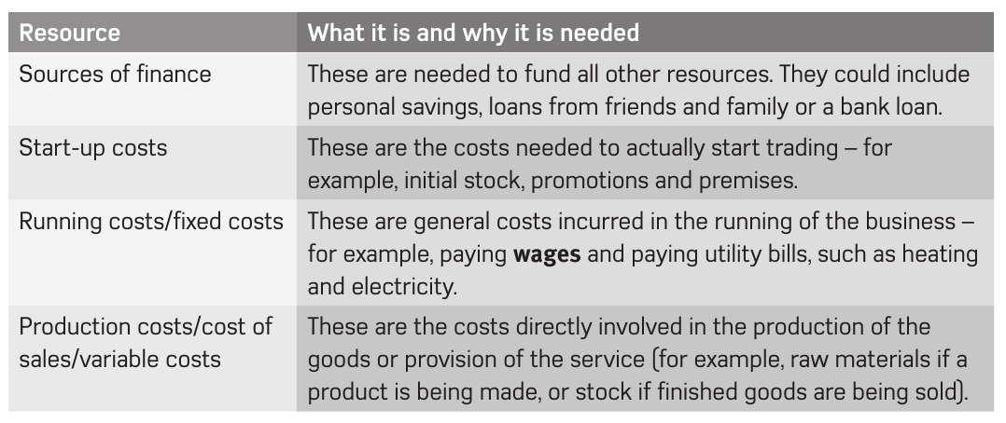
Human:
Micro enterprise: 1-10 employees
Small: 11-49 employees
Skills & Qualifications
Physical:
Location
Materials
Equipment
Fixtures & Fittings
ICT
Stock
Financial:
Start Up
Running
Fixed
Variable
Cost of Sales

Slide 37
Section Seven Costs and pricing strategy
7.1 Costs
Costs | Where will you obtain these | Estimated Costs
Physical resources
Financial Resources
Human Resources

Slide 38
Section Seven
Costs and pricing strategy
7.2 Start-up Costs & Pricing
Item | Cost
 | Total Cost =
Item | Price | Quantity | Total

Slide 39
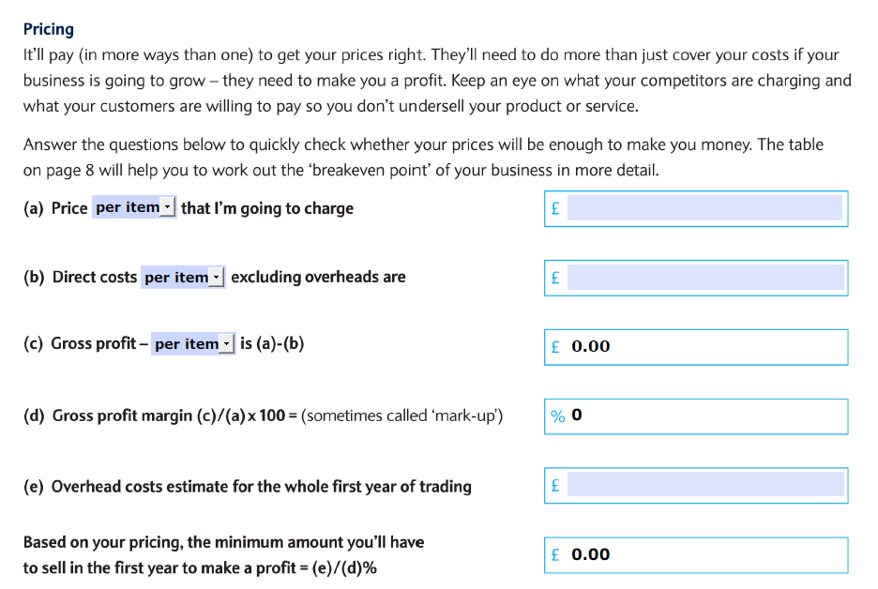

Slide 40
Section Seven
Costs and pricing strategy
Physical resources
Financial Resources
Human Resources
7.3 Running Costs
Running Cost | Cost per unit | Quantity | Total
 |  | Total Cost =
7.3 Break even

Slide 41
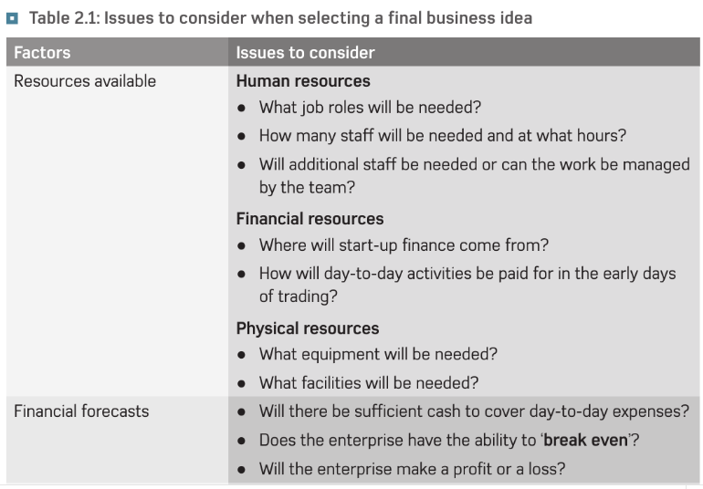

Slide 42
Start-up costs
Item | Equation | Price
Tables | £165 x 7 | £1,155
Chairs | £37 x 36 | £1,332
Oven | £1,187.99 x 2 | £2,379.98
Sink | £289.99 x 2 | £579.98
Fridge | £1,078 x 1 | £1,078
Plate sets | £35 x 10 | £350
Dip trays | £6.99 x 10 | £69.9
Total |  | £6944.86
Running (operating) costs | Price
Electricity | £2,500 per month
Water | £2,500 per month
Stock | £1,500 per month
Phone | £28.49 per month
Internet | £19.70 per month
Fuel | £2,800 per month
Rent | £20,000 pa = 1666.67 per month
Total | £11084.86 per month

Slide 43
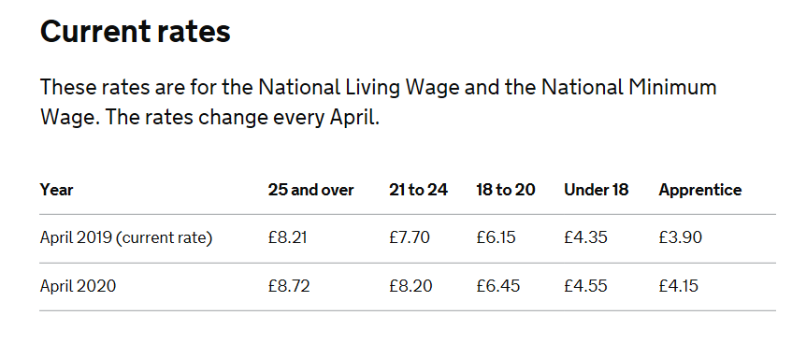
Wages/Salary

Slide 44
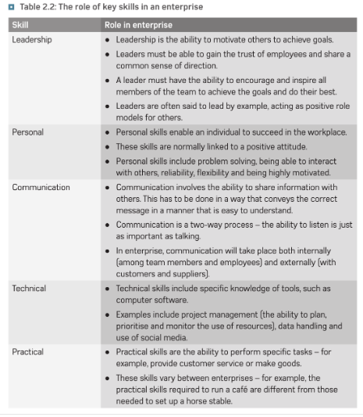

Slide 45
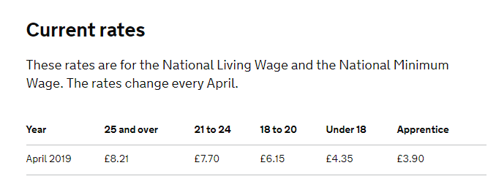
Employee’s
My restaurant will be quite small therefore I will need a head chef, 3 cooks and two waiters. Both Chefs and cooks will need to be qualified in catering and hospitality and GCSE in English and Maths. Chefs and cooks need catering and hospitality to be able cook products that I will serve to people, they also need GSCE’s English and maths to be able to communicate with other team members and be able to measure out the ingredients needed for the recipe. My waiter will need to have GCSE’s in English and maths to be able to communicate with people.
The qualities that my staff will need is to be friendly and hardworking. One of my cooks will be an apprentice. That means they will be college students and I will have to pay them £3.50 per hour and for their college tuition, because they will have to attend the college for one day a week. I can also get the government funding as long as I pay 10% of the tuition.
My head chef, waiter and one of the cooks will work full time, and other cook will work part time. Head chef will have to be older and more experienced, about 25 years old or over. That means I will have to pay them minimum of £7.50 per hour. My cooks will have to be around 21 years old so they can still get experience but I will be able save some money on their wage for few years, meaning I will have to pay them minimum of £7.05 per hour. My waiter will be around 18 to 20 because I will be able to teach them about the wines and different dishes, yet I will have to pay them minimum of £5.60 which is less than more experienced waiter. Also my staff will be able to get the pay rise when they are working hard enough.

Slide 46
Section Seven
Costs and pricing strategy
7.4 Break even
Break-even Point = fixed cost
selling price- variable cost
Break-even Point =
7.5 Sources of finance

Slide 47
Sources of Financial Support
Bank
Family & Friends
Prince’s Trust
Government Grants
Shareholders

Slide 48
Finance
My money for the business will come partly from my partner as I am in a partnership for my business this means that I wont have to rely on myself and the bank only in order to get the business running. I will obviously need a loan from the bank however I wont need to borrow as much as I will not only have my own investments but the investments of my partner and hopefully my relatives in order to open my shop.
I will be renting my building at first (image and location on slide 8) however if I am doing well in my business after a couple of years I would think about buying the building so that I wont have to keep paying rent forever and so I have a choice about what happens to it which can be very beneficial for me. I will also have to buy any stock I have as I wont be able to create new books (or at least enough to sell in an independent business) and it’s the same with the writing equipment this will come from suppliers.

Slide 49
Sources of Financial Support
One way that I could get financial support for my business is through using a bank loan and making small repayments over a set period of time, many banks such as Santander and Barclays will lend up to £25,000 over a 5 year period to new businesses however other such as Lloyds bank will only loan up to £10,000 however you can have more time to pay it back if you wish, many banks will also offer business advice to start up businesses through a help and support page or by contacting them directly, partially in order to make sure that you don’t waste their money.
Another source of business support is through the Princes Trust which is a scheme funded by Prince Charles in order to help young people (especially in deprived areas) start up new businesses, they give training courses to young people and instruct them on how to run a business independently in addition if your business idea is especially favourable they will lend you up to £7500 to help your business get started while this isn’t as much as what a bank offers you will have much less to pay back relieving young people of the pressure that banks sometimes cause making it a very reliable source of help. Another way they help is because the Princes Trust also gives advice on advertising and webpages giving young people a better chance of running a successful business.
Finally many people choose to rely on family and friends for extra support as family members are less likely to charge you lots of money for a loan and are more likely to help you in more ways than one for example some family members or friends may work part-time for your business this not only saves you the hassle of recruiting new people it may also save you money as family members may not demand as much money as payment (if at all) in order to help keep your business afloat especially in hard times (usually the first 12 months and slower parts of the year like January) this will overall help your business

Slide 50
Section Eight
Financial forecast
8.1 Cash flow
 | April | May | June | July
Inflows
Outflows
Net Cash Flow
Opening Balance
Closing Balance

Slide 51
Section Nine
Risk assessment, and contingency plans
9.1 Risk Assessment
Time to create/buy stock
Unexpected costs
Financial resources
Quality
Competition
Lack of customer interest
Resources

Slide 52
Section Ten
Conclusion
10.1 Timescale
Initial Plan
Start of Trading
10.2 Evaluate how successful your business will be & Why

Slide 53
Research ideas
Aims
Product service
Communication
& Promotion
Resources
Sources of Support
Assess risk
Funding & Advice
Find Premises
Resources
Staff
Promotion/Marketing
Begin Trading
Planning of ideas- 3 months
Find resources 4 months
OPEN
I believe that a realistic timescale to set up this business would be………………
because…………..

Slide 54
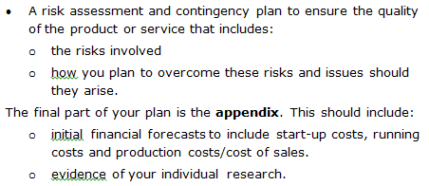

Slide 55
Risk Involved | Degree | How I would over come the risk
Lack of entrepreneurial skill
Competitor actions
Unexpected costs
Sourcing materials
Quality control issues
Lack of customer interest
Political change
Changes in the economy
Social changes
Changes to technology

Slide 56
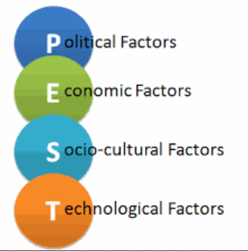
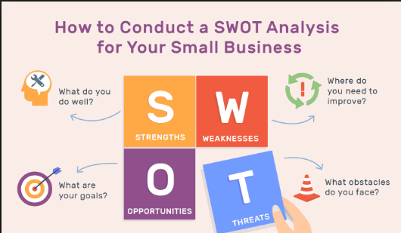
Conclusion Overall, I believe my enterprise idea will be successful because………

Slide 57
Bibliography
Questionnaires/Research/Websites/Books/Journals etc

