Slide 1
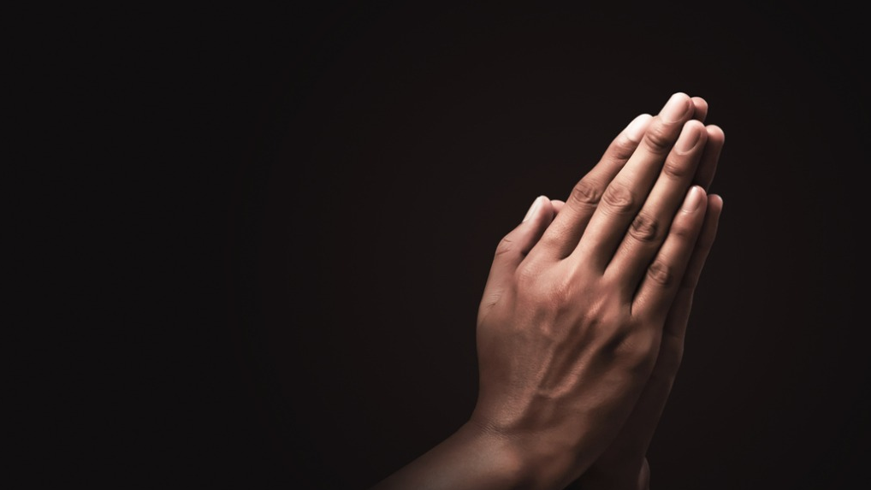
Prayers for the week 6th – 10th July

Slide 2
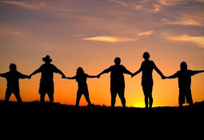
Monday 6th July Dear Lord, As we enter the penultimate week of this very unusual school year give us the strength and determination to keep going until the end. Watch over our friends and families and give us the resolve to make sure that we always conduct ourselves in a way which will keep our community safe. St Joseph – Pray for us

Slide 3
Tuesday 7th July
Dear Lord
As we enter a new normal coming out of lockdown, give us the strength to think about the world we want.
Grant us the courage not to rush back to our old ways, but to rebuild our world together, creating foundations of justice, with equality and peace for all.
St Joseph – Pray for us

Slide 4
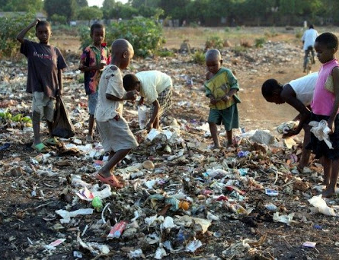
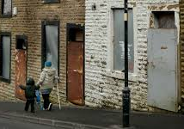
Wednesday 8th July
We pray for people who live in extreme poverty, especially those without access to basics during the Coronavirus pandemic. May God grant us all the capacity and courage to build a better, more just and equal world where no child goes hungry, and we all have the opportunity to flourish
St Joseph – Pray for us

Slide 5
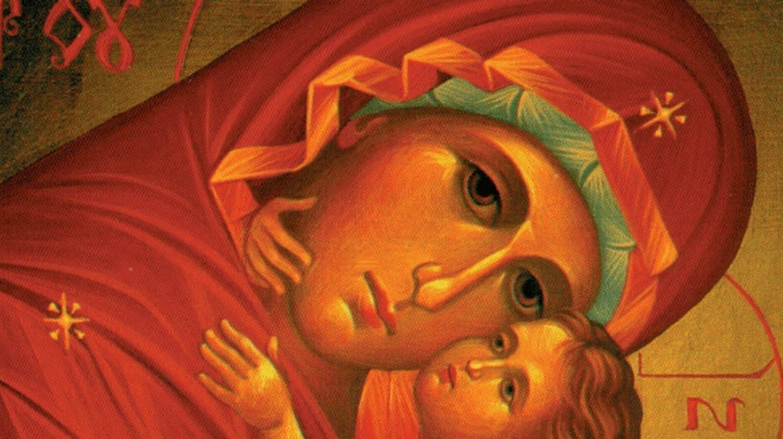
Thursday 9th July We turn to Our Lady and take and ask her to take our petitions to God; Hail Mary full of Grace, the Lord is with thee. Blessed are thou amongst women and blessed is the fruit of thy womb Jesus. Holy Mary Mother of God, pray for us sinners now and at the hour of our death Amen.

Slide 6
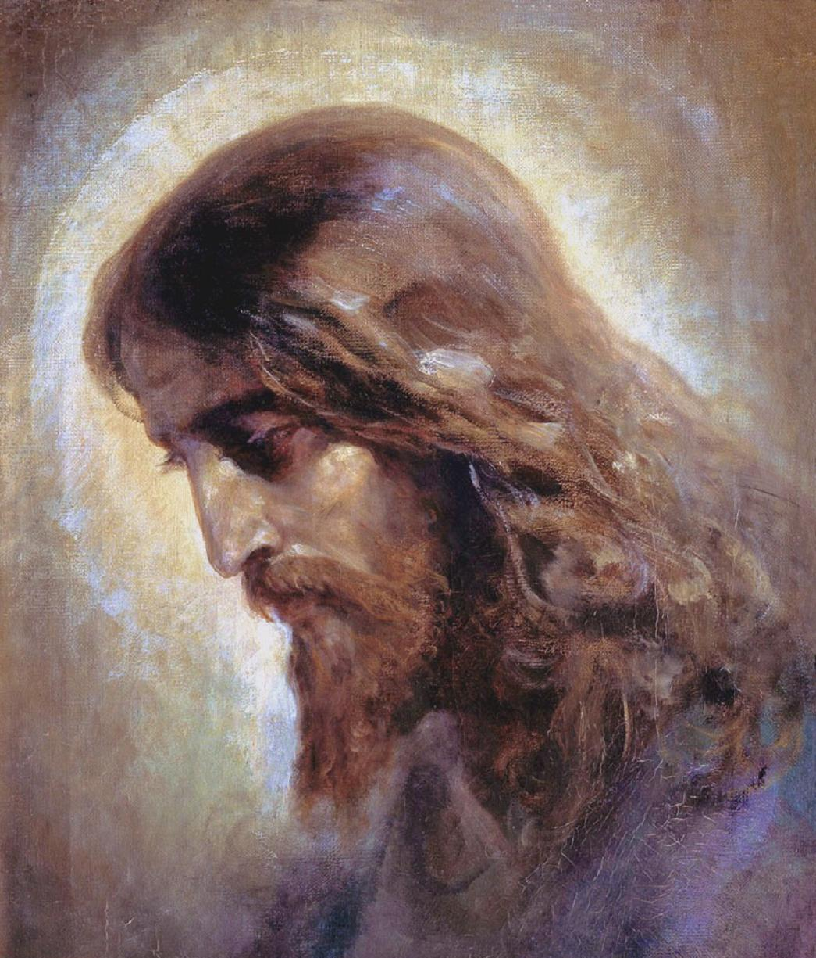
Friday 10th July
Lord Jesus, when you walked with us on earth
you spread your healing power.
We place in your loving care all who are affected by Coronavirus.
Keep us strong in faith, hope and love.
Bring relief to our sick, console our bereaved,
protect those who care for us.
We lift our prayer to you Lord,
and trust in your infinite mercy,
as we wait for the daybreak.
St Joseph – Pray for us

