Slide 1
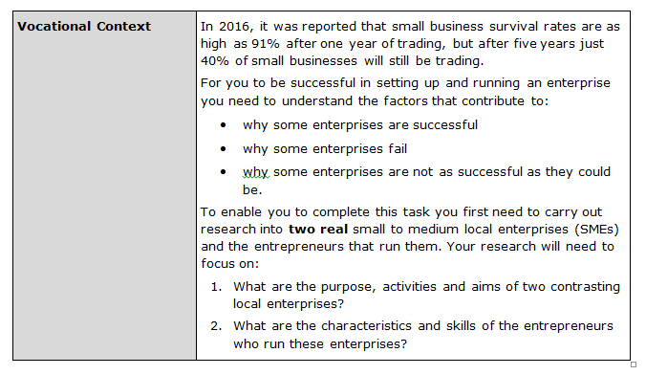
Connect

Slide 2
Title: Assignment 1: Task 3: Section 2
Enterprises: Success or Failure
LO: To evaluate how internal and
external factors affect success or failure
Success criteria:
I can identify internal and external factors
I can explain the importance of internal and external factors
I can evaluate the importance of internal and external factors affecting a selected enterprise
Literacy Foci Term 1b
Reading: Sequencing
Writing: homophones and common spelling mistakes

Slide 3
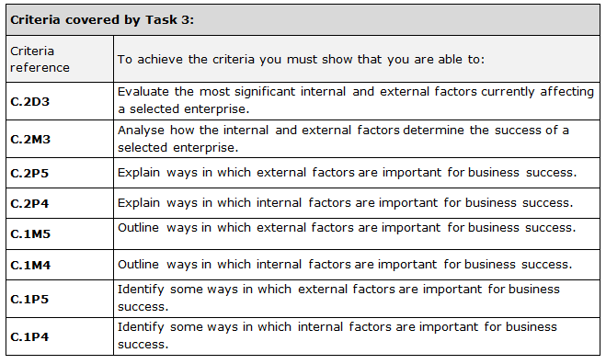

Slide 4
Activate

Slide 5
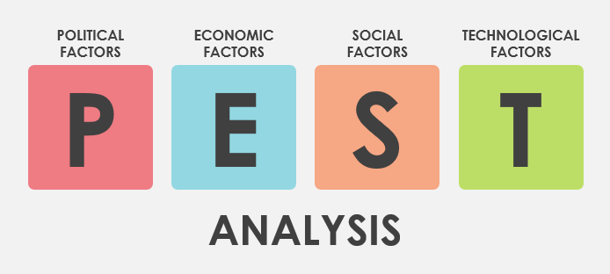

Slide 7
High number of customers brings in revenue Quality of services Reputation/Testimonials Wig making | High prices Lack of services for male customers No tanning
Add services for males Borrow money and expand- open a second salon Become a Partnership/ Private Limited to raise more investment Improve promotions locally – Bolton News/School Proms Social Media/Internet | Local competitors have lower prices (Vida Loca) In times of recession people may cut back on luxury treatments- Brexit means economy is uncertain.

Slide 9
If tax increases If inflation/prices rise Uncertain future if the UK leaves the E.U National Minimum Wage increase in April 2019 | Employment is high in 2019-people are willing to spend If Unemployment increases-people are less willing to spend on extra luxuries Increase in National Minimum Wage If interest rates increase
Changes in fashion trends Environmental Concerns- recycling, disposal of waste, clean energy Welfare concerns- ensure salon products are not tested on animals Number of elderly increasing Improved education and training in Bolton (College) | Internet and mobiles allow good access to website and social media Promotion Apps New hairdryers/straighteners e.g; Dyson/GHD Need for Wi-fi for customers

Slide 10
I will now complete a SWOT analysis for the Original Hair Studio.
The main strengths regarding internal and external influences on the enterprise are……….
Weaknesses include……..
Opportunities presented by internal and external factors include……
Threats to the enterprise could be……..
I will also use a PEST analysis to assess external factors.
Political influences on Original Hair Studio are……..this is positive/negative because……
Economic impacts could include………….this may impact on success because…..
Social considerations include……….which is an opportunity to…
Technology can have positive and negative impacts because….

Slide 11
I will now complete a SWOT analysis for Carr’s Pasties.
The main strengths regarding internal and external influences on the enterprise are……….
Weaknesses include……..
Opportunities presented by internal and external factors include……
Threats to the enterprise could be……..
I will also use a PEST analysis to assess external factors.
Political influences on Carr’s Pasties are……..this is positive/negative because……
Economic impacts could include………….this may impact on success because…..
Social considerations include……….which is an opportunity to…
Technology can have positive and negative impacts because….

Slide 12
Questionnaires

Slide 13
Reasons SME is successful
Survival
Breaking Even
Making a Profit
Meeting customer needs
Increasing market share

Slide 14
Bibliography
www.gov.uk
BTEC Tech Award Student Book by Richards, Coupland Smith and Redfern
www.carrspasties.co.uk
www.originalhairstudio.co.uk
www.theboltonnews.co.uk
www.goodsalonguide.com
www.tripadvisor.co.uk
www.greggs.co.uk
www.thesalonbolton.co.uk

Slide 15
Consolidate

Slide 18
Homework task:
Due in:

Slide 19
Term 1b Reading Focus: Sequencing Time Order Words – that will help me develop my ability to write in sequence
Before | First | Next | Last | Sometimes
Earlier | Firstly | After | Afterwards | At times
Once | At the onset | As soon as | Eventually | Gradually
In the past | Before | Consequently | Finally | Occasionally
Not long ago | Embark | Not long after | In conclusion | Periodically
Preceding | Starting with | Soon after | Ultimately | Rarely
Previously | To begin | Shortly | Until | seldom
Editable

Slide 21
Top ten misused homophones Check your work – and that you have used them in the correct place | Used correctly | Corrected
Too: in addition
There: place
Their: belonging to
It’s: contraction of: it is
Our: group belonging
Know: having knowledge
You’re: contraction of: you are
Where: question of place
Through: passing
Top ten misused homophones Check your work – and that you have used them in the correct place | Used correctly | Corrected
Too: in addition
There: place
Their: belonging to
It’s: contraction of: it is
Our: group belonging
Know: having knowledge
You’re: contraction of: you are
Where: question of place
Through: passing
Top ten misused homophones Check your work – and that you have used them in the correct place | Used correctly | Corrected
Too: in addition
There: place
Their: belonging to
It’s: contraction of: it is
Our: group belonging
Know: having knowledge
You’re: contraction of: you are
Where: question of place
Through: passing

Slide 22
Top twenty one! Term 1b writing focus: Frequently misspelled words Check your work – and that you have used them in the correct place
Separate Sep a rate | Apparently Ap parent ly | Further Fur ther
Definitely Def in it ely | Across Across | Government Gov ern ment
A lot Not alot | Believe Be lie ve | Honest honest
Embarrass Em barr ass | Business Bus in ess | Knowledge Know led ge
Unnecessary Unn e ce ssary | Beginning Be ginn ing | Irresistible Irre sist ible
Disappoint Dis ap point | Calendar Cal en dar | Occasion O cca sion
Achieve Ach ie ve | Familiar Fam il iar | Receive Re ceive
Term 1b Writing focus: Common spelling mistakes.

Slide 24
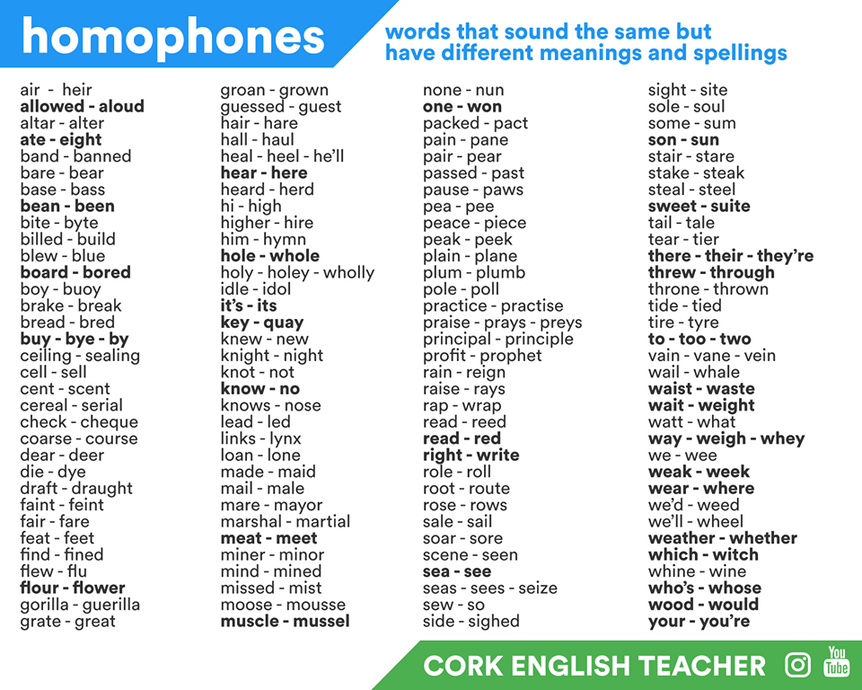
Term 1b Writing focus: Homophones

Slide 25
Lesson evaluation

