Slide 1
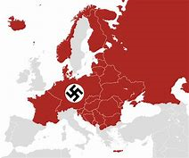
Paper 3
Weimar and Nazi Germany
Exam practice questions
Booklet 2

Slide 3
Know what I want!
DOs | DON’TS
Read the Weimar and Nazi Germany revision book. | Try and learn all the information in one go.
Read the questions carefully and plan using the TCKRS sheet. | Write outside of the time period
Link directly to the question. | Use the revision when writing the questions

Slide 4
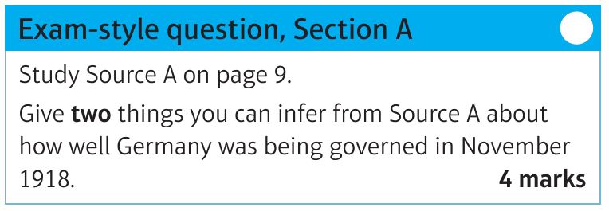
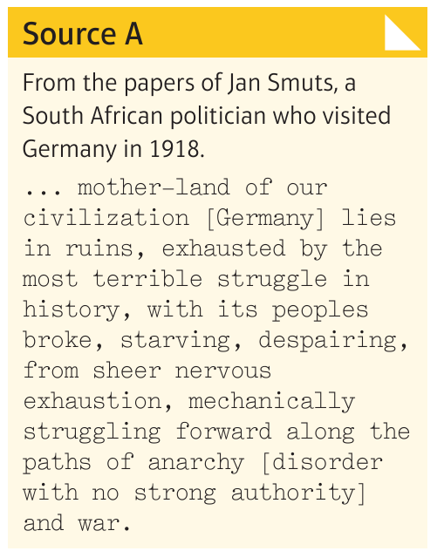
Demonstrate
I can infer from the source:
The details in the source that tell me this:
I can infer from the source:
The details in the source that tell me this:
Carry out a quick TKCRS check
T | Theme
K | Knowledge
C | Command words
R | Restrictions
S | Structure

Slide 5
Demonstrate
Q1. Give two things that you can infer from Source A about how well Germany is being governed in November 1918.
I can infer from the source:
--------------------------------------------------------------------------------------------------------------------------------------------------------------------------------------------------------------------------------------------------
---------------------------------------------------------------------------------------------------------------------------------------------------------------------------------------------------------------------------------------------------------------------------------------------------------------------------------------------------------------------------The details in the source that tell me this:
----------------------------------------------------------------------------------------------------------------------------------------------------------------------------------------------------------------------------------------------------------------------------------------------------------------------------------------------------------------------------------------------------------------------------------------------------------------------------------------------------I can infer from the source:
-----------------------------------------------------------------------------------------------------------------------------------------------------------------------------------------------------------------------------------------------------------------------------------------------------------------------------------------------------------------------------------------------------------------------------------------------------------------------------------------------------------------------------------------------------------------------------------------------------------------------------The details in the source that tell me this:
---------------------------------------------------------------------------------------------------------------------------------------------------------------------------------------------------------------------------------------------------------------------------------------------------------------------------------------------------------------------------

Slide 6
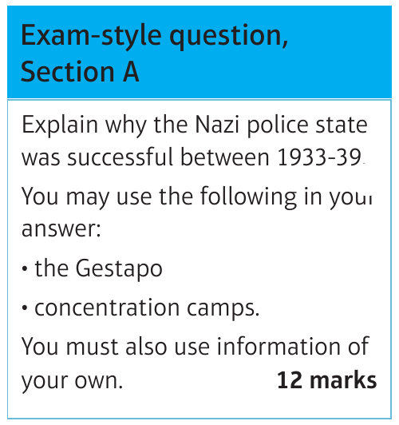
Describe: What | Explain: Failure
2.
3.
Carry out a quick TKCRS check
T | Theme
K | Knowledge
C | Command words
R | Restrictions
S | Structure

Slide 7
Demonstrate
3D
Explain why the Nazi police state was successful between 1933-39
----------------------------------------------------------------------------------------------------------------------------------------------------------------------------------------------------------------------------------------------------
------------------------------------------------------------------------------------------------------------------------------------------------------------------------------------------------------------------------------------------------------------------------------------------------------------------------------------------------------------------------------------------------------------------------------------------------------------------------------------------------------------------------------------------------------------------------------------------------------------------------------------------------------------------------------------------------------------------------------------------------------------------------------------------------------------------------------------------------------------------------------------------------------------------------------------------------------------------------------------------------------------------------------------------------------------------------------------------------------------------------------------------------------------------------------------------------------------------------------------------------------------------------------------------------------------------------------------------------------------------------------------------------------------------------------------------------------------------------------------------------------------------------------------------------------------------------------------------------------------------------------------------------------------------------------------------------------------------------------------------------------------------------------------------------------------------------------------------------------------------------------------------------------------------------------------------------------------------------------------------------------------------------------------------------------------------------------------------------------------------------------------------------------------------------------------------------------------------------------------------------------------------

Slide 8
-------------------------------------------------------------------------------------------------------------------------------------------------------------------------------------------------------------------------------------------------------------------------------------------------------------------------------------------------------------------------------------------------------------------------------------------------------------------------------------------------------------------------------------------------------------------------------------------------------------------------------------------------------------------------------------------------------------------------------------------------------------------------------------------------------------------------------------------------------------------------------------------------------------------------------------------------------------------------------------------------------------------------------------------------------------------------------------------------------------------------------------------------------------------------------------------------------------------------------------------------------------------------------------------------------------------------------------------------------------------------------------------------------------------------------------------------------------------------------------------------------------------------------------------------------------------------------------------------------------------------------------------------------------------------------------------------------------------------------------------------------------------------------------------------------------------------------------------------------------------------------------------------------------------------------------------------------------------------------------------------------------------------------------------------------------------------------------------------------------------------------------------------------------------------------------------------------------------------------------------------------------------------------------------------------------------------------------------------------------------------------------------------------------------------------------------------------------------------------------------------------------------------------------------------------------------------------------------------------------------------------------------------------------------------------------------------------------------------------------------------------------------------------------------------------------------------------------------------------------------------------------------------------------------------------------------------------------------------------------------
---------------------------------------------------------------------------------------------------------------------------------------------------------------------------------------------------------------------------------------------------------

Slide 9
-------------------------------------------------------------------------------------------------------------------------------------------------------------------------------------------------------------------------------------------------------------------------------------------------------------------------------------------------------------------------------------------------------------------------------------------------------------------------------------------------------------------------------------------------------------------------------------------------------------------------------------------------------------------------------------------------------------------------------------------------------------------------------------------------------------------------------------------------------------------------------------------------------------------------------------------------------------------------------------------------------------------------------------------------------------------------------------------------------------------------------------------------------------------------------------------------------------------------------------------------------------------------------------------------------------------------------------------------------------------------------------------------------------------------------------------------------------------------------------------------------------------------------------------------------------------------------------------------------------------------------------------------------------------------------------------------------------------------------------------------------------------------------------------------------------------------------------------------------------------------------------------------------------------------------------------------------------------------------------------------------------------------------------------------------------------------------------------------------------------------------------------------------------------------------------------------------------------------------------------------------------------------------------------------------------------------------------------------------------------------------------------------------------------------------------------------------------------------------------------------------------------------------------------------------------------------------------------------------------------------------------------------------------------------------------------------------------------------------------------------------------------------------------------------------------------------------------------------------------------------------------------------------------------------------------------------------------------------------------------
---------------------------------------------------------------------------------------------------------------------------------------------------------------------------------------------------------------------------------------------------------

Slide 10
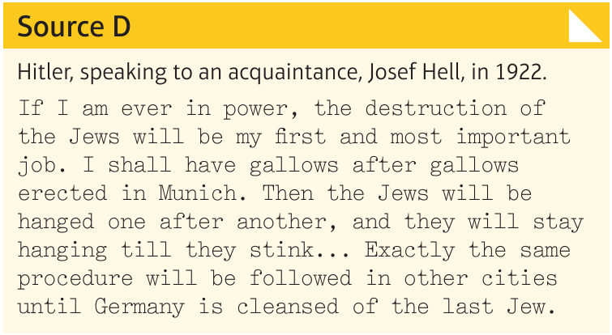
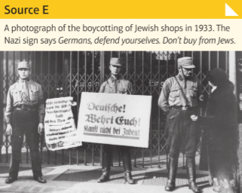
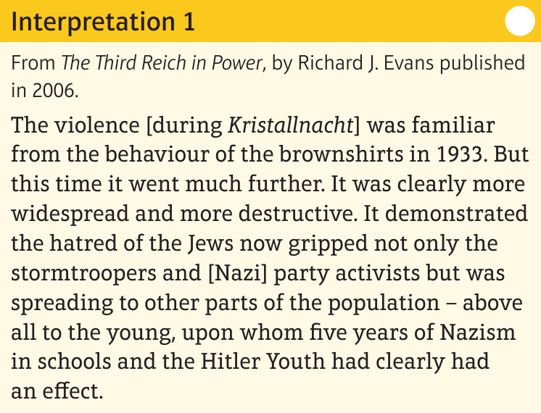
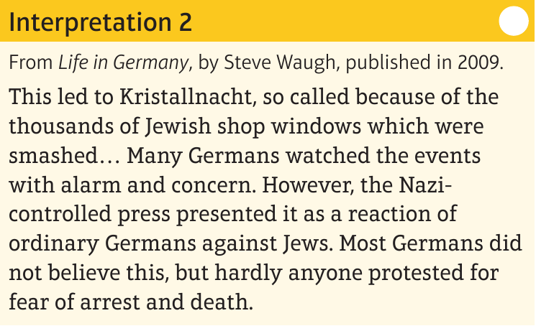
Annotate all of
the sources and
interpretations
Use these to
respond to your
questions

Slide 11
Demonstrate
Source D is useful for an enquiry into the persecution of the Jews because (Content of the source supported with own knowledge)
Source D is useful for an enquiry into the persecution of the Jews because because (Content of the source supported with own knowledge)
Source E is useful for an enquiry into the persecution of the Jews because (Content of the source supported with own knowledge)
Source C is usefulf or an enquiry into the persecution of the Jews because (Provenance of the source supported with own knowledge)
Q3a. How useful are sources D and E for an enquiry into the persecution of the Jews?
Explain your answer, using Sources D and E and your knowledge of the historical context.
8 Marks
Carry out a quick TKCRS check
T | Theme
K | Knowledge
C | Command words
R | Restrictions
S | Structure

Slide 12
Demonstrate
Q3a. How useful are sources D and E for an enquiry into the persecution of the Jews?
Explain your answer, using Sources D and E and your knowledge of the historical context.
8 Marks
--------------------------------------------------------------------------------------------------------------------------------------------------------------------------------------------------------------------------------------------------
------------------------------------------------------------------------------------------------------------------------------------------------------------------------------------------------------------------------------------------------------------------------------------------------------------------------------------------------------------------------------------------------------------------------------------------------------------------------------------------------------------------------------------------------------------------------------------------------------------------------------------------------------------------------------------------------------------------------------------------------------------------------------------------------------------------------------------------------------------------------------------------------------------------------------------------------------------------------------------------------------------------------------------------------------------------------------------------------------------------------------------------------------------------------------------------------------------------------------------------------------------------------------------------------------------------------------------------------------------------------------------------------------------------------------------------------------------------------------------------------------------------------------------------------------------------------------------------------------------------------------------------------------------------------------------------------------------------------------------------------------------------------------------------------------------------------------------------------------------------------------------------------------------------------------------------------------------------------------------------------------------------------------------------------------------------------------------------------------------------------------------------------------------------------------------------------------------------------------------------------------------------

Slide 13
-------------------------------------------------------------------------------------------------------------------------------------------------------------------------------------------------------------------------------------------------------------------------------------------------------------------------------------------------------------------------------------------------------------------------------------------------------------------------------------------------------------------------------------------------------------------------------------------------------------------------------------------------------------------------------------------------------------------------------------------------------------------------------------------------------------------------------------------------------------------------------------------------------------------------------------------------------------------------------------------------------------------------------------------------------------------------------------------------------------------------------------------------------------------------------------------------------------------------------------------------------------------------------------------------------------------------------------------------------------------------------------------------------------------------------------------------------------------------------------------------------------------------------------------------------------------------------------------------------------------------------------------------------------------------------------------------------------------------------------------------------------------------------------------------------------------------------------------------------------------------------------------------------------------------------------------------------------------------------------------------------------------------------------------------------------------------------------------------------------------------------------------------------------------------------------------------------------------------------------------------------------------------------------------------------------------------------------------------------------------------------------------------------------------------------------------------------------------------------------------------------------------------------------------------------------------------------------------------------------------------------------------------------------------------------------------------------------------------------------------------------------------------------------------------------------------------------------------------------------------------------------------------------------------------------------------------------------------------------------------
---------------------------------------------------------------------------------------------------------------------------------------------------------------------------------------------------------------------------------------------------------

Slide 14
Demonstrate
Interpretation 1 suggests ….about the appeal of the Nazi party
However interpretation 2 suggests ……the appeal of the Nazi party
The main difference between the two interpretations is ….
3B
Study interpretations 1 and 2. They give different views about public reaction to Kristallnacht.
What is the main difference between these views? (4 marks)
Carry out a quick TKCRS check
T | Theme
K | Knowledge
C | Command words
R | Restrictions
S | Structure

Slide 15
Demonstrate
3B
Study interpretations 1 and 2. They give different views about public reaction to Kristallnacht.
What is the main difference between these views? (4 marks)
------------------------------------------------------------------------------------------------------------------------------------------------------------------------------------------------------------------------------------------------------------------------------------------------------------------------------------------------------------------------------------------------------------------------------------------------------------------------------------------------------------------------------------------------------------------------------------------------------------------------------------------------------------------------------------------------------------------------------------------------------------------------------------------------------------------------------------------------------------------------------------------------------------------------------------------------------------------------------------------------------------------------------------------------------------------------------------------------------------------------------------------------------------------------------------------------------------------------------------------------------------------------------------------------------------------------------------------------------------------------------------------------------------------------------------------------------------------------------------------------------------------------------------------------------------------------------------------------------------------------------------------------------------------------------------------------------------------------------------------------------------------------------------------------------------------------------------------------------------------------------------------------------------------------------------------------------------------------------------------------------------------------------------------------------------------------------------------------------------------------------------------------------------------------------------------------------------------------------------------------------------------

Slide 16
Demonstrate
Interpretation 1 is different to interpretation 2 because … Interpretation 1 suggests …
Source … supports this because …
Interpretation 2 highlights ….
Source … supports this because ….
3C
Suggest one reason why interpretations 1 and 2 give different views about the public reaction to Kristallnacht.
You may use sources D and E to help you to explain your answer.
* Historians have given weight
to different sources
Carry out a quick TKCRS check
T | Theme
K | Knowledge
C | Command words
R | Restrictions
S | Structure

Slide 17
Demonstrate
3C
Suggest one reason why interpretations 1 and 2 give different views about the public reaction to Kristallnacht.
You may use sources D and E to help you to explain your answer.
4 marks
------------------------------------------------------------------------------------------------------------------------------------------------------------------------------------------------------------------------------------------------------------------------------------------------------------------------------------------------------------------------------------------------------------------------------------------------------------------------------------------------------------------------------------------------------------------------------------------------------------------------------------------------------------------------------------------------------------------------------------------------------------------------------------------------------------------------------------------------------------------------------------------------------------------------------------------------------------------------------------------------------------------------------------------------------------------------------------------------------------------------------------------------------------------------------------------------------------------------------------------------------------------------------------------------------------------------------------------------------------------------------------------------------------------------------------------------------------------------------------------------------------------------------------------------------------------------------------------------------------------------------------------------------------------------------------------------------------------------------------------------------------------------------------------------------------------------------------------------------------------------------------------------------------------------------------------------------------------------------------------------------------------------------------------------------------------------------------------------------------------------------------------------------------------------------------------------------------------------------------------------------------------

Slide 18
Demonstrate
I strongly agree/ disagree with interpretation 1.. because
Another reason why you agree / disagree
However Interpretation 2 highlights ….
Overall conclusion which interpretation do you agree with and why?
3D
How far do you agree with interpretation 1
about the events of Kristallnacht in 1938?
Explain your answer, using both interpretations and your knowledge of the historical context.
16 marks
4spag
Carry out a quick TKCRS check
T | Theme
K | Knowledge
C | Command words
R | Restrictions
S | Structure

Slide 19
Demonstrate
3D
How far do you agree with interpretation 1 about the events of Kristallnacht in 1938?
Explain your answer, using both interpretations and your knowledge of the historical context.
----------------------------------------------------------------------------------------------------------------------------------------------------------------------------------------------------------------------------------------------------------------------------------------------------------------------------------------------------------------------------------------------------------------------------------------------------------------------------------------------------------------------------------------------------------------------------------------------------------------------------------------------------------------------------------------------------------------------------------------------------------------------------------------------------------------------------------------------------------------------------------------------------------------------------------------------------------------------------------------------------------------------------------------------------------------------------------------------------------------------------------------------------------------------------------------------------------------------------------------------------------------------------------------------------------------------------------------------------------------------------------------------------------------------------------------------------------------------------------------------------------------------------------------------------------------------------------------------------------------------------------------------------------------------------------------------------------------------------------------------------------------------------------------------------------------------------------------------------------------------------------------------------------------------------------------------------------------------------------------------------------------------------------------------------------------------------------------------------------------------------------------------------------------------------------------------------------------------------------------------------

Slide 20
-------------------------------------------------------------------------------------------------------------------------------------------------------------------------------------------------------------------------------------------------------------------------------------------------------------------------------------------------------------------------------------------------------------------------------------------------------------------------------------------------------------------------------------------------------------------------------------------------------------------------------------------------------------------------------------------------------------------------------------------------------------------------------------------------------------------------------------------------------------------------------------------------------------------------------------------------------------------------------------------------------------------------------------------------------------------------------------------------------------------------------------------------------------------------------------------------------------------------------------------------------------------------------------------------------------------------------------------------------------------------------------------------------------------------------------------------------------------------------------------------------------------------------------------------------------------------------------------------------------------------------------------------------------------------------------------------------------------------------------------------------------------------------------------------------------------------------------------------------------------------------------------------------------------------------------------------------------------------------------------------------------------------------------------------------------------------------------------------------------------------------------------------------------------------------------------------------------------------------------------------------------------------------------------------------------------------------------------------------------------------------------------------------------------------------------------------------------------------------------------------------------------------------------------------------------------------------------------------------------------------------------------------------------------------------------------------------------------------------------------------------------------------------------------------------------------------------------------------------------------------------------------------------------------------------------------------------------------------------------------
---------------------------------------------------------------------------------------------------------------------------------------------------------------------------------------------------------------------------------------------------------

Slide 21
-------------------------------------------------------------------------------------------------------------------------------------------------------------------------------------------------------------------------------------------------------------------------------------------------------------------------------------------------------------------------------------------------------------------------------------------------------------------------------------------------------------------------------------------------------------------------------------------------------------------------------------------------------------------------------------------------------------------------------------------------------------------------------------------------------------------------------------------------------------------------------------------------------------------------------------------------------------------------------------------------------------------------------------------------------------------------------------------------------------------------------------------------------------------------------------------------------------------------------------------------------------------------------------------------------------------------------------------------------------------------------------------------------------------------------------------------------------------------------------------------------------------------------------------------------------------------------------------------------------------------------------------------------------------------------------------------------------------------------------------------------------------------------------------------------------------------------------------------------------------------------------------------------------------------------------------------------------------------------------------------------------------------------------------------------------------------------------------------------------------------------------------------------------------------------------------------------------------------------------------------------------------------------------------------------------------------------------------------------------------------------------------------------------------------------------------------------------------------------------------------------------------------------------------------------------------------------------------------------------------------------------------------------------------------------------------------------------------------------------------------------------------------------------------------------------------------------------------------------------------------------------------------------------------------------------------------------------------------------------------
---------------------------------------------------------------------------------------------------------------------------------------------------------------------------------------------------------------------------------------------------------

Slide 22
-------------------------------------------------------------------------------------------------------------------------------------------------------------------------------------------------------------------------------------------------------------------------------------------------------------------------------------------------------------------------------------------------------------------------------------------------------------------------------------------------------------------------------------------------------------------------------------------------------------------------------------------------------------------------------------------------------------------------------------------------------------------------------------------------------------------------------------------------------------------------------------------------------------------------------------------------------------------------------------------------------------------------------------------------------------------------------------------------------------------------------------------------------------------------------------------------------------------------------------------------------------------------------------------------------------------------------------------------------------------------------------------------------------------------------------------------------------------------------------------------------------------------------------------------------------------------------------------------------------------------------------------------------------------------------------------------------------------------------------------------------------------------------------------------------------------------------------------------------------------------------------------------------------------------------------------------------------------------------------------------------------------------------------------------------------------------------------------------------------------------------------------------------------------------------------------------------------------------------------------------------------------------------------------------------------------------------------------------------------------------------------------------------------------------------------------------------------------------------------------------------------------------------------------------------------------------------------------------------------------------------------------------------------------------------------------------------------------------------------------------------------------------------------------------------------------------------------------------------------------------------------------------------------------------------------------------------------------------------------------
---------------------------------------------------------------------------------------------------------------------------------------------------------------------------------------------------------------------------------------------------------

