Slide 1
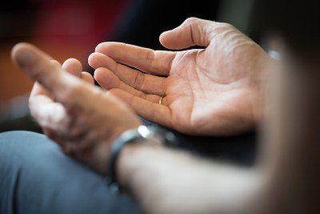
PRAYERS FOR THE WEEK 1ST – 5TH JUNE

Slide 2
Monday 1ST June
Dear Lord
We are now in the Church calendar of ordinary time, although the time we find ourselves in is anything but ordinary.
We ask for your love and protection throughout this final half term and ask for resilience to give us the strength to continue our studies, either at home or in school.
Amen
St Joseph – Pray for us

Slide 3
TUESDAY 2ND JUNE
We pray for our global family: that through God's grace, and inspired by the message of Saint Oscar Romero, we and all our brothers and sisters may live life to the full and show love and compassion in this time and always.
St Joseph – Pray for us

Slide 4
WEDNESDAY 3RD JUNE
Dear Lord
We pray for the Church and for the world: that God may grant us the gifts of courage, compassion and wisdom as we face challenging circumstances together. Never let us forget the words of Christ " Love they neighbour"
St Joseph – Pray for us

Slide 5
THURSDAY 4TH JUNE
Let us take this time to offer our petitions to Mary who intercedes for us to the Lord;
Hail, holy Queen, Mother of mercy, hail, our life, our sweetness and our hope.
To thee do we cry, poor banished children of Eve: to thee do we send up our sighs, mourning and weeping in this vale of tears.
Turn then, most gracious Advocate, thine eyes of mercy toward us, and after this our exile,
Show unto us the blessed fruit of thy womb, Jesus, O merciful, O loving, O sweet Virgin Mary!
Amen

Slide 6
Friday 5th JUNE
Dear Lord
As we complete the first week of the final term, we give thanks for giving strength during the week. We ask that you keep us safe over the weekend and despite the temptations there may be, let our conduct be in a way which supports not hinders the current situation the world is in.
We ask you to watch over our families until we begin another week of work.
St Joseph – Pray for us

